Slide 1
Medical Gas Administration

Slide 2
Oxygen Therapy
Medical gases are drugs
RTs assess need for therapy, recommend and administer dosage, determine goals of therapy, monitor response, alter therapy accordingly, and record their data in the pt record (chart)

Slide 3
Oxygen Therapy
General Goals/Objectives
  Correcting hypoxemia
    By raising alveolar and blood levels of oxygen
    Easiest objective to attain and measure
  Decreasing symptoms of hypoxemia
    Supplemental O₂ can help relieve symptoms of hypoxia
      Less dyspnea/WOB
      Improve mental funx

Slide 4
Oxygen Therapy
Goals/Objectives – cont.
  Minimizing CP workload
    CP system will compensate for hypoxemia by –
      Increasing ventilation to get more O₂ in the lungs and to the blood
        Increased WOB
      Increasing cardiac output to get more oxygenated blood to tissues
        Hard on the heart, especially if diseased
    Hypoxia causes Pulmonary vasoconstrix and Pulmonary HyperTxn
      These cause an increased workload on the right side of the heart
        Over time, the right heart will become more muscular and then eventually fail (Cor Pulmonale)
Supplemental O₂ can relieve hypoxemia and relieve pulmonary vasoconstrix and HyperTxn by reducing right ventricular workload

Slide 5
Oxygen Therapy
O₂ % delivered
FiO₂

Slide 6
Oxygen Therapy
Assessing the need for oxygen therapy
  3 basic ways
    Laboratory measures – Invasive or noninvasive
    Clinical problem or condition
    Symptoms of hypoxemia

Slide 7
Oxygen Therapy
Assessing the need for oxygen therapy
    Laboratory measures – Invasive or noninvasive
      PO₂ – Partial pressure of oxygen
        PAO₂ – Partial pressure of oxygen in alveoli
        PaO₂ – Partial pressure of oxygen in arterial blood
      Hgb Saturation
        SaO₂ – Arterial Saturation of Oxyhemaglobin
        SpO₂ – Pulse Oximetry of Oxyhemaglobin Saturation

Slide 8
Oxygen Therapy
Assessing the need for oxygen therapy
    Clinical problem or condition
      Specific clinical problems or conditions where hypoxemia is common
        Post-op
        COPD
        PE
        Etc.

Slide 9
Oxygen Therapy
Assessing the need for oxygen therapy
    Symptoms of hypoxemia
  Respiratory, Cardiovascular, and Neurological
    Tachycardia, Tachypnea, hypertxn, cyanosis, dyspnea, disorientation, clubbing, etc.

Slide 10
Oxygen Therapy –
Assessing the Need for
  RT will combine objective and subjective measures to confirm inadequate oxygenation
    Often will recommend administration based solely on subjective measures

Slide 11
Oxygen Therapy –
Design & Performance
Requires expert in-depth knowledge
  What is the FiO₂ range?
  Low = <35%
  Mod = 35 - 60%
  High = >60%
Does the FiO₂ remain fixed or variable when pt demand changes?
  Fixed
    FiO₂ does not vary
  Variable
    FiO₂ varies when pt changes
  Dependent on provided flow and Pt demand

Slide 12
Oxygen Therapy
Design & Performance
  Low-flow
    Flow does not meet inspiratory demand
    O₂ is diluted with air upon inspiration
    Nasal cannula
    Nasal catheter
    Tracheal catheter

Slide 13
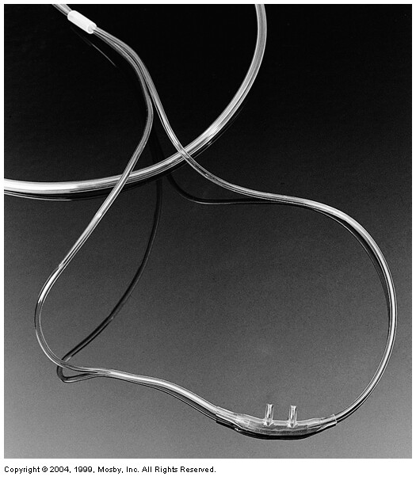
Nasal Cannula

Slide 14
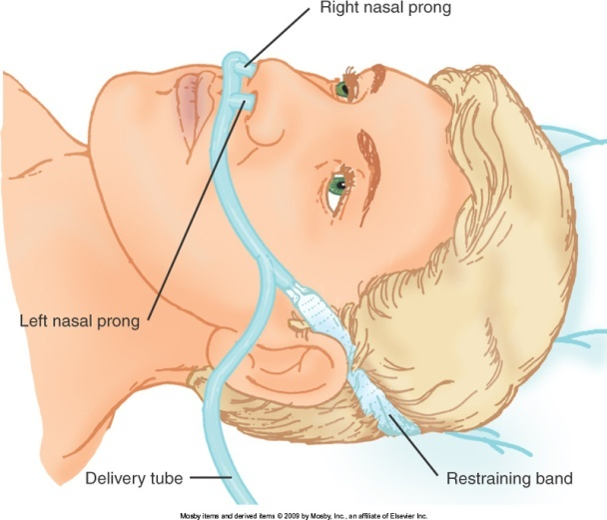
Oxygen Therapy
Low-Flow Devices
    Nasal cannula
      Adult
        0-6 l/m
        >4L requires humidity (?)
        Can cause irritation, dryness, bleeding, etc.
        Rule of thumb for nasal
          With normal rate/depth
          [4 X (L/M)] + 20 = ~FiO₂
            24-44%
      Neo
        0-2 l/m

Slide 15
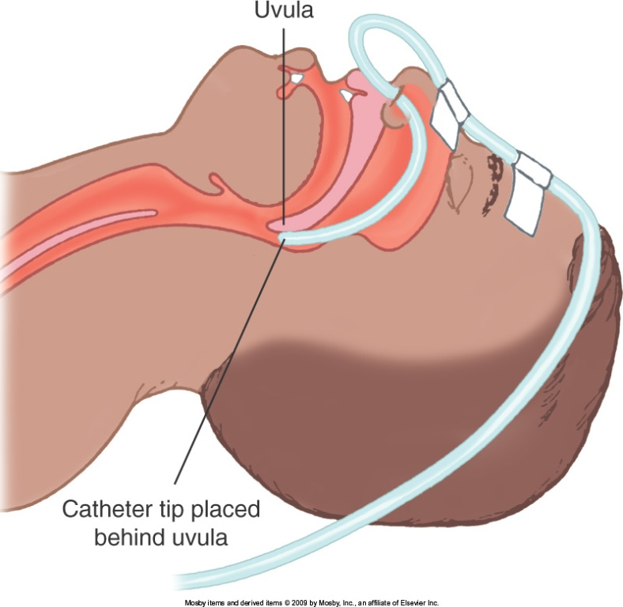
Oxygen Therapy
Low-Flow Devices
    Nasal catheter
      Adult
        Visualize placement or blind to depth = to length of nose to tragus
        Replace Q8hrs
          Affects secretion, irritax, etc.
        Good for short procedures
          bronchoscopy

Slide 16
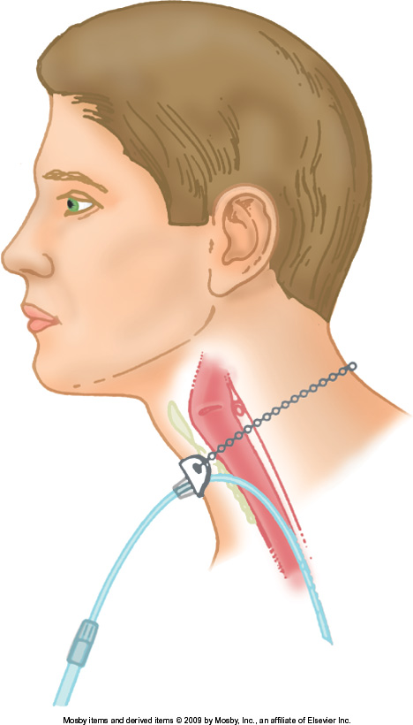
Oxygen Therapy
Low-Flow Devices
    Xtracheal catheter
      Surgically inserted in trachea
      Uses trachea/upper airway as reservoir
        Requires very low flows to meet needs

Slide 17
Oxygen Therapy
Low-Flow Devices
    Performance characteristics of low-flow
      FiO₂ varies with amount of air dilution, pt-dependent
      Must assess response to therapy
      Rule of thumb nasal cannula
        With normal rate/depth
          [4 X (L/M)] + 20 = ~FiO₂

Slide 18
Oxygen Therapy
Low-Flow Devices
    Troubleshooting low-flow
      Obstruction
      Displacement
      Irritation
    Reservoir Systems
      Builds O₂ supply in reservoir b/w breaths
      Reduces air dilution
      Reduces O₂ use, increased utilization
      Provides higher FiO₂ @ lower flows

Slide 19
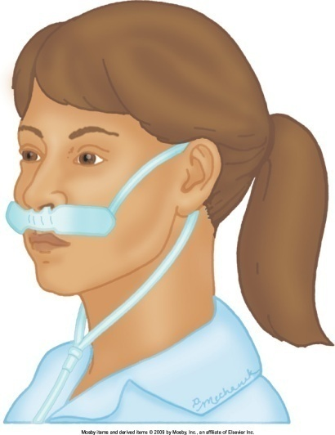
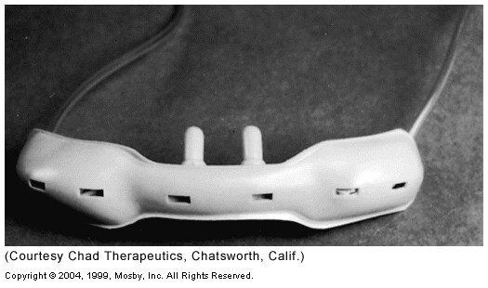
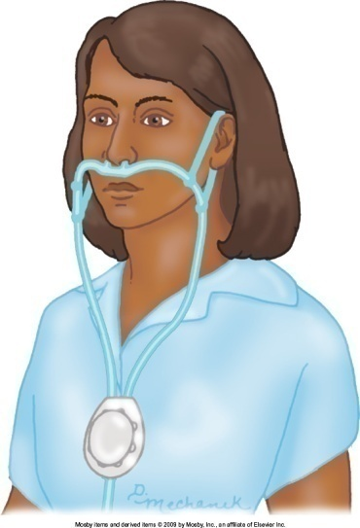
Oxygen Therapy
Low-Flow Devices
  Reservoir cannula
      Frequent replacement
      No humidification
      Requires nasal exhalation
    Nasal
      Stores ~20ml
      Aesthetically displeasing
    Pendant
      Better aesthetically
      Extra weight can irritate ears/face

Slide 20
Oxygen Therapy
Low-Flow Devices
Reservoir masks
  Simple mask
  Non-rebreather
  Partial non-rebreather
  Non-rebreathing reservoir circuit

Slide 21
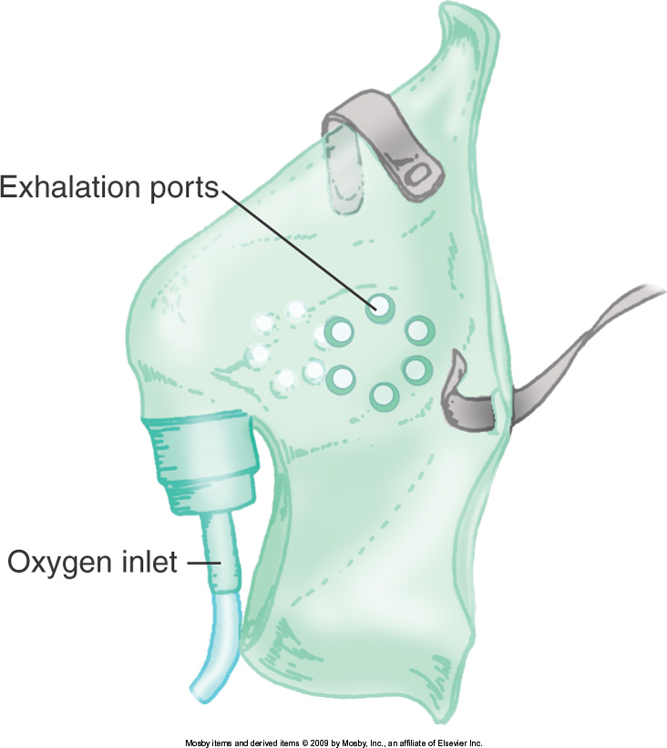
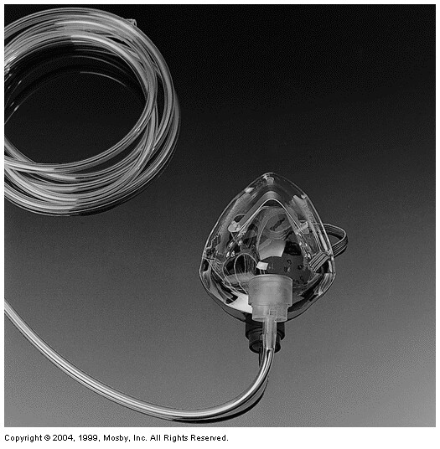
Low-Flow Devices
Reservoir Masks
Simple mask
    Gas gathers in mask
    Exhalax ports
    Air entrained through ports and around mask
    5-10 L/M
      <5 = CO₂ rebreathing
      >10 = use more invasive mask

Slide 22
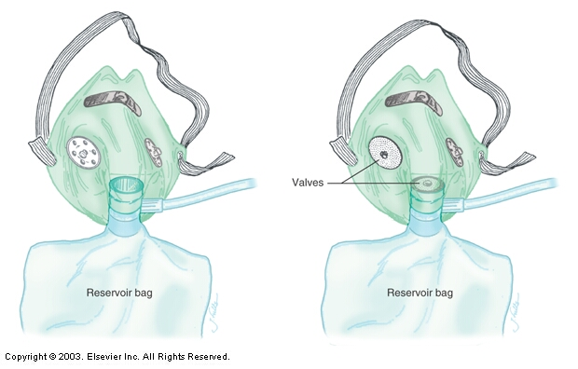
Partial rebreather, Non-rebreather

Slide 23
Low-Flow Devices
Reservoir Masks
Partial rebreather
  Utilizes 1L reservoir bag and mask
  No valves
    1st third (dead space) is breathed into reservoir bag and rebreathed
    Air entrainment from ports and around mask
  Adequate flow as long as reservoir bag does not collapse on inspiration

Slide 24
Low-Flow Devices
Reservoir Masks
Non-rebreather
  Utilizes one-way valves
    b/w reservoir and mask
    on one exhalax port
  Leak-free will provide 100%
    >~70% FiO₂ is rare
      Hard to provide a leak-free system

Slide 25
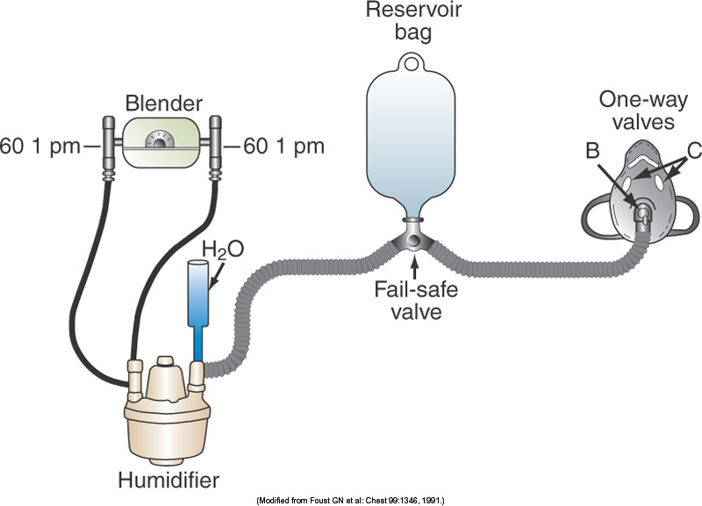
Low-Flow Devices
Reservoir Masks
Non-rebreathing reservoir circuit
  Principle same as mask system
    Reservoir
      Can be a piece of blue tubing or res bag
  Can be used with Tpiece on Trach/ETT
    Utilizes failsafe inlet valve

Slide 26
Low-Flow Devices
Reservoir Masks
    Troubleshooting reservoir systems
      Irritax
      Obstrux
      Dislodgement

Slide 27
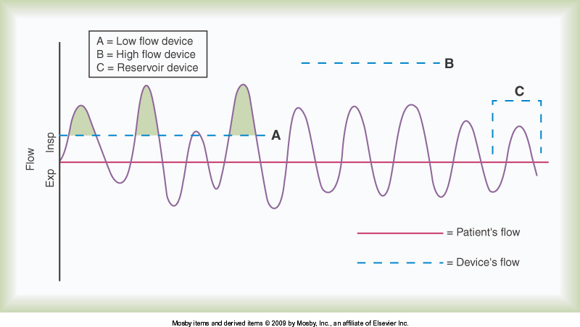
Low- vs. High-Flow vs. Reservoir

Slide 28
Oxygen Therapy
High-Flow Devices
High-flow
  Supplies given FiO₂ @ flows higher than inspiratory demand
    Peak I Flow = 3 X Minute Ventilation
    Minute Vent = f x Vt
    20L/m is upper end of normal Minute Ventilation (60L/M)
  Uses entrainment or blenders

Slide 29
Oxygen Therapy
High-Flow Devices
Principles of gas mixing –
    Find FiO₂ when you know air and O₂ flows
    When given an FiO₂, find air – O₂ ratio and total flow
    Magic box
    O₂ and air flow needed for a given FiO₂ and total flow

Slide 30
Find O₂ %, Air & O₂ Flow Given
What is the O₂ % when mixing 6L of O₂ and 6L of air?
  O₂ % = (Air flow x 20) + (O₂ flow x 100)
        Total Flow
        = (6 x 20) + (6 x 100)
        12
        = (120) + (600)
        12
        = 60%

Slide 31
Given FiO₂, Find Ratio and Total Flow
Order to deliver 40% O₂
  Air = 100 - FiO₂
  O₂ FiO₂ - 20
  = 100 - 40
  40 - 20
  = 60 = 3 = 3 parts air
  20 1 1 part O₂
  If O₂ flowmeter is set at 5L/m, you are entraining 15L/m Air. Total flow = 20L/m

Slide 32
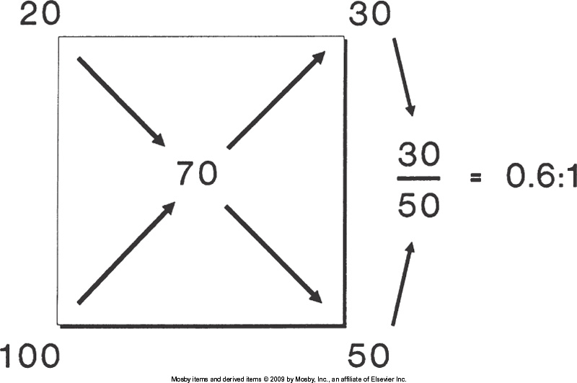
Air 100 – FiO₂ = 30 = 3 = 0.6 parts air to 1 part O₂
O₂ 20 – FiO₂ 50 5 1
If O₂ flowmeter is set at 6L/m
air entrained = 3.6L/m, O₂ flow = 6L/m
total flow = 9.6 L/m

Slide 33
Given FiO₂ and Total Flow, Find Flow to Set your O₂ Flowmeter to
FiO₂ ordered = .35 Total flow = 60L/m
O₂ Flow = (total flow) (FiO₂ - 20)
79
= (60 l/m) (35 - 20)
79
set O₂ flowmeter = 11.4 l/m

Slide 34
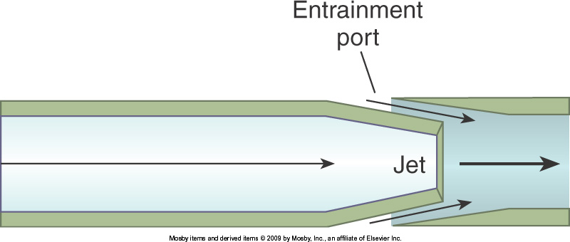
Oxygen Therapy
High-Flow Devices
Air entrainment system
  Amount of air entrained varies directly with port size and velocity
  The more air entrained,
    Higher flow
    Lower FiO₂

Slide 35
Oxygen Therapy
High-Flow Devices – Entrainment
FiO₂ depends on
  Air to O₂ ratio (Amount of air entrained)
  Downstream resistance (Backpressure)
    Increased resistance
      Decreases entrainment
        Decreases total flow
        Increased FiO₂
    % O₂ delivered may increase, but FiO₂ may decrease due to insufficient flow for insp demand

Slide 36
Oxygen Therapy
High-Flow Devices – Entrainment
Input flow changes
  Nominal effect on FiO₂
  Changes total flow
Magic box
  Only for estimax
  For accuracy use E38 - 2

Slide 37
Oxygen Therapy
High-Flow Devices – Entrainment
AE devices
  AEM (Venti-mask)
  AE Nebulizer (Large volume nebulizer)
    Cool/heated aerosol

Slide 38
Oxygen Therapy
High-Flow Devices – Entrainment
  Air entrainment mask
    Adjustable air entrainment ports and jets to precisely control FiO₂ and flow
    The higher the flow, the lower the FiO₂
      (Inverse relaxship) vice versa
    For precise FiO₂’s, total flow must be >Insp demand (Peak Insp flow) (3 X min vent)
    Aerosol collar
      Allows connection of a humidified gas to the entrainment port

Slide 39
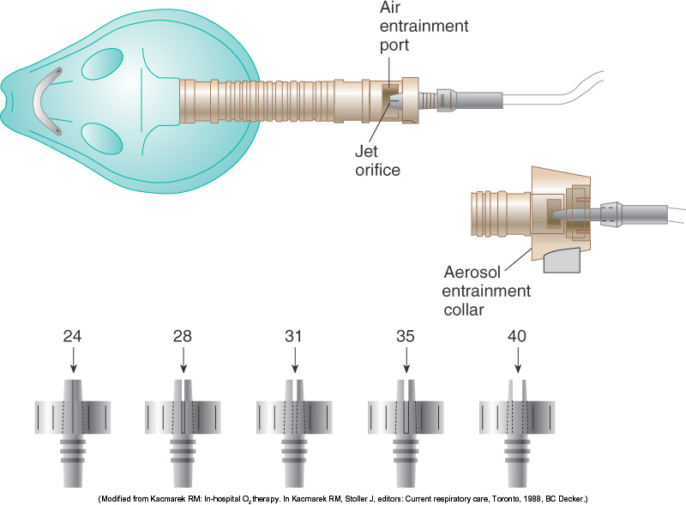
AEM

Slide 40
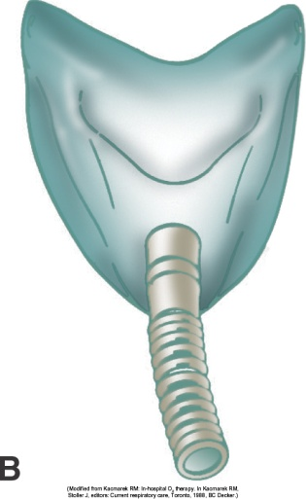
Oxygen Therapy
High-Flow Devices – Entrainment
  Air entrainment nebulizer (Cool/heated aerosol mask)
    Same as mask, except
      There is additional temp and humidity control
        It allows for administrax of particulate water (sterile) to airway
          Great for trachs (Heated)
          Airway edema (Cool)
      It has fixed jets; port is only variable
        Limits O₂ flow to 12-15 l/m
      Provides fixed FiO₂ only when total flow exceeds insp demand
        Face tents provide less-consistent FiO₂

Slide 41
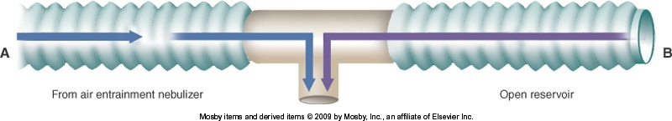
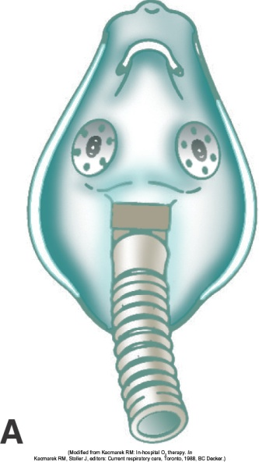
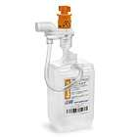
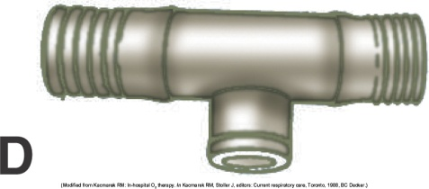
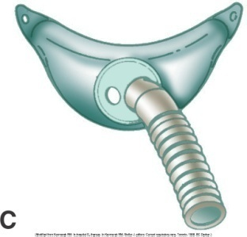
Oxygen Therapy
High-Flow Devices – Entrainment
LVN contd.
  Determining if total flow is sufficient
    Visual inspex
      Aerosol mist is seen exiting tubing on insp and flow is constant
      Pt Vt compared to neb flow

Slide 42
Oxygen Therapy
High-Flow Devices – Entrainment
Troubleshooting air entrainment systems
  Affected by downstream resistance
    Water in tubing
    Obstruction

Slide 43
Oxygen Therapy
High-Flow Devices – Entrainment
  Providing moderate to high FiO₂ @ high flow
    @100% a LVN can only provide 12-15L/M
    To be a true high-flow device, it must ensure constant FiO₂ by providing full insp demand

Slide 44
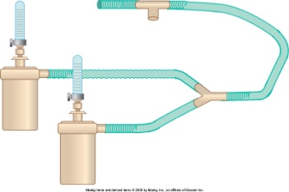

Oxygen Therapy
High-Flow Devices – Entrainment
  Providing moderate to high FiO₂ @ high flow
  Methods
    Add reservoir tubing if intubated or trached
    Closed reservoir
      3-5L anesthesia bag w/ emerg inlet valve
    Shotgun
      Dual LVNs
      Most common
    Lower entrainment
      Decrease FiO₂, increase flow
      Add supplemental O₂ to mask

Slide 45
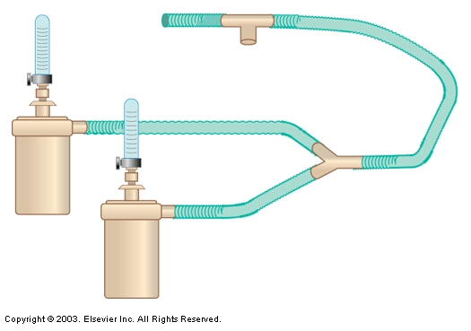
Dual Nebulization System

Slide 46
Oxygen Therapy
High-Flow Devices – Entrainment
Problems w/ downstream flow resistance
  Downstream pressure from the entrainment port
    Increases back P
    Decreases entrainment
      Increases FiO₂
      Decreases flow
    Results in variably delivered FiO₂
      Not enough flow to meet insp demand

Slide 47
Oxygen Therapy
More Reservoirs
Enclosures
  Tents
  Hoods
  Incubators
Others
  BVM
  Pulse dose cannula
  Concentrators

Slide 48
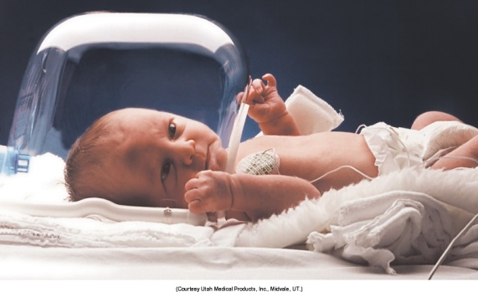
Oxygen Therapy
More Reservoirs – Enclosures
    Hoods
      Best method to deliver controlled O₂ to infants
      Covers only head
        Ideal to allow nursing access
      7 L/m minimum flow
        To flush adequately
      Flows above 10 - 15 L/M are contraindicated
        Generates damaging noises, cold and dry
        Cold stress can increase O₂ consumpx and apnea
      Analyze FiO₂ @ pt head level (layering)
      Must heat and humidify incoming gas
        Do not direct at pt face
        Maintain neutral thermal environment
          Age and weight appropriate

Slide 49
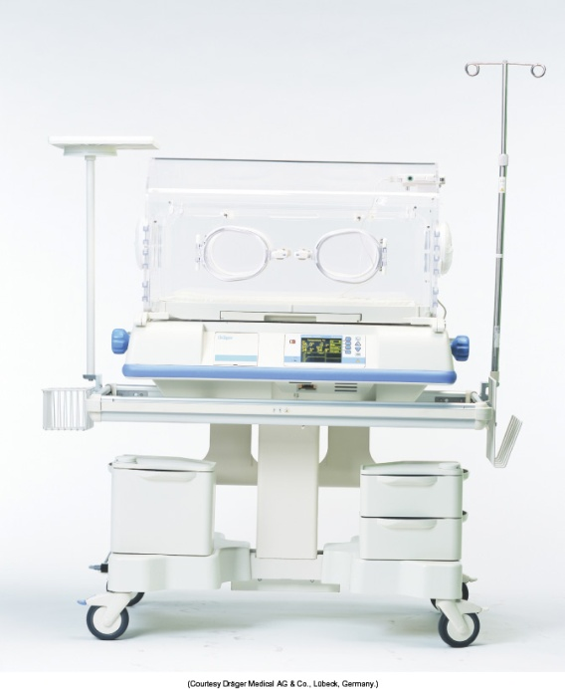
Oxygen Therapy
More Reservoirs – Enclosures
Incubator (Isolette)
  Plexiglas enclosure
  Servo-controlled convex heating with supplemental O₂
  Freq opening and dilution make it hard to deliver high O₂
  Hoods are used in incubators to provide supplemental O₂

Slide 50
Oxygen Therapy
More Reservoirs – Others
Others
  BVM
    Resuscitation bag
  Pulse dose cannulas
  Oxygen concentrators

Slide 51
Oxygen Therapy
High-Flow Devices – Blenders
Blending systems
  Used when entrainment cannot provide high enough FiO₂ @ high flows
  Need frequent analyzing for safety
  Methods
    Manual mixers
    Blenders

Slide 52
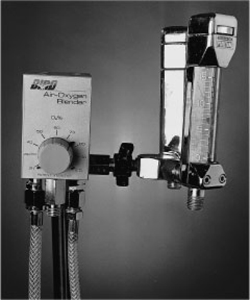
Oxygen Blender

Slide 53
Oxygen Therapy
High-Flow Devices – Blenders
  Blending methods
    Mixing gas manually
      Individual air and O₂ flow meters combined for a desired FiO₂ and flow
    Oxygen blenders F38 - 20
      Air and O₂ inlets
      P regulated
      Precision-blended for FiO₂ and flow
      Alarms for O₂ delivery outside of set range
      Prone to inaccuracy and failure

Slide 54
To Calculate FiO₂ Blending Two Devices
(FiO₂)(V total)+ (FiO₂)(V total) =FiO₂
V total + V total
(.7)(20)+(.5)(20) = FiO₂
20 + 20
14 + 10 =24 = .6
40 40

Slide 55
Oxygen Therapy
Selecting Delivery Approach
Not one best method every time
The RT and their expert knowledge need to be available for –
  Consultation
  Assessment/reassessment
  Alterax of therapy
  Discontinuax of therapy

Slide 56
Oxygen Therapy
Selecting Delivery Approach
  Purpose (Objective)
    Increase FiO₂ to correct hypoxemia
    Minimize symptoms of hypoxemia
    Minimize CP workload
  Patient
    Cause and severity of hypoxemia
    Age
    Neuro status/orientax
    Airway in place/protected
    Regular rate and rhythm (Minute Ventilax)

Slide 57
Oxygen Therapy
Selecting Delivery Approach
Equipment performance
  The more critical, the greater need for high, stable FiO₂
    Becomes more difficult the more critical the situation, due to pt varying pattern

Slide 58
Oxygen Therapy
Selecting Delivery Approach
  Pt categories
    Emergency
      Highest FiO₂ possible
      Highest PaO₂ possible
    Critical adult
      >60% O₂
      PaO₂ >60mmHg
      SpO₂ >90%
    Stable adult, acute illness, mild hypoxemia
      Low to mod FiO₂
      Response to therapy, not precise concentraxs

Slide 59
Oxygen Therapy
Selecting Delivery Approach
Pt categories cont.
    Chronic dx adult, acute on chronic illness
      Ensure adequate oxygenax without depressing ventilation
        SpO₂ 85 - 90%
        PaO₂ 50 - 60mmHg
        Use venti mask to control FiO₂ precision
        Assess response to therapy!
        If not maintainable on cannula, use masks
          Pt may remove mask frequently due to
            Discomfort
            Convenience
            Change in mental status
          Encourage cannula use b/w mask use if mask must come off for periods

Slide 60
Oxygen Therapy
Protocol-based O₂ therapy
  Will ensure
    Initial assessment
    Qualifying measure for protocol
    Modifiable tx plan according to need
    Discontinuation of therapy per protocol

Slide 61
Oxygen Therapy
Precautions & Hazards
  O₂ toxicity
    Primarily affects lungs and CNS
    2 determining factors of O₂ tox
      PO₂
      Time of exposure
      I.e. the higher the PO₂ and exposure time, the greater the toxicity
    CNS effects occur with hyperbaric pressures
    Pulmonary effects can occur @ clinical PO₂ levels
      Patchy infiltrates on x-ray, prominent in lower lung fields
      Major alveolar injury

Slide 62
Oxygen Therapy
Precautions & Hazards
O₂ toxicity cont.
    Pathophysiology
      High PO₂ damages capillary endothelium
      Followed by interstitial edema and AC membrane thickening
      Type I cells are destroyed (Cells that create new lung tissue, gas xchange cells)
      Type II cells proliferate (trigger inflamax response)

Slide 63
Oxygen Therapy
Precautions & Hazards
O₂ toxicity cont.
    Pathophysiology cont.
      Exudative phase
        Alveolar fluid buildup (from inflamax response) leads to
          Low ventilation/perfusion ratio (shunting)
          Hypoxemia
          Hyaline membranes form @ alveolar level
            Proteinaceous eosinophilic (basic) material
            Composed of cellular debris and condensed plasma proteins
          Pulmonary fibrosis develops
          Pulmonary HyperTxn develops

Slide 64
Oxygen Therapy
Precautions & Hazards
O₂ toxicity cont.
    Cause
      Overproducx of O₂-free radicals
        Byproducts of cellular metabolism
        Toxic in excessive amounts
        Normally, antioxidants and other special enzymes dispose of excess free radicals
        Neutrophils (WBCs) and macrophages flood the infiltrate the tissue and mediate inflammation response, leading to more free radicals

Slide 65
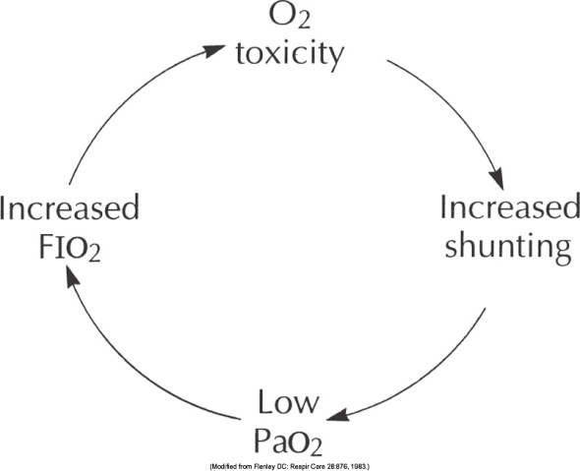
Oxygen Therapy
Precautions & Hazards
O₂ toxicity cont.
    How much is too much?
      >50% for very extended times
      >PO₂ the less time it takes
    Goal
      Use the lowest FiO₂ possible to maintain adequate tissue oxygenation
    Other consideraxs
      Growing lungs are more sensitive to O₂
        Retinopathy of Prematurity (ROP)
        Bronchopulmonary Dysplasia (BPD), chronic lung dz
      Never withhold O₂ from a hypoxic pt
        Alternative is death due to tissue hypoxia

Slide 66
Oxygen Therapy
Precautions & Hazards
  Depression of ventilation
    Hypercarbic drive is blunted
      High PCO₂ no longer stimulates pt to increase ventilation
    Suppression of hypoxic drive

Slide 67
Oxygen Therapy
Precautions & Hazards
Depression of ventilation – cont.
      The only stimulus left to increase ventilation is due to hypoxia
      When you add too much O₂, (remove the hypoxia), you effectively remove the neurological stimulus to breathe (peripheral chemoreceptors)
        Hypoventilation occurs
          VDS/VT ratio increases
      CO₂ continues to elevate to sedative levels
        Pt stops breathing until hypoxic again
        If CO₂ is too high, they will remain sedated and code (CP arrest)
      Never withhold O₂ therapy from a hypoxic pt (PaO₂)
      True hypoxic drive is extremely rare

Slide 68
Oxygen Therapy
Precautions & Hazards
  Retinopathy of Prematurity (ROP) retrolental fibroplasia
    Up to 1 month of age
    Excessive blood oxygen level causes retinal vasoconstrix
    Leads to necrosis of the vessels
    New vessels proliferate
      These new and fragile vessels hemorrhage and cause scarring
      Scarring leads to retinal detachment and blindness
    Keep PaO₂ <80mmHg (American Academy of Pediatrics)

Slide 69
Oxygen Therapy
Precautions & Hazards
  Absorption atelectasis
    Normal alveoli content is room air
    O₂ and CO₂ diffuse and replace each other as they load and unload the lungs and blood
    If high levels of O₂ are used
      No “non-diffusing” gases remain in the lung
      The O₂ will diffuse, leaving the alveoli nearly vacant and collapsing it
    Can also occur with hypopnea/hypoventilax patterns
      Sedax, surgical pain, CNS dysfuncx, etc.

Slide 70
Oxygen Therapy
Precautions & Hazards
Absorption atelectasis – cont.
    Can be used to remove free air from body cavities
      After removing normal levels of “non-diffusing” gases from the lungs, the blood quickly depletes its level of these gases and will absorb them from the free air in the cavities it is residing in

Slide 71
Oxygen Therapy
Precautions & Hazards
  Fire
    Fire triangle
      O₂, heat, and fuel
    Increase risk of fire
      High concentration of O₂
      High pressures of O₂
    Reduce O₂ buildup in enclosed environments
      Under drapes
      Operating rooms, etc.
    Be cautious when using electronic equipment
      Scalpels, cardioversion, cardio shock

