Slide 1
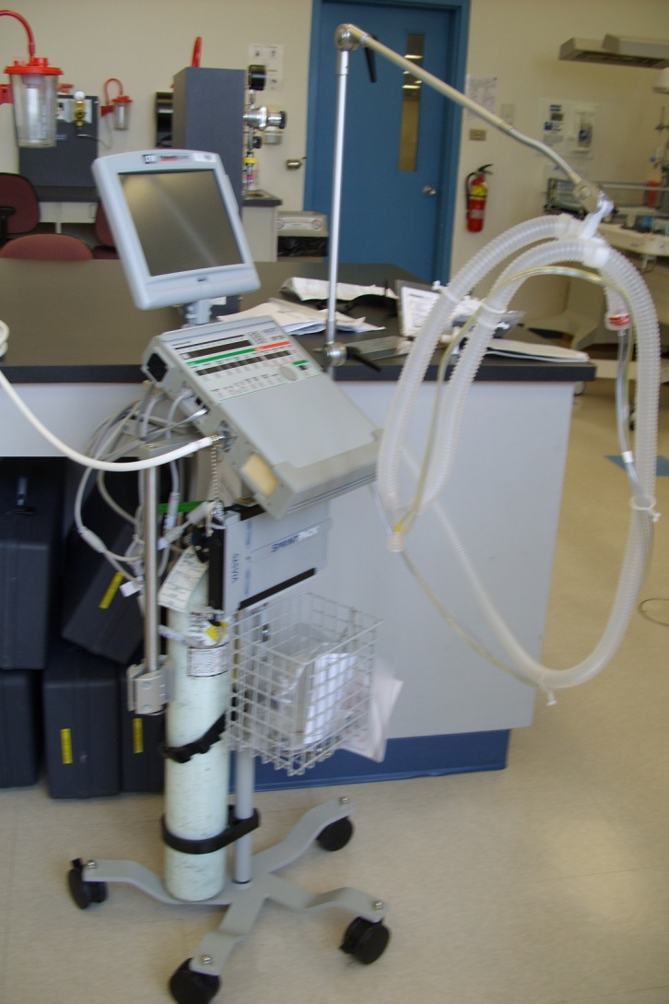
LTV 1200
Transport Ventilator
and Beyond!
Notes:
Maybe do a group exercise as to what has to be in a transport ventilator and what would be nice. Like an air compressor. If it doesn’t what do we have to be aware of – O₂ washout, atelectasis, increased secretions, and inflammation.

Slide 2
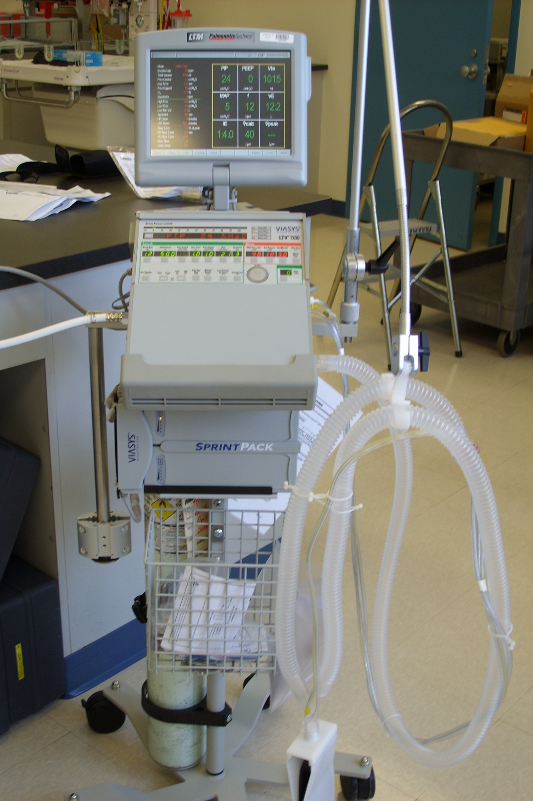
LTV 1200
Mosby’s reading – LTV1000 pages 726 -741
Don’t forget to clean both the fan filter and the air inlet filter
Notes:
The 1000 is very similar; the primary change is that the exp valve has a manual peep adjustment.

Slide 3
LTV 1200
Microprocessor-controlled
Electrical and pneumatic (turbine) driven
Time- and flow-cycled
Pressure-limited
Available for infant, adult, and pediatric populations

Slide 4
The Battery
Needs at least 8 hours to charge
Internal battery duration depends on settings, and age and condition of battery, so the company will not commit to a length of time. Thus it should only be used for short, in-hospital transports.
POTENTIALLY up to 45 minutes.
FYI – This ventilator can be used in the home, with an additional external battery and modifications for homecare use.
When operating in battery mode, the visuals will darken unless a button is pressed. Alarms will still illuminate when activated.

Slide 5
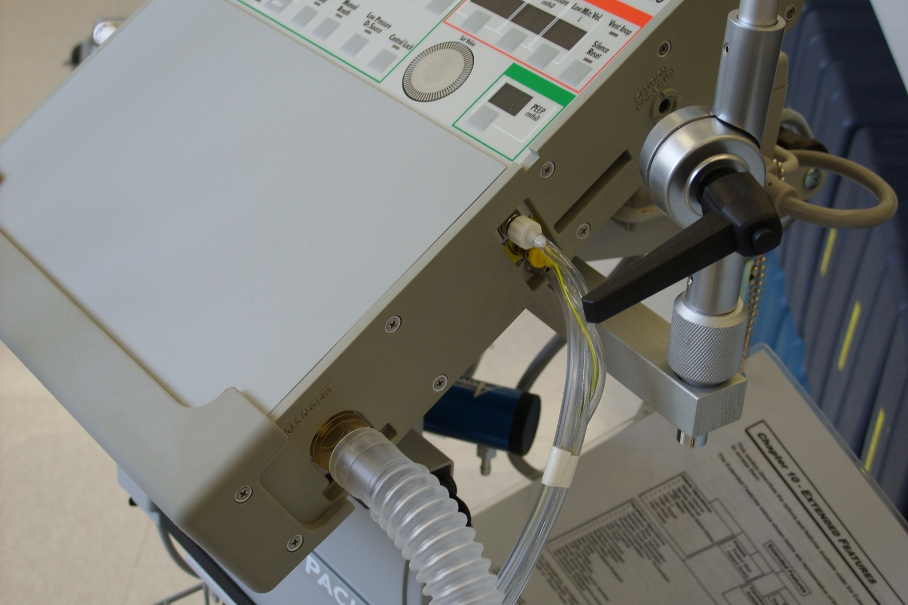
Tubing Attachment

Slide 6
The Circuit
One large (22mm) patient breathing circuit
Two flow transducer tubings
One exhalative valve drive line port
Notes:
A single direction circuit similar to, but not the same as, a bipap system. Exhalation valve is on the short exp limb, so flow and volume are detected at the wye. How does this work? By measuring pressure drop across a partial obstruction; this gives us flow and volume. It’s not measured back at the vent! PEEP is set by adjusting pressure on the backside of a mushroom valve. Apply the level of Peep you want to the back: if you set 8 cmH₂O behind the valve, you will have 8 cmH₂O in the circuit.

Slide 7
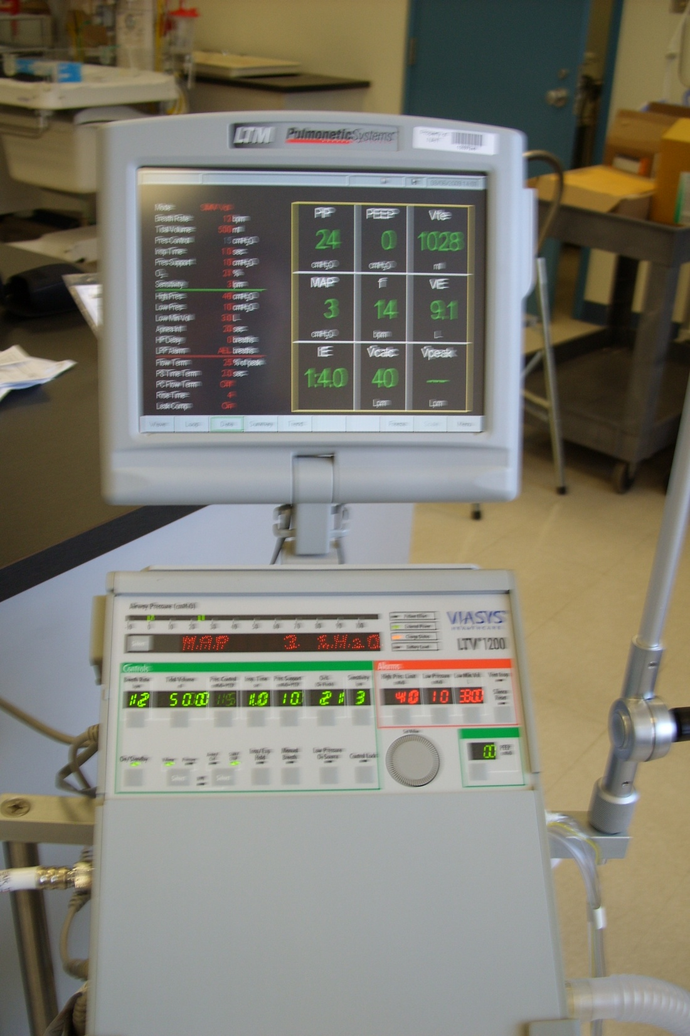
Modes
Control
A/C vol or press
SIMV vol or press
PS
CPAP
NiPPV

Slide 8
Setting the Controls
Touch and turn (No need to ‘retouch’ or ‘accept’)
Active elements are brighter, inactive are faded or show dashes - -
‘Select’ button scrolls through monitored parameters, extended features, etc.
With Insp/Exp hold, compliance and auto-peep can be measured
Notes:
Has pretty much everything any other ICU vent has (plus a compressor), just a little harder to access.

Slide 9
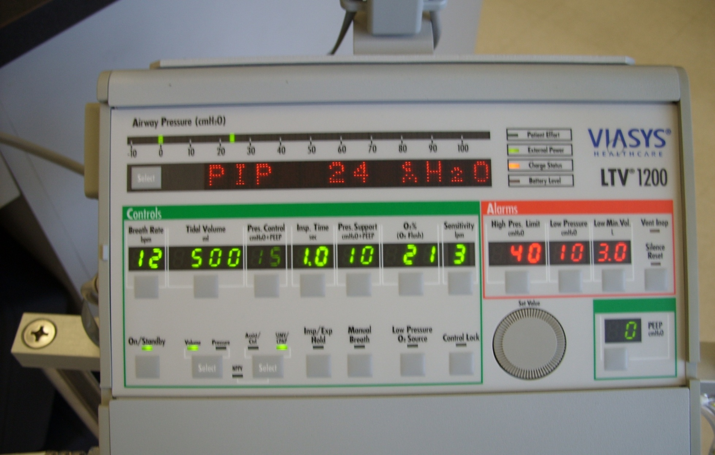
Front Panel Controls

Slide 10
Front Panel Controls
Sensitivity
  Set from 1-9 L/min
  Set greater than the leak measurement (esp. important in NIPPV)
  1 most sensitive, 9 least (e.g. Triggers breath a change of 1L/min or 2, or 3, etc.)
  Pressure sensitivity set to -3cmH₂O
  If set to ‘- -’ it means the A/C is actually in control mode! Do not let this happen!
Notes:
Base flow is 10 lpm bias flow through the system.
Pressure sensitivity; is this a built in backup? Yes, but listed for the LTV 1000

Slide 11
Front Panel Control
O₂ Flush
  On the ‘FiO₂’ button
  Only available using high-pressure O₂
  Set in ventilator operations
  Will activate for 1 - 3 minutes as set
  Press the button again to turn off and FiO₂ will return to previous setting

Slide 12
Low-Pressure O₂ Source
Button must be activated to use a low-pressure device, such as a concentrator, to deliver O₂
Estimated FiO₂ is calculated and takes into consideration MV
See chart in operator’s manual
Button should be off when using high-pressure devices to ensure the proper internal alarms are active
Notes:
Use in homecare scenario. Where you don’t have access to a high-pressure gas source, run off a compressor or O₂ tank.

Slide 13
Extra Tidbits
PEEP-compensated
A/C vol. calculates flow, NOT a dual mode
Alarm silence is for 60 seconds
Constant bias flow of 10L/min for patient triggering
Notes:
Dual mode, meaning a PRVC-type mode. Change wording for next year.

Slide 14
Flow Termination
Variable flow termination used for PC and PS breaths
Defaults to when flow drops to 2L/min cycles into exhalation
Can set in ventilator operations from 10-40% as a percentage of peak flow
PC flow termination only occurs if the flow termination is activated before the Ti ends
Can also set a time termination as a backup
Notes:
This is an exp flow sensitivity.
In PC you can choose to have this as an option instead of time cycling as would normally happen. This would almost change it to a MMV-type mode.
Time termination is a backup in PSV! If flow doesn’t drop down to set level (preset is actually 3), it will cycle. This is valuable in times where a leak might be present.

Slide 15
Extended Features Menu
Push and hold the select button for three seconds, and use the dial to navigate through the menu
Example of options – Other alarms, vent operations, presets, SBT, ventilator check out and maintenance of transducer, event trace
Notes:
SBT – Spontaneous Breathing Trial, basically a CPAP trial. This really is a mini ICU vent.

Slide 16
Extended Features Menu
Spontaneous breathing trials
  Can set duration, vent settings (PEEP, PS)
  SBT alarms
  SBT Display

Slide 17
Vent Operations Menu
Can set date and time
Set default vent settings
O₂ cylinder duration
Rise time
  Set from 1 - 9 (fastest to slowest)

