Slide 1

Examination and Assessment of the Pediatric Patient
RET 203
PALS – Pediatric Advanced Life Support Study Guide : Barbara Aehlert

Slide 2
Neo/Ped Anatomy
Neonates have a larger tongue relative to oropharyngeal space
    Predisposes them to airway obstruction
Neonates have a larger head relative to body size
    1:4 for neonates vs. 1:8 for adults
Neonates have a larger occiput
    Natural head position while laying flat is flexion
    Difficult to maintain airway neutrality

Slide 3
NEO/PED Airway
There are some major airway differences between children
and adults
  Narrowest portion of pediatric airway is at the cricoid cartilage
  This makes the neonatal trachea more funnel-shaped
  Big floppy epiglottis
  Epiglottis located at C1 in children vs. C4 in adults

Slide 4
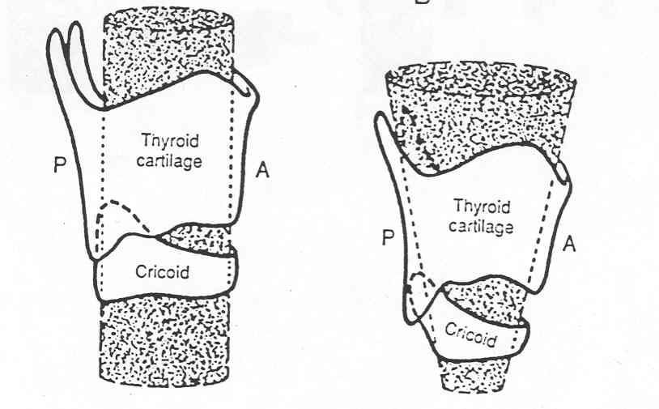
NEO/PED Airway
Notes:
Notice that the pediatric airway on the right is more funnel-shaped than the adult airway on the left, and that the cricoid cartilage is the narrowest portion of the airway.

Slide 5
NEO/PED Airway
Level of tracheal bifurcation T3 in neonates, T5 in adults
Much more compliant trachea compared to adults
Angle of mainstem bronchi in peds –
  10 deg. right, 30 deg. left
Angle of mainstem bronchi in adults –
  30 deg. right, 50 deg. left

Slide 6
NEO/PED Thorax
Ribs are more horizontal
  Loss of “Bucket Handle” effect, also known as costal inhalation
Cartilage is much more compliant
  Less-effective costal exhalation
  In respiratory distress, the chest wall may actually retract during inspiration
    Paradoxical or “See-saw” respirations
Notes:
As a person breathes in, the rib cage expands in its side-to-side dimension to accommodate the expanding lungs. Similarly, as a bucket handle is moved up from its resting position, it extends farther in the side-to-side dimension.
One type of movement involves the so-called "bucket handle" effect. As each rib swings upon its ends, like a bucket handle swinging up from the sides of the bucket the rib moves upward and outward laterally. As this type of movement occurs on both sides of the rib cage, the transverse diameter of the rib cage increases from side to side.
Get video showing bucket handle effect.

Slide 7
NEO/PED Thorax
Intercostal muscles in neonates and young peds – primary function is to stabilize the chest
  They don’t have the leverage/strength to lift the ribs
Diaphragm
  Chief muscle of respiration
  Muscles of diaphragm inset horizontally vs. obliquely
  Diaphragm sits higher in thorax in resting position in peds
  Smaller FRC in neonates – Gradually increases towards adolescence
Notes:
Thorax is compliant to aid passage through birth canal.
Oblique = convex.

Slide 8
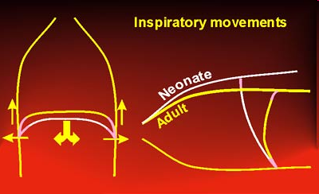
NEO/PED Thorax
Thorax of neonates is more bullet-shaped vs. conical in adults
www.spirexpert.com
Notes:
www.spirxpert.com
The way in which the diaphragm is extended within the thorax differs between neonate and adolescent, and the difference matters. Let us first look at neonate and adult in the erect posture. In adults, the muscular part of the diaphragm is apposed to the lower rib cage and rises very steeply, whereas the membranous part is extended horizontally. This is a very advantageous construction. When the diaphragmatic muscle contracts, it pulls the membranous part down like the dome of a parachute. This extends the lung downwards and results in an inspiratory movement. At the same time, the pleural pressure falls. This might cause an inwards, and hence an expiratory, movement of the thorax. However, the downward displacement of the diaphragm compresses the abdominal content, elevating the abdominal pressure. On that account, the lower ribcage is pushed outward. The relatively stiff thorax hinges outwards and upwards, and this reinforces the inspiratory manoeuvre.
In the neonate the geometry is less favourable. The diaphragm is more level, and the muscular part is not closely apposed to the rib cage. This diminishes the potential for displacing the diaphragm downwards. Also, when the muscle contracts, the lower rib cage is pulled inwards, a paradox movement with a view to inspiration. Whilst the downward displacement of the lung leads to inspiring air, this is associated with less increase in abdominal pressure than in the adult. In addition, the abdominal pressure is less efficiently translated into an outward acting force on the lower rib cage, because the area of apposition is much more limited. Finally, because the rib cage is so pliable, some of the drop in pleural pressure is associated with an inward movement of the rib cage, counteracting to some extent the efficiency of the inspiratory manoeuvre.
In the supine position, the intra-abdominal mass displaces the diaphragm into the thoracic cavity. Lung volume in the supine posture is therefore smaller than in the erect posture. The displacement of the diaphragm by the abdominal contents also influences its geometry, the upper part being at a greater angle to the rib cage; this is a less-favourable position for the muscle to move the diaphragm towards the abdomen, but on the other hand the larger stretch helps the muscle to operate at a more efficient part of its force-length curve.
Why is resting RR faster in kids than adults?

Slide 9
NEO/PED Anatomy
Because of the above disadvantages, the primary means by which neo/ped patients increase minute volume is by increasing RR rather than increasing tidal volume
The younger the child, the less likely they are to exhibit all signs and symptoms of respiratory distress
Keep in mind that pediatric patients have more reasons to have respiratory distress, and less ability to manifest that distress
Notes:
Similar to increasing HR rather than SV.

Slide 10
Comparison of Neonatal and Adult Anatomy
Structure | Neonate | Adult
Head/body size ratio | 1:4 | 1:8
Tongue size | Large | Proportional
Laryngeal shape | Funnel-shaped | Rectangular
Narrowest portion of upper airway | Cricoid cartilage | Rima glottidis
Shape and location of epiglottis | Long/C1 | Flat, C4
Level of tracheal bifurcation | T3 - 4 | T5
Compliance of trachea | Compliant, flexible | Noncompliant
Angle of mainstem bronchi | 10 degrees right, 30 degrees left | 30 degrees right, 50 degrees left
Anteroposterior transverse diameter ratio | 1:1 | 1:2
Thoracic shape | Bullet-shaped | Conical
Resting position of diaphragm | Higher than adult | Normal
Location of heart | Centre of chest, midline | Lower portion of chest, left of midline
Body surface area/body size ratio | 9 times adult | Normal

Slide 11
Pediatric Assessment

Slide 12
How to Approach a Pediatric Assessment
Interaction is dependent on age and level of understanding
Assessment requires a relationship with the caregiver and patient
History-taking is a crucial skill
Observation is often more important than hands-on examination when assessing a child

Slide 13
Approaching the Patient
Make friends with the child to gain their cooperation
Be confident, yet non-threatening
Do as much assessing as possible with child dressed
Get down to the child's level
Use language that kids can understand
Explain what you are going to do
Have caregiver hold them

Slide 14
Approaching the Patient
Older children or adolescents should have a chaperone (parent or nurse) nearby
Allow privacy, especially for older children
May need to be opportunistic and perform whatever examination you can (E.g. Leave looking in throat until the end because it can cause distress for the child)
Obtain consent to perform examination and conduct it in a child-friendly manner

Slide 15
Components of a Pediatric Assessment
Initial assessment
    Pediatric Assessment Triangle (PAT) (First impression)
    Primary survey (ABCDE assessment)
    Secondary survey
        Vital signs
        Focused history
        Detailed physical examination
Ongoing assessment
Notes:
It’s shown in this powerpoint as a linear process, but stages may happen simultaneously as you gain experience or with other caregivers helping.

Slide 16
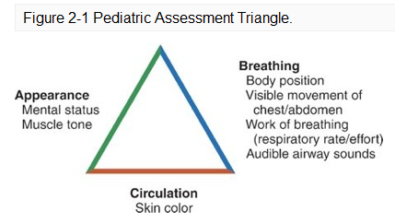
Components of a Pediatric Assessment

Slide 17
PAT
First impression/“across-the-room” assessment
  Gut feeling
Remember that approaching an ill or injured child can increase agitation, possibly worsening the child's condition
  You are a stranger to them

Slide 18
PAT
PAT is performed before approaching or touching the child
Pause a short distance from the patient and look/listen
Quickly determine if a life-threatening problem exists that requires immediate intervention
Takes 60 seconds or less and no equipment is required (Stethoscope, BP cuff, etc.)

Slide 19
PAT
Used to determine if a child is “sick” or not
Patient’s condition can change at any time so reassess frequently
Essentially triaging the patient, or establishing the severity of illness
Helps you get an idea of the general area of physiologic abnormality
Determines urgency of further assessment

Slide 20
PAT
Also important to note as part of your first impression
  Interactions
    Are they appropriate?
    How is the caregiver reacting?
Cleanliness
Are additional resources or help needed?
Key point – If at any time during your initial assessment you notice abnormal findings, proceed immediately to primary survey
Notes:
There is an awkward situation where you assess parental substance abuse, physical abuse etc.
Use additional resources, e.g. police/security.

Slide 21
PAT – Appearance
The appearance portion of the PAT is a global assessment of adequacy of ventilation, oxygenation, circulation, and CNS function

Slide 22
PAT – Appearance
TICLS – Pronounced tickles
  Tone (muscle tone)
  Interactivity/mental status
    Level of responsiveness
    Interaction with caregiver
    Response to you or others
  Consolability
  Look or gaze
  Speech or cry
Notes:
Tone: Is the child moving vigorously, or is the child limp, listless, or flaccid?
Interactivity: Is the child alert and attentive to his or her surroundings, or uninterested/apathetic?
Consolability: Can the child be comforted by the caregiver or healthcare professional?
Look/Gaze: Do the child's eyes follow your movement, or is there a vacant stare?
Speech/Cry: Is the child's speech or cry strong, or is it weak or hoarse?

Slide 23
PAT – Appearance
Normal
Normal muscle tone
Child responds to name (If older than 6 to 8 months of age)
Equal movement of all extremities
Eyes open
Normal speech or cry
Abnormal
Agitation/marked irritability
Reduced responsiveness/ drooling (Beyond infancy)
Limp or rigid muscle tone
Inconsolable crying
Failure to recognize caregiver
Paradoxical irritability

Slide 24
PAT – Breathing
Breathing assessment
  Reflects adequacy of airway, oxygenation, and ventilation
  Check body position
  Chest and abdominal excursion
  Respiratory rate and effort
  Listen for audible airway sounds
Notes:
Insert normal RR for peds and neos.

Slide 25
PAT – Breathing
Normal findings
  Regular body position
  Symmetrical chest and abdominal excursion
  Normal RR; no accessory muscle usage
  No audible airway sounds

Slide 26
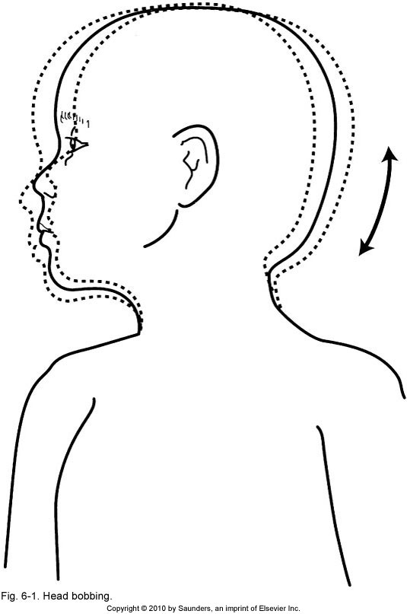
PAT – Breathing
Abnormal findings
  Abnormal body position i.e. sniffing, tripod, head bobbing.
  Head bobbing is an indicator if increased work of breathing in infants. The head falls forward with exhalation and comes up with expansion of the chest on inhalation.

Slide 27
PAT – Breathing
Abnormal findings cont.
  Nasal flaring, retractions/indrawing
    All are signs of increased work of breathing
  Very deep, or very shallow, respirations
  Paradoxical breathing (See-saw resps)
  RR < or > in newborns, accessory muscle usage

Slide 28
PAT – Breathing
Abnormal findings cont.
  Abnormal airway sounds
    Gasping – Inhaling or exhaling with quick, laboured breaths
    Grunting – Short, low-pitched sound heard at end exhalation as an infant’s attempt to create PEEP by exhaling against a semi-closed glottis. Helps maintain patency of small airways and lengthens O₂/CO₂ transit time.
    Gurgling – Abnormal sound associated with the collection of liquid in the patient’s oropharynx. Can be an early sign of airway protection impairment.
Notes:
Guppy breathing.

Slide 29
PAT – Breathing
Abnormal findings cont.
  Abnormal airway sounds
    Snoring
    Stridor – Harsh, high-pitched sound heard on inspiration associated with upper airway obstruction
    Wheezing – High-pitched whistling sound caused by turbulent airflow through narrowed airways
Notes:
Insp/exp. Stridor.
Biphasic stridor

Slide 30
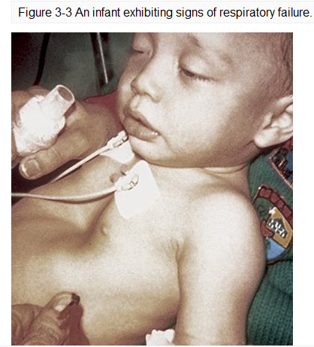
PAT – Breathing
Notes:
Signs of respiratory failure
•Sleepy, intermittently combative, or agitated Figure 3-3
•Decreased muscle tone.
•Decreased level of responsiveness or response to pain.
•Inadequate respiratory rate, effort, or chest excursion.
•Tachypnea with periods of bradypnea; slowing to bradypnea/agonal breathing.
Signs of respiratory arrest
•Mottling; peripheral and central cyanosis.
•Unresponsive to voice or touch.
•Absent chest wall motion.
•Absent respirations.
•Weak to absent pulses.
•Bradycardia or asystole.
•Limp muscle tone.

Slide 31
PAT – Circulation
Circulation assessment
  Reflects adequacy of cardiac output and perfusion of vital organs
  As this is only a quick assessment, skin colour is the best thing to check
  Normal finding is for child’s colour be normal for their ethnic group
  Abnormal findings include mottling, pallor, or cyanosis

Slide 32
Components of a PEDS Assessment
Now that the initial assessment is complete, what is next?
  Primary survey!
    Purpose is to determine if any life-threatening conditions exist and to manage them if they do

Slide 33
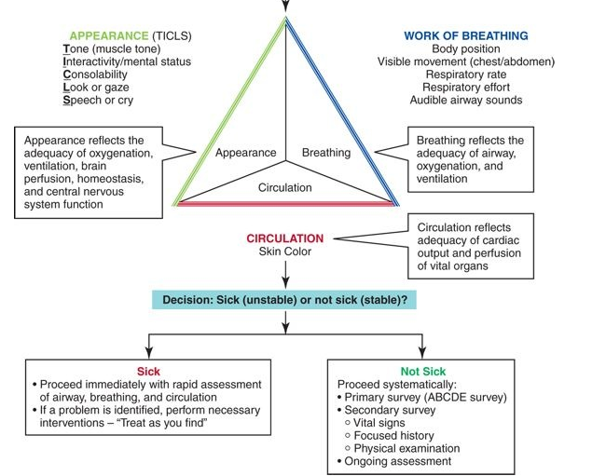
Notes:
PAT is first – Can be done in 60 seconds or less.
Pediatric Inital Asessment Algorithm

Slide 34
PRIMARY Survey
The primary survey –
ABCDE assessment
The primary survey focuses on Basic Life Support (BLS) patient assessment and management
Notes:
During the primary survey, assessment and management occur simultaneously. The primary survey should be periodically repeated, particularly after any major intervention or when a change in the patient's condition is detected.
Usually requires less than 60 seconds to complete but may take longer if intervention is needed at any point.

Slide 35
Primary Survey
A – Airway and cervical spine protection
B – Breathing and ventilation
C – Circulation and bleeding control
D – Disability (mental status)
E – Expose and examine/environment

Slide 36
Primary Survey – A
Ensure airway patency, absence of signs and symptoms of airway obstruction
  Are they able to handle oral secretions?
  Can they speak or make appropriate sounds for their age?
  Are airway protection reflexes intact? (Gag/cough)
Cervical spine injury present or suspected?
Notes:
A conscious child will usually find a position that optimizes their own airway, so be mindful of this during assessment.

Slide 37
Primary Survey – A
  Indications of an impending airway emergency
    Preferred posture (E.g. tripod position, holding head to maintain an open airway)
    Drooling
    Difficulty swallowing
    Swelling of the lips and/or tissues of the mouth
    Inadequate air movement
    Obstruction by the tongue, blood, vomitus, foreign body
    Abnormal airway sounds
Notes:
If the airway is in doubt, you must secure airway before proceeding to ‘B’
If the child is responsive and the airway is open (patent), move on to evaluation of the patient's breathing. If the child is responsive but cannot talk, cry, or cough forcefully, evaluate for possible airway obstruction.

Slide 38
Primary Survey – B
Breathing and ventilation
  Look, listen, and feel – Includes but not limited to inspection, palpation, and auscultation
Goal is to differentiate between normal breathing, respiratory distress, and respiratory failure
  Respiratory distress – Increased work of breathing or respiratory effort
  Respiratory failure – A clinical condition in which there is inadequate blood oxygenation and/or ventilation to meet the metabolic demands of body tissues

Slide 39
Primary Survey – B
Normal breathing assessment findings
  Awake and alert
  Normal chest excursion and work of breathing
  Skin colour normal (No cyanosis)
  Normal breath sounds
  RR appropriate for age
Notes:
What are signs of work of breathing?
In a nutshell, adequate gas exchange with no signs of hypoxia.

Slide 40
Primary Survey – B
Normal RR by age
Age Breaths/Min (At rest)
Infant (1 to 12 mo) 30 to 60
Toddler (1 to 3 y) 24 to 40
Preschooler (4 to 5 y) 22 to 34
School-age (6 to 12 y) 18 to 30
Adolescent (13 to 18 y) 12 to 16
What is the best way to count RR in infants and children?
Notes:
With a stethoscope for infants, look and watch chest/abdomen. For peds, 10 seconds minimum.

Slide 41
Primary Survey – B
In addition to counting RR, check whether it is regular, irregular, or periodic
Watch/listen for both phases of breathing (Insp. and exp.)
  Prolonged inspiratory phase suggests an upper airway obstruction
  Prolonged expiratory phase suggests lower airway obstruction
Notes:
What are the different types of resps? E.g. Kussmauls, cheyne stokes, etc.

Slide 42
Primary Survey – B
Tachypnea
  Is it a breathing emergency?
  May be an abnormal finding related to a disease process, or a compensatory mechanism
  May be related to fever, pain, or in a newborn – exposure to cold
  Could be secondary to excitement, anxiety, pain, etc.
  This is why it is important to assess all aspects of breathing/ventilation
Notes:
E.g. Compensatory mechanism is DKA kussmauls breathing.
At any age an RR > 60 is abnormal.

Slide 43
Primary Survey – B
Bradypnea
  An abnormally slow rate of breathing
  Very worrying sign in children and infants
  Can be caused by muscle fatigue, worsening hypoxia
  Can be caused by CNS depression, hypothermia
Notes:
Remember that children increase RR, not Vt in resp. Distress just like HR not SV, so very worrying.

Slide 44
Primary Survey – B
  Signs of increased work of breathing
    Anxious appearance, concentration on breathing
    Use of accessory muscles and/or grunting
    Leaning forward to inhale
    Nasal flaring
    Retractions – Sinking in of the soft tissues above the sternum (suprasternal) or clavicle (supraclavicular), or between (intercostal), or below (subcostal) the ribs during inhalation

Slide 45
Primary Survey – B
Signs of increased work of breathing cont.
    Tracheal tug
    Head bobbing
    Paradoxical breathing ‘see-saw’
In cases of severe obstruction, retractions may extend to the suprasternal notch and supraclavicular areas
Notes:
Learn what suprasternal notch is, supraclavicular areas.

Slide 46
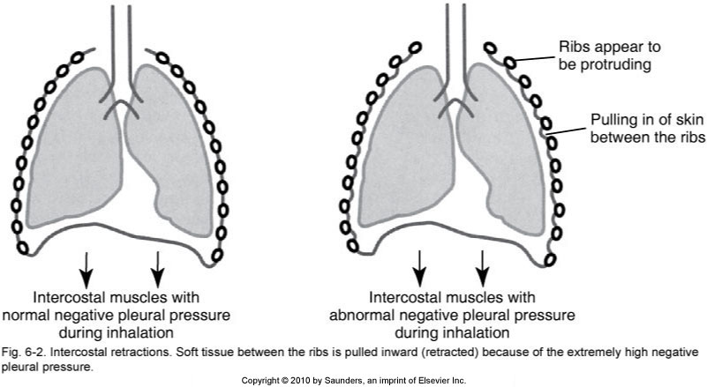
Intercostal Retractions
Notes:
Soft tissue between the ribs is pulled inward (retracted) because of the extremely high negative pleural pressure.

Slide 47
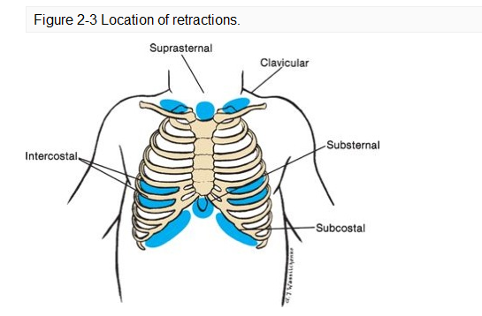

Slide 48
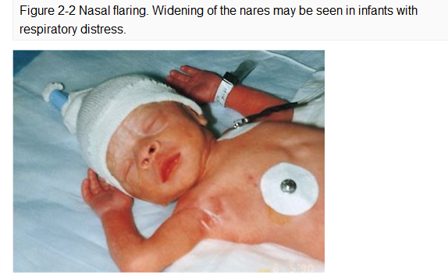
Figure 2-2 Nasal flaring. Widening of the nares may be seen in infants with respiratory distress.

Slide 49
Primary Survey – B
Listen
  Check for equal air entry
  Listen along the midaxillary line (under each armpit) and in the midclavicular line under each clavicle. Alternate from side-to-side and compare your findings
  Remember that the chest wall is thin in children making breath sounds easily transmitted from one side to the other
Notes:
Because the chest of a child is small and the chest wall is thin, breath sounds are easily transmitted from one side of the chest to the other. As a result, breath sounds may be heard despite the presence of a pneumothorax, hemothorax, or atelectasis.
Wheezing may be heard throughout the lungs or, in the case of a foreign body obstruction, may be localized.
To minimize the possibility of sound transmission from one side of the chest to the other, listen for air movement at the nose and mouth. Note if respirations are quiet, absent, or noisy (E.g. stridor, wheezing, snoring, crowing, gurgling).
Bilateral breath sounds? Breath sounds are normally quiet.

Slide 50
Primary Survey – B
Finally, check the thorax for tenderness, instability, or crepitations
Check for sub Q emphysema
Check again whether they are abdominal (diaphragmatic breathing) or using intercostals
At what age do we expect either?
Notes:
The transition from abdominal (diaphragmatic) breathing to intercostal breathing begins between 2 and 4 years of age and is complete by 7 to 8 years of age.
Respirations in infants and children younger than 6 or 7 years are primarily abdominal (diaphragmatic) because the intercostal muscles of the chest wall are not well-developed and fatigue easily from the work of breathing. Effective respiration may be jeopardized when diaphragmatic movement is compromised (E.g. gastric or abdominal distension), because the chest wall cannot compensate. As the child grows older, the chest muscles strengthen, and chest expansion becomes more noticeable.

Slide 51
Primary Survey – B
Signs of respiratory distress
  Nasal flaring, retractions, grunting
  Tachypnea
  Increased depth of breathing (hyperpnea)
  Head bobbing
  Mild paradoxical breathing, mild stridor
  Restlessness
  Tachycardia

Slide 52
Primary Survey – B
Signs of respiratory failure
  Cyanosis
  Severe accessory muscle use
  Severe paradoxical breathing (guppy breathing)
  Mod – Severe stridor
  Diminished breath sounds or chest excursion (hypopnea)
  Decreased LOC or response to pain
  Bradypnea
  Poor muscle tone

Slide 53
Primary Survey – B
Respiratory Distress | Respiratory Failure
• Nasal flaring • Inspiratory retractions • Tachypnea • Increased depth of breathing (hyperpnea) • Head-bobbing • Mild see-saw respirations • Restlessness • Tachycardia • Grunting • Mild stridor | • Cyanosis • Diminished breath sounds • Decreased level of responsiveness or response to pain • Poor skeletal muscle tone • Bradypnea • Tachycardia • Severe accessory muscle use Moderate or worse stridor Hypopnea

Slide 54
Primary Survey – C
Circulation and bleeding control
  Ensures adequate cardiac function and tissue perfusion
  Check that central and peripheral pulses are strong and regular
  Appropriate HR based on age
  Check heart rhythm if monitored
  Capillary refill time less than 2 seconds
  Awake, alert, warm and dry, normal skin colour
Notes:
A weak central pulse may indicate decompensated shock.
A peripheral pulse that is difficult to find, weak, or irregular suggests poor peripheral perfusion and may be a sign of shock or hemorrhage.
Any rhythm other than sinus is abnormal.
Mottled suggests decreased cardiac output, ischemia, or hypoxia, but can be normal in an infant exposed to a cool environment.

Slide 55
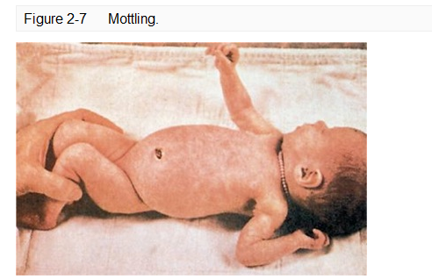

Slide 56
Primary Survey – C
Where do we assess the pulse?
  Depends on age
  Newborns – Palpate the base of the umbilical cord between your thumb and forefinger
  Neonate – Assess the brachial pulse
  Infant and young child – Assess the brachial pulse
  Child older than 1 – Assess the carotid pulse
Notes:
Femoral pulse can be used as well for children < 1 but brachial is preferred.

Slide 57
Primary Survey – C
HR Normals
  Neonate 100-180
  Infant (Neonate to 1 yr) 100-160
  Toddler (1 - 3 yrs) 90-150
  Preschooler (3 - 4 yrs) 80-140
  School-age 70-120
  Adolescent 60-100
Notes:
Pulse rate for a sleeping or sedate healthy child can be 10% lower than the above normals.

Slide 58
Primary Survey – D
Disability (Mental status)
  Assessing level of alertness/responsiveness
  Use ‘AVPU’ mnemonic
  A – Alert
  V – Responds to verbal stimuli
  P – Responds to pain
  U – Unresponsive
Notes:
Another assessment tool: The Glasgow Coma Scale (GCS) may be used to establish a baseline and for comparison in later, serial observations. A GCS score that falls two points suggests significant deterioration; urgent patient reassessment is required.
To avoid confusion with spinal reflexes, assess the patient's motor response by applying a stimulus above the neck.
Another assessment tool: The Glasgow Coma Scale (GCS) may be used to establish a baseline and for comparison in later, serial observations.
Question the parent/caregiver about the child's normal mood, activity level, attention span, and willingness and ability to cooperate.

Slide 59
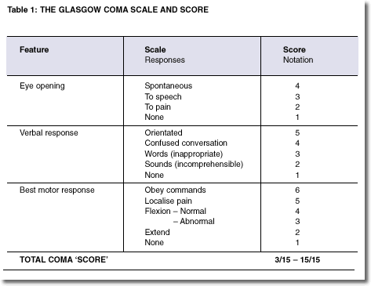
Primary Survey – D
Glasgow Coma Scale (GCS) may be used as well
Notes:
Is a GCS reliable on a young child? No.

Slide 60
Primary Survey – E
Expose and examine/environment
  Remove clothing if necessary to examine the patient
  Respect modesty, and keep patient covered to prevent heat loss as much as possible
  Check for environmental causes of illness e.g. hypothermia
Notes:
Heat stroke/dehydration, etc.

Slide 61
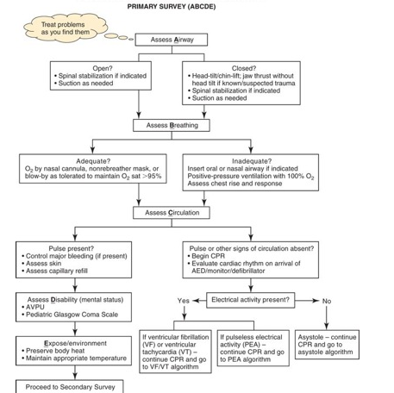

Slide 62
Secondary Survey
Vital signs
Focused history
Detailed physical examination
Initial assessment
PAT
Primary survey
Secondary survey
Ongoing assessment

Slide 63
Secondary Survey
Vital Signs
Temperature (36.5 - 37.5)
  Fever is a temp. > 38.5 or sustained temp. > normal
    Fever is an indication of systemic infection or inflammation
  Hypothermia is a temp. < 35
    At 35.0°C body core temperature is below what is required for normal metabolism and body functions
Notes:
Oral temp. may not be appropriate in someone with coughing/breathing difficulty.
Rectal can still be used in children under 4.
Hypothermia is a condition in which core temperature drops below the required temperature for normal metabolism and body functions, which is defined as 35.0 °C (95.0 °F).

Slide 64
Secondary Survey
Vital Signs
Temperature
  Obtain via an appropriate route for the child’s age
    Rectal – Use for children under 3 months
    Oral – Can use as soon as a child can understand and cooperate
    Axillary – Can use in children 3 months and older but may be unreliable
    Tympanic – Can use in children 3 months and older
  Can vary with exercise, stress, crying, and/or clothing
Notes:
Normal temp drops slightly rectal – oral – axillary.

Slide 65
Secondary Survey
Vital Signs
Heart rate
  Neonate 100-180
  Infant (Neonate to 1 yr) 100-160
  Toddler (1 - 3 yrs) 90-150
  Preschooler (3 - 4 yrs) 80-140
  School age 70-120
  Adolescent 60-100
Notes:
Can be assessed with palpation, ECG, auscultation.

Slide 66
Secondary Survey
Vital Signs
Blood pressure
  One of the least-sensitive indicators of perfusion in children
  In children under 3, an adequate central pulse is considered a sign of adequate BP
Notes:
Children often become agitated during this procedure, which increases their pulse and respiratory rate. To decrease children's anxiety about blood pressure measurement, tell them you are going to give their arm “a hug.”
Use of a cuff that is too large will result in a falsely low reading. Use of a cuff that is too small will result in a falsely high reading.

Slide 67
Secondary Survey
Vital Signs
BP normals by age
AGE | BP
Prem | 55-75/35-45
0 - 3 mo. | 65-85/45-55
3 - 6 mo. | 70-90/50-65
6 - 12 mo. | 80-100/55-65
1 - 3 yr | 90-105/55-70
3 - 6 yr | 95-110/60-75
6 - 12 yr | 100-120/60-75
Adolescent | 110-130/65-85

Slide 68
Secondary Survey
Vital Signs
BP calculations
  In premature infants, the MAP should be approximately equal to their gestational age
  Age x 2 +90 = Normal SBP in children
  A SBP < Age x 2 +70 indicates hypotension
  Diastolic BP should usually be 2/3 of systolic
Notes:
1 month or less < 60 is hypotension, after that use age x 2 formula with the age being zero.

Slide 69
Secondary Survey
Vital Signs
Respiratory rate
Age Breaths/Min (At rest)
Infant (1 - 12 mo) 30 to 60
Toddler (1 - 3 y) 24 to 40
Preschooler (4 - 5 y) 22 to 34
School-age (6 -12 y) 18 to 30
Adolescent (13 -18 y) 12 to 16

Slide 70
Secondary Survey
Vital Signs
Oxygen saturation
  Oxygen saturation should always be >95% in children
  How does fetal hemoglobin affect O₂ saturation?

Slide 71
Focused History
Use a way to organize the information obtained when taking a patient’s history
Can be done simultaneously with assessment
‘SAMPLE’
Notes:
History is often obtained simultaneously during the physical examination and while therapeutic interventions are performed.
While performing the physical examination, ask the patient, family, bystanders, or others questions regarding the patient's history.
SAMPLE is a mnemonic used to organize the information obtained when taking a patient history.
It’s used to organize the information obtained when taking a patient history.

Slide 72
Secondary Survey
History
‘SAMPLE’ mnemonic
  S Signs and symptoms
  A Allergies
  M Medications
  P (Pertinent) Past medical history
  L Last oral intake
  E Events leading to illness or injury

Slide 73
Secondary Survey
History
Signs and symptoms
  Assessment findings and history as they relate to the chief complaint
  When did it start/occur?
  Sputum/cough?
  What was the child doing when it started/occurred?
  How long did it last? Does it come and go? Is it still present?
  Where is the problem? Describe character and severity if painful
  Aggravating or alleviating factors?
  Previous history the same?

Slide 74
Secondary Survey
History
Allergies
  Medication allergies first
  Environmental/product allergies e.g. pollen/latex
Medications
  Prescription and OTC drugs the child is taking
  Dose route and frequency of medication
  Check proficiency with meds such as MDIs

Slide 75
Secondary Survey
History
(Pertinent) Past medical history
  Is the child currently under a physician's care?
  Serious childhood illnesses
  Hospitalizations
  Surgical procedures
  Trauma/injuries/fractures/ingestions/burns
  Immunization status
  For infants and toddlers, obtain a birth history
Notes:
○Complications during pregnancy or delivery (E.g. caesarean delivery, forceps delivery).
○Congenital anomalies.
○“Did the baby go home with you?”
•Immunization status with regard to diphtheria, tetanus, pertussis, varicella, poliomyelitis, Haemophilus influenza type B, hepatitis B, rubeola, rubella, mumps, and so forth.
(Pertinent) Past medical history
•Is the child currently under a physician's care?
•Serious childhood illnesses: Age, complications.
•Hospitalizations: Age, reason for admission, length of stay.
•Surgical procedures: Age, reason for procedure, complications.
•Trauma/injuries and fractures/ingestions, burns: Age, circumstances surrounding event, treatment, complications.
•For infants and toddlers, obtain a birth history.
○Maternal age, gestational duration, prematurity, birth weight.

Slide 76
Secondary Survey
History
Last oral intake
  Time and amount of last meal or drink
  For infants, find out whether breast- or bottle-fed, type of formula used, are there feeding difficulties?
Events leading up to illness or injury
  Injury scenario, mechanism of injury
  Onset, duration, and precipitating factors of illness

Slide 77
Secondary Survey
Detailed Physical Exam
The purpose of the physical examination in the Secondary Survey is to detect non life-threatening conditions and provide care for those conditions/injuries.
A detailed physical examination is presented here for completeness. A focused physical examination may be more appropriate, based on the patient's presentation and chief complaint.

Slide 78
Inspect and palpate each of the major body areas for DCAP-BLS-TIC
  Deformities
  Contusions
  Abrasions
  Penetrations/punctures
  Burns
  Lacerations
  Swelling/edema
  Tenderness
  Instability
  Crepitus
Notes:
Crepitus is a medical term to describe the grating, crackling, or popping sounds and sensations experienced under the skin and joints.

Slide 79
Secondary Survey
Detailed Physical Exam
Need some kind of systematic approach to the physical exam
  System-by-system approach or…
  ABCDE
  Head to toe
Notes:
Do head to toe in infants and young children as some may not like an unfamiliar person touching their face, looking in their mouth, etc.

Slide 80
Secondary Survey
Detailed Physical Exam
Airway
  Start with mouth, throat, and pharynx
    Check for hoarseness, sore throat, dysphagia
    Note unusual odours (alcohol, nuts)
  Check neck for crepitus and tracheal position
    Palpate if unsure of tracheal position
    Look for JVD
    Check for presence of medic alert necklace

Slide 81
Secondary Survey
Detailed Physical Exam
Breathing
  Inspect – Work of breathing, chest symmetry, accessory muscle use, retractions, and breathing pattern
  Palpate – Check DCAP-BLS-TIC
  Percuss
  Auscultate – Equality of breath sounds, adequate air entry, adventitious sounds, normal heart sounds
Notes:
Check for murmur in babies.

Slide 82
Secondary Survey
Detailed Physical Exam
Circulation assessment
  Awake and alert
  Central and peripheral pulses are strong and regular
  Heart rate and BP are within normal range for age
  Capillary refill time is less than 2 seconds
Notes:
Capillary refill time of 3 to 5 seconds is delayed and may indicate poor perfusion or exposure to cool ambient temperatures.
Capillary refill time longer than 5 seconds is markedly delayed and suggests shock.
Alternate sites for assessment of capillary refill include the forehead, chest, abdomen, or fleshy part of the palm.
Never assume a child is well-perfused based on a good capillary refill time.

Slide 83
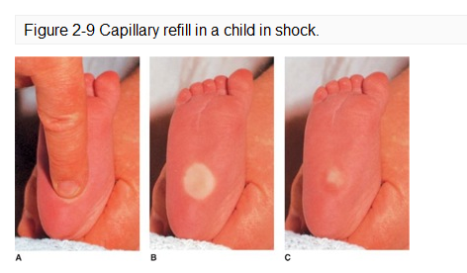

Slide 84
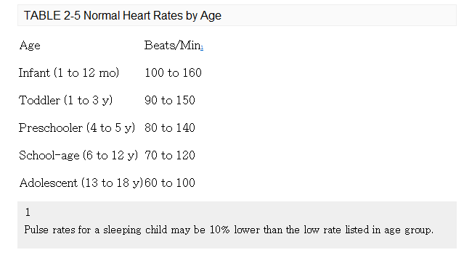
Secondary Survey
Detailed Physical Exam
Circulation assessment cont.

Slide 85
Secondary Survey
Detailed Physical Exam
Circulation assessment cont.
  Adequate oral intake and hydration
    Moist mucous membranes and adequate skin turgor
  Adequate urine output for age and weight
  Skin colour normal, warm and dry
    Newborns may have acrocyanosis of the hands and feet
Notes:
Pink, pale, dusky, cyanotic, mottled.
Mottled suggests decreased cardiac output, ischemia, or hypoxia, but can be normal in an infant exposed to a cool environment.

Slide 86
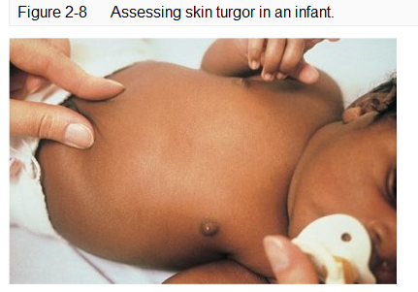
Notes:
To assess skin turgor (elasticity), grasp the skin on the abdomen between your thumb and index finger (Figure 2-8). Pull the skin taut and then release quickly. Observe the speed with which the skin returns to its original contour when released.
The skin should resume its shape immediately with no tenting or wrinkling. Good skin turgor indicates adequate hydration. A positive finding is more helpful than a negative one. Never assume a child is well-hydrated based on good skin turgor.
Decreased skin turgor (a sign of dehydration and/or malnutrition) is present when the skin is released and remains pinched (tented) and then slowly returns to its normal shape.

Slide 87
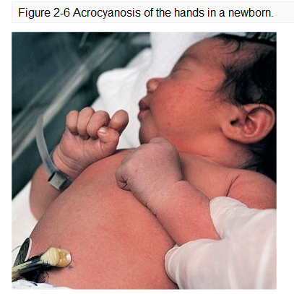

Slide 88
Ongoing Assessment
Purpose
  Re-evaluate the patient's condition
  Assess the effectiveness of emergency care interventions provided
  Identify any missed injuries or conditions
  Observe subtle changes or trends in the patient's condition
  Alter emergency care interventions as needed

Slide 89
Ongoing Assessment
The ongoing assessment should be
  Performed on EVERY patient
  Performed after ensuring completion of critical interventions
  Performed after the detailed physical examination, if one is performed
  Repeated and documented every 5 minutes for an unstable patient
  Repeated and documented every 15 minutes for a stable patient

Slide 90
Ongoing Assessment
Reassess airway patency, oxygen saturation
Reassess breathing effectiveness
Reassess pulse rate and quality, perfusion status, cardiac rhythm
Reassess mental status and activity level
Reassess and document vital signs
Evaluate emergency care interventions
Notes:
Components of the ongoing assessment:
Reassess airway patency, oxygen saturation.
Reassess breathing effectiveness: Rise and fall of the chest.
Respiratory rate
Depth/equality of breathing.
Rhythm of respirations.
Signs of increased work of breathing (respiratory effort).
Breath sounds
Reassess pulse rate and quality, perfusion status, cardiac rhythm.
Look for changes in colour of skin and mucous membranes.
Feel for changes in skin temperature and moisture.
Reassess capillary refill in infants and children younger than 6 years of age.
Reassess mental status and activity level.
Reassess and document vital signs.
Re-evaluate emergency care interventions.

Slide 91
Ongoing Assessment
Other factors to consider during assessment
  Cough
  Sputum
  Diagnostics (CXR, ECG, etc.)
  Lab results including ABG or CBG
Notes:
Colour of sputum and odour? Amount? (Large amount might indicate CF, blood – bronchiectasis.)
Sound of cough (Barky might indicate croup/epiglottitis). Productive? – Bronchiolitis/pneumonia.
Nonproductive – Asthma/allergies?
Chest X-ray – Never use alone to dx, but verify.

