Slide 1
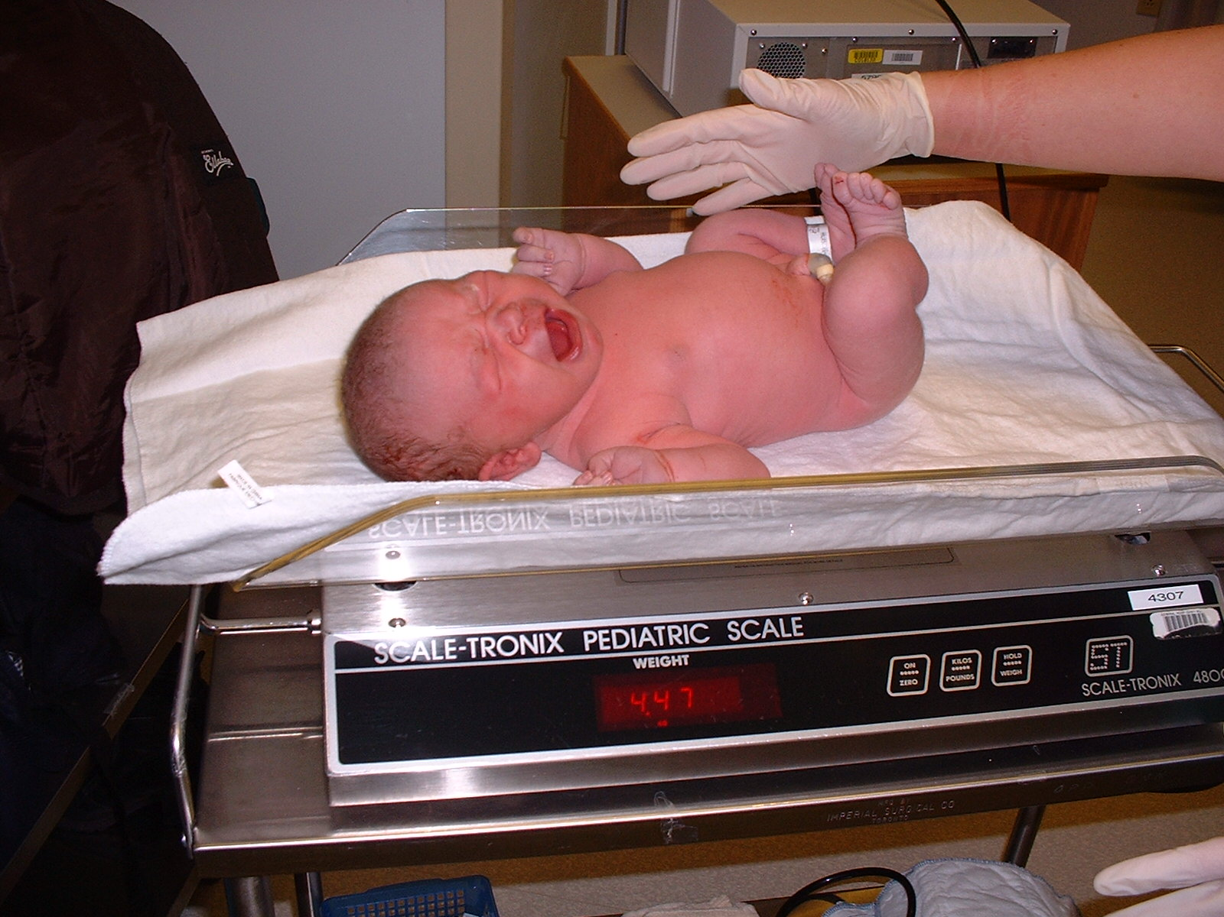
Physical Exam of the Newborn
LOG 3 – RET 203
Notes:
41 week gestation
4.47 Kg

Slide 2
Prematurity
37 - 40 Weeks’ gestation is considered “Term”
32 - 36 Prematurity – Lower percentage of infants ventilated
28 - 32 Prematurity – Half the infants in need of mechanical ventilation
24 - 28 Severe prematurity – Frequently in need of mechanical ventilation

Slide 3
Gestational Age Assessment
Evaluating gestational age requires consideration of several factors. The three main factors are as follows
Gestational duration based on the last menstrual cycle
Prenatal ultrasound evaluation
Postnatal findings based on physical and neurologic examinations
Notes:
Until 1960s, gest. age was based on weight. Not accurate since fetuses grow at different rates in-utero.
Important to know actual date to help health care team to help baby and also recognize if there are any problems.
Infants whose weight falls between the 10th and 90th percentiles are Appropriate for Gestational Age (AGA). Those above the 90th percentile are Large for Gestational Age (LGA), while those below the 10th percentile are Small for Gestational Age (SGA).

Slide 4
Dubowitz Assessment
Obtained during a routine physical exam
Examines 11 physical signs and 10 neurological signs
Each area is assigned a point value
Points added up for a score that reflects a gestational age
Accurate to within 2 weeks and is used in the first 5 days of life
Problem – Takes a lot of time to do.
Both Dubowitz and Ballard are reliable, but the Ballard system is quicker

Slide 5
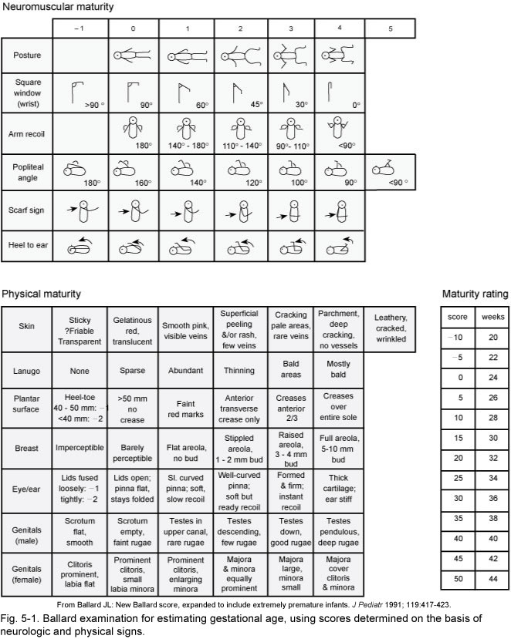

Slide 6
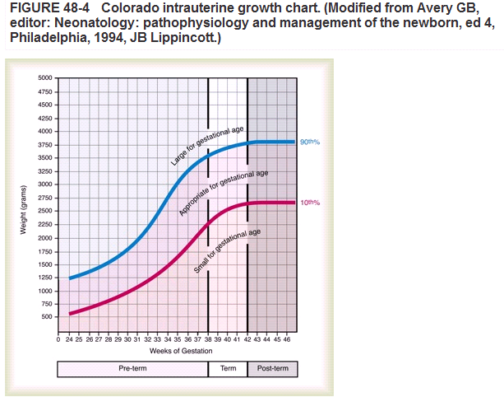

Slide 7
Physical Examination to Determine Gestational Age
EXTERNAL CRITERIA:
Vernix
Grayish/white, cheese-like substance that covers fetus
Composed of subaceous gland secretions, lanugo, and shed epithelial cells
Appears around 20 - 24 weeks and remains thick on fetus until ~week 36
Usually disappears by weeks 41 - 42

Slide 8
Skin Maturity
Appearance of skin is an excellent indicator of gestational age
Skin becomes thicker and less transparent with ↑ in age
As fetus matures, vessels become less visible and skin becomes pink
Preterm – Thin, almost transparent with many visible blood vessels
Term – Adult-looking skin
Post-term – Many cracks/wrinkles and no visible vessels

Slide 9
Nails
Always present
Post-term – Long fingernails
Lanugo
Fine, downy hair that covers the fetal body
Appears at ~ week 26 and covers the thorax, head, and extremities
Slowly disappears as fetus matures
Term – Might have some lanugo on the shoulders and forehead, but usually gone by 40 weeks
More common in neonates with dark skin

Slide 10
Ear recoil
Examination of pinna (External portion of the ear)
Cartilage in ear is not fully present until around 34 weeks
At 25 - 26 weeks the pinna is basically flat and will remain folded if doubled over
As the cartilage grows, the recoil will increase
Recoils and looks similar to an adult at term
Breast tissue/areola
25 - 26 weeks – The breast is barely visible
27 weeks – The areola is a bit visible but there is no palpable tissue
As fetus matures, areola grows and breast tissue increases

Slide 11
Sole creases
Creases on the soles of the foot (Plantar creases)
Increase in wrinkles as gestation increases
Prem – Starts as faint red lines, by term the entire sole is covered with deep creases

Slide 12


Suctioning
Infant head is suctioned upon delivery (first)
Again after delivery, and as needed
May use “bulb” syringe to clear mouth, then nose

Slide 13
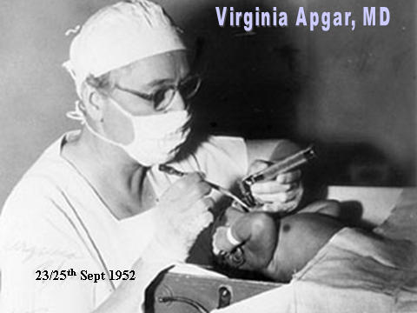
Apgar Scoring
Notes:
Developed as an objective way to evaluate the condition of a neonate. Also great for assessing the effectiveness of a resuscitation.
Five areas assessed:
1.Respiratory effort
2. Heart rate
3. Muscle tone
4. Reflex irritability
5. Colour
Following a 10-hour period of intense labour, a 2000-gram female is born by vaginal delivery. One minute after delivery, the baby has a heart rate of 120 bpm, exerts little respiratory effort, and has good colour except for some cyanosis in her extremities. The baby cries when a suction catheter is passed into her nasal passages and has good muscle tone. How will these findings help you in your assessment and treatment of this newborn?
The Apgar score was introduced by Virginia Apgar in 1952 as a rapid method of newborn assessment. Five physical signs are evaluated and given a rating of 0, 1, or 2 points, depending on severity of findings. The scores are totalled and become the infant's Apgar score (see below). Apgar assessment is done at 1 and 5 minutes after birth, with additional scoring every 5 minutes for 20 minutes for infants who score less than 7 initially. Infants with low scores (0-2) require immediate resuscitation efforts. Infants with a score of 3 to 6 may need oxygen and additional stimulation, whereas infants with scores of 7 or more are considered stable. Resuscitation efforts should not be delayed until after 1 minute in severely depressed infants. This newborn's Apgar score is 8, suggesting no additional intervention is necessary. The acronym APGAR may be used to help remember the five areas of assessment (see below).

Slide 14
Apgar
A – Appearance (Colour)
P – Pulse
G – Grimace (Reflex irritability)
A – Activity (Muscle tone)
R – Respiratory rate
Each of these categories is scored with 0, 1, or 2, depending on the observed condition of the newborn
Notes:
First score is at 1 minute and second is at 5 minutes, and every 20 minutes, if needed.
Apgar is not given until 1 minute after birth. It cannot be used as a criteria to initiate resuscitation, but rather as an assessment of how well the neonate is responding to resusc.
Five-minute Apgar is predictive of future impairment, with a low score being associated with a high risk of long-term damage.

Slide 15
Apgar Score
Heart rate
Heart rate is evaluated by stethoscope. This is the most important assessment
    If there is no heartbeat = scores 0
    Less than 100 beats per minute = scores 1
    Greater than 100 beats per minute = scores 2

Slide 16
Apgar Score
Heart rate
Assessed by
Palpating the base of the umbilical cord
Auscultating
Palpating the brachial/femoral artery

Slide 17
Apgar Score
Respiratory effort
  No respirations = scores 0
  Respirations are slow or irregular = scores 1
  Good crying = scores 2

Slide 18
Apgar Score
Muscle tone
  Muscle tone is flaccid = scores 0
  Some flexion of the extremities = scores 1
  Active motion = scores 2

Slide 19
Apgar Score
Reflex irritability
Reflex irritability is a term describing the level of newborn irritation in response to stimuli (Such as a mild pinch)
      No reaction = scores 0
      Grimacing = scores 1
      Grimacing and a cough, sneeze, or a vigorous cry = scores 2

Slide 20
Apgar Score
Colour
  Pale blue (Cyanotic) = scores 0
  Body is pink and the extremities are blue (Acrocyanosis) = scores 1
  Entire body is pink = scores 2

Slide 21
Apgar Score
The 1-minute APGAR score assesses how well the infant tolerated the birthing process
The 5-minute APGAR score assesses how well the newborn is adapting to the environment

Slide 22
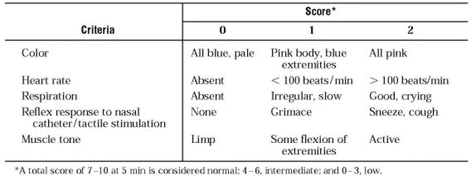
The Apgar Score
Notes:
Infants who have difficulty making the transition to life outside the uterus must be given help at once.
The Apgar Scale is used to assess the infant’s physical condition on 5 criteria, each of which is rated from 0 to 2.
Two Apgar ratings are given, at 1 and 5 minutes after birth, since some babies have trouble adjusting at first but do quite well after a few minutes.

Slide 23
Stabilizing the Neonate
Post-delivery, there are several questions you should ask
What is the gestational age?
Was the amniotic fluid clear?
Is the baby breathing or crying?
Is there good muscle tone?
If there is more time, you may ask other pertinent questions regarding the labour and delivery, mom’s health, and/or any known complications in-utero

Slide 24
Stabilizing the Neonate
Once the baby is presented in front of you, you should
Dry/warm the infant
Position the infant
Suction – Clear the airway

Slide 25
Stabilizing the Neonate
Once the baby is presented in front of you, you should
Dry/warm the infant
  Reduce thermal stress
  Overhead (radiant) warmer
  Remove wet linen
  < 1500 g infant – Place in a polyethylene bag

Slide 26
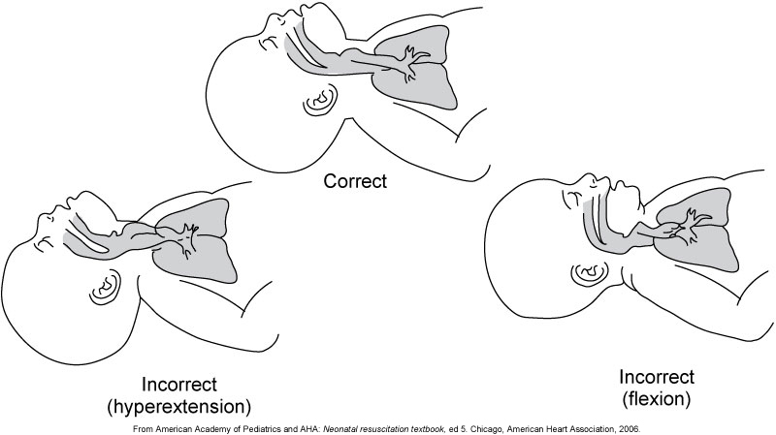
Stabilizing the Neonate
Once the baby is presented in front of you, you should
Position the infant

Slide 27
Stabilizing the Neonate
Suction – Clear the airway
  Clearing the a/w should be performed when there are ineffective respirations
  Suctioning is performed with a bulb suction
      Mouth first
      Nares second
  90 - 100 mmHg vacuum pressure

Slide 28
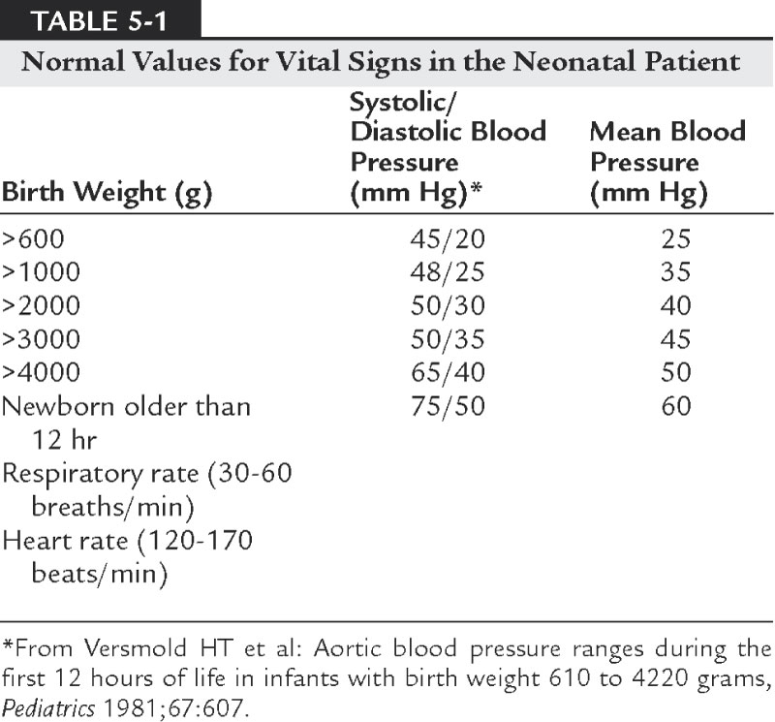
Physical Examination
Notes:
Hands-on Examination
Warm hands and stethoscope
MAP = Gestational Age + 5 (estimation)
Capillary filling time – Squeezed foot should refill with blood in 3 seconds or less. Increased filling time = decreased perfusion.

Slide 29
Physical Examination
General inspection
  Body position and symmetry
    Birth injury
  Skin
    Colour
      Vernix caseosa
      Lanugo
Notes:
Quiet observation.
Colour (Cyanosis, jaundice, meconium staining).
Patient’s activity (Muscle tone, movement, symmetry).
Head size (Hydrocephaly, anencephaly).
Respiratory rate/respiratory distress.
Mottling refers to irregular areas of dusky skin.
The yellow colour associated with mild to moderate jaundice is common among newborns after the first day of life. Jaundice on the first day of life, however, is always an indication for immediate evaluation.

Slide 30
Physical Examination (cont.)
Respiratory function
  Rate
  Rhythm
  Silverman score
  Auscultation
  Chest radiography
  ABGs
Notes:
Respiratory Rate
30 - 60 BPM
Usually abdominal breathing.
Breath sounds are clear and equal.
Abnormal findings:
If the rate is greater than 60 or less than 30.
If there are sternal retractions, nasal flaring, inspiratory stridor, or expiratory grunting.
Apnea 5 - 10 seconds (Periodic breathing).
True apnea 15 - 20 seconds.
And are associated with bradycardia and cyanosis (desaturation).
Apnea is a pathologic condition in which breathing ceases for longer than 20 seconds. Apnea may be associated with cyanosis, bradycardia, pallor, and/or hypotonia (Abnormally low muscle tone). Frequently, apnea is associated with nonspecific symptoms of diseases seen
Infant physical assessment begins with measurement of vital signs. A normal newborn respiratory rate is 40 to 60 breaths/min. The lower the gestational age, the higher the normal respiratory rate will be. Although a 28-week gestational age infant may normally breathe 60 times a minute, the rate more typical of the term newborn is 40 breaths/min. Tachypnea (Greater than 60 breaths/min) can occur because of hypoxemia, acidosis, anxiety, or pain. Respiratory rates below 40 breaths/min should be interpreted with previous trends of the newborn's respiratory rate. A baseline respiratory rate of 36 breaths/min in a term newborn is within normal limits; however, a respiratory rate of 36 breaths/min in a preterm newborn previously breathing at 70 breaths/min may indicate compromise. Causes of slow respiratory rates include medications, hypothermia, or neurologic impairment. Normal infant heart rates range from 100 to 160 beats/min. Heart rate can be assessed by auscultation of the apical pulse, normally located at the fifth intercostal space, midclavicular line. Alternatively, the brachial and femoral pulses may be used. Weak pulses indicate hypotension, shock, or vasoconstriction. Bounding peripheral pulses occur with major left-to-right shunting through a Patent Ductus Arteriosus (PDA). A strong brachial pulse in the presence of a weak femoral pulse suggests either a PDA or coarctation of the aorta.

Slide 31
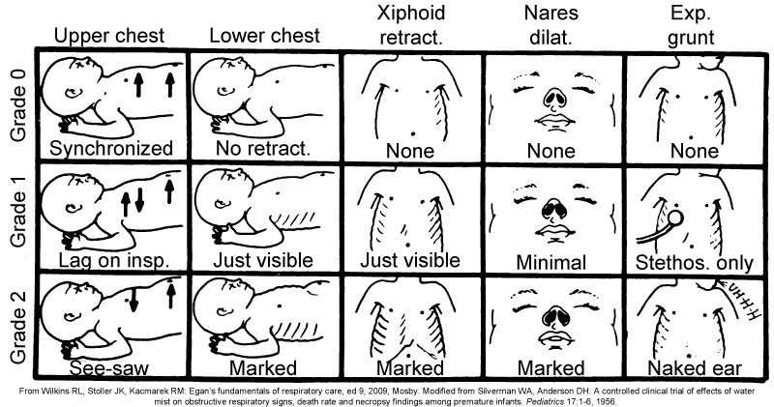
Silverman Score
Notes:
Diminished breath sounds occur in neonates with respiratory distress syndrome, atelectasis, pulmonary interstitial emphysema, and shallow respirations. Rhonchi, coarse sounds similar to snoring, emanate from the large bronchi as air rushes through secretions contained within them. Suctioning with the endotracheal tube, if present, may eliminate the secretions responsible. Wheezes are commonly heard during expiration and represent turbulent air flow due to bronchoconstriction or the presence of secretions. Air rushing through fluid in the smaller airways and alveoli produce rales or crackles. Rales are heard in infants with respiratory distress syndrome, pneumonia, and pulmonary edema, as well as in normal infants soon after birth. Frequently, infants with large upper airway obstruction generate stridor, a high-pitched creaking or squeaking, and primarily an inspiratory sound. To distinguish stridor from wheezing, place the head of the stethoscope over the neck area. If the sound is louder over the neck than over the chest, then it is most likely due to stridor rather than wheezing.

Slide 32
Physical Examination
Crying
  Strength
  Sound
Notes:
Cry
After the examiner has obtained some newborn experience, it is impressive how much information something as simple as a baby's cry can provide. A loud and vigorous cry is usually a sign of a healthy infant. A moaning, weak, or faint cry suggests serious illness. Frequently, an infant with respiratory distress syndrome strains with a grunting cry. An infant with a piercing, high-pitched cry often has a neurologic injury, drug withdrawal, or increased intracranial pressure. Hoarse crying can be associated with laryngeal edema, as in recently extubated infants. However, a hoarse cry may also be heard with congenital hypothyroidism, cretinism, or hypocalcemia with laryngospasm.

Slide 33
Respiratory Distress
Nasal Flaring (ALAE NASI)
“Air Hunger”
↑ Pressure needed to move air = ↑ degree of flaring
Notes:
Nasal flaring is seen as dilation of the alar nasi on inspiration. The extent of flaring varies according to the facial structure of the infant. Nasal flaring coincides with an increase in work of breathing. In concept, nasal flaring decreases the resistance to air flow. It also may help stabilize the upper airway by minimizing negative pharyngeal pressure during inspiration. Cyanosis may be absent in infants with anemia.

Slide 34
Grunting
Positive pressure on expiration to prevent alveolar collapse
Exhalation against a partially closed glottis (Partial valsalva))
Mild to severe
Notes:
Grunting occurs when infants exhale against a partially closed glottis. By increasing airway pressure during expiration, grunting helps prevent airway closure and alveolar collapse. Grunting is most common in infants with respiratory distress syndrome, but is also seen in other respiratory disorders associated with alveolar collapse.

Slide 35
Respiratory Rate
RR > 60 =Tachypnea
True apnea 15 - 20 seconds

Slide 36
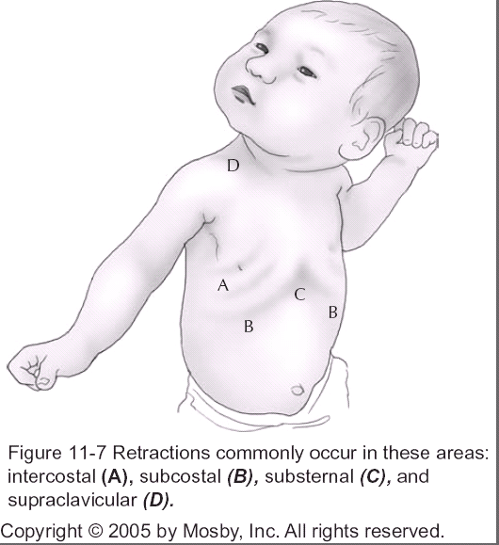
Retractions
Inward movement of the chest wall
Intercostal (Between ribs)
Supraclavicular (Above)
Subcostal (Below rib margin)
Suprasternal (Top of sternum)
The “see-saw” effect (Paradoxical)
Notes:
Retractions represent the drawing in of chest wall skin between bony structures. Retractions can occur in the suprasternal, substernal, and intercostal regions. Retractions indicate an increase in work of breathing, especially because of decreased pulmonary compliance. Paradoxical breathing in infants differs from the adult form. Instead of drawing the abdomen in during inspiration, the infant with paradoxical breathing tends to draw in the chest wall. This inward movement of the chest wall may range in severity, as with retractions, and paradoxical breathing indicates an increase in ventilatory work.

Slide 37
Cyanosis
Peripheral
Central
Notes:
The examiner should look at the infant's skin to see whether the infant is cyanotic. Some caution must be used in interpreting these findings. Infants with hypothermia or infants with polycythemia (Hematocrit levels greater than 65%) may have bluish extremities (Acrocyanosis), yet they are not really hypoxemic. Infants who are preterm and immature with thin skin can look quite pink when they are really hypoxemic. The careful examiner looks at the colour of the mucous membranes in the mouth and tongue and the nail beds in the extremities. These locations give a more reliable indication of the infant's true level of oxygenation.

Slide 38
Physical Examination
Chest and cardiovascular system
  Chest configuration
  Point of Maximal cardiac Impulse (PMI)
  Transillumination (Pneumothorax)
Notes:
Heart rate
120 - 160 BPM (Up to 200 when crying).
Normal impulse is on the 5th intercostal space, midclavicular line.
Heart sounds → 2 clear sounds to each beat.
A ductal murmur is normal on the first 2 days of life for term infants and up to 7 for preterm infants.
Persistent tachycardia usually associated with CHD, CHF, and shock.
Bradycardia usually secondary to significant apnea.
Transillumination
Transillumination is a technique often used in examining infants but not older patients. It can be used in infants because their chest wall is thin enough to shine a light through. The source is usually a bright fibreoptic light, which is placed against the chest wall in a dark room. Normally this produces a lighted halo around the point of contact with the skin. In the presence of a pneumothorax or pneumomediastinum, the entire hemithorax lights up. This technique is rapid and allows rapid treatment of a serious condition. The procedure should be performed by an examiner who is familiar with the technique because some fibreoptic lights can cause cutaneous burns and it is possible to be misled by the area of transilluminance.

Slide 39
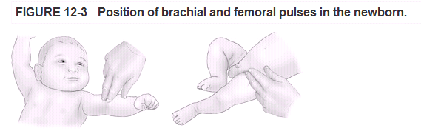
Physical Examination cont.
Chest and cardiovascular system
Heart rate
Cardiac sounds
Pulses
Blood pressure
Pulse oximetry
Pre- and post-ductal
Notes:
The circumference of a newborn's chest is equivalent to the head circumference. Inspection of the chest may reveal malformations such as pectus carinatum (Protruding xiphisternum or xiphoid process, also called pigeon chest) or pectus excavatum (Funnel chest). Bulging or asymmetry of the chest wall usually indicates an important pathologic condition such as enlargement of the heart, pneumothorax, phrenic nerve damage, or diaphragmatic hernia.
A pulse oximeter can provide valuable information in the evaluation of the cardiovascular system. Because the sensor of the pulse oximeter is applied to a distal extremity, the oximeter will display a low pulse rate and perfusion signal as peripheral pulses and perfusion decrease. The cause of this poor perfusion must be determined. However, if the oximeter suggests decreased perfusion while central blood pressure remains normal, the cause may be volume depletion with compensatory peripheral vasoconstriction.

Slide 40
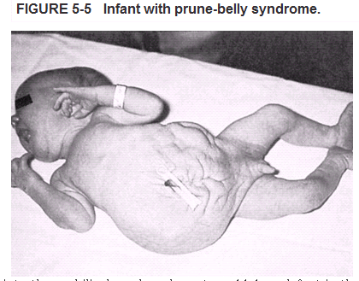
Physical Assessment
Abdomen
Contour
Obvious abdominal wall anomalies
Auscultation and palpation
More than stomach
Cord
Anatomy
Notes:
Successful abdominal examination requires a calm and quiet infant. Observe the contour of the abdomen, and determine whether it is scaphoid (sunken anterior wall), flat, or distended. Distention is a significant finding characterized by tightly drawn skin through which engorged subcutaneous vessels can easily be seen. Distention can suggest a variety of pathologic conditions including sepsis, obstruction, tumours, ascites, pneumoperitoneum, or necrotizing enterocolitis. Enterocolitis is a bowel infection characterized by sepsis, peritonitis, bowel perforation, and significant mortality. Any of these conditions may cause elevation of the diaphragm and therefore compromise lung expansion.
A scaphoid, hollowed, or unusually flattened abdomen may be associated with congenital diaphragmatic hernia, in which abdominal contents are displaced into the chest through a defect in the muscular diaphragm. More noticeable abnormalities of the abdomen include prune-belly syndrome, which is a congenital lack of abdominal musculature (Figure 5-5); omphalocele, a protrusion of the membranous sac that encloses abdominal contents through an opening in the abdominal wall into the umbilical cord; and gastroschisis, a defect in the abdominal wall lateral to the midline with protrusion of the intestines.
Palpation of the abdomen may be helpful in assessing an infant's pulmonary status. An infant's abdomen and abdominal organs move significantly with respiration because the diaphragm is the major source of power for respiration and an infant's abdominal wall musculature is relatively weak. Anything that impedes the motion of the abdomen or its organs hinders the infant's respiration. Liver or spleen enlargement (Hepatomegaly or splenomegaly, respectively); enlargement of other organs, such as kidneys, bladder, or bowel; or intraabdominal tumours can impede abdominal motion. Distention of the abdomen by fluid (ascites) or air (gaseous bowel distention) or pneumoperitoneum (free air in the abdomen) also impedes abdominal motion.

Slide 41
Physical Examination
Head and neck
  Shape of head
    Fontanelles
  Scalp edema
  Face
    Dysmorphic
    Edema
  Ears

Slide 42
Physical Examination cont.
Head and neck
  Nares
  Mouth
      Lips
      Oral cavity
  Neck
  Clavicles
Notes:
The clavicles are often broken during the delivery of large infants with shoulder dystocia (Difficult delivery owing to the fact that the anterior shoulder of the infant cannot pass below the mother's hip bone) or in breech deliveries. Frequently, the injury is noted when the infant refuses to move the affected shoulder.

Slide 43
Physical Examination cont.
Musculoskeletal system, spine, and extremities
  Dysmorphic
  Number of digits
  Abnormal positioning of joints
  Spine

Slide 44
Neurologic Examination
  Depends on maturation
  Movement, crying, response to touch and body tone are all checked for neurologic well-being
  Neonatal reflex tests
      Rooting
      Suck
      Grasp
      Moro reflex
Notes:
The general neurologic state of the infant is assessed during much of the physical examination. Note whether the infant responds appropriately to its surroundings or is lethargic or overly irritable. It is also important to determine whether the infant moves all extremities and whether the movements are symmetric and smooth or jittery and jerky. Infants with evidence of difficult delivery may manifest signs of extremity weakness associated with trauma to the brachial plexus.
Pick the neonate up under the arms to assess muscle tone in the term infant. A normal infant will suspend well. An infant with decreased tone will noodle through the hands. Infants with normal tone will maintain their extremities in a flexed position at rest.
A number of reflexes are present in the newborn. Everyone has observed the grasp reflex, in which the newborn infant grasps a finger placed in the palm of the hand. A similar downward curving of the toes occurs if a finger is pressed against the sole of the foot; this is referred to as the plantar grasp reflex. The startled reaction to sound or touch is similar to the Moro reflex, which occurs when the head is allowed to fall back slightly. The normal term infant's extremities will extend rapidly with open hands. The neonate will then slowly flex them back toward the body. Infants will respond to a bright light by shutting their eyelids tight. They will often turn toward unique sounds or sights and may focus on objects, especially faces. Suspending the infant and touching the top of the foot against a surface can demonstrate the stepping reflex – The infant should lift the leg and then place it flat on the surface.

Slide 45
The Newborn Baby’s Capacities
Reflexes – An inborn, automatic response to a particular form of stimulation
Notes:
Some reflexes have survival value. For example, the rooting reflex helps a breast-fed baby find the mother’s nipple.
Some reflexes may have had significance in our evolutionary past, but no longer serve a special purpose (e.g. the Moro reflex).
Several reflexes help parents and infants establish gratifying interaction.

Slide 46
Newborn Reflexes
  Some reflexes have survival value
  Some reflexes may have had significance in our evolutionary past
  Reflexes’ disappearance is due to increase in voluntary control over behaviour
  Way of assessing the health of the baby’s nervous system
Notes:
Some reflexes have survival value. For example, the rooting reflex helps a breast-fed baby find the mother’s nipple.
Some reflexes may have had significance in our evolutionary past, but no longer serve a special purpose (e.g. the Moro reflex).
Several reflexes help parents and infants establish gratifying interaction.

Slide 47
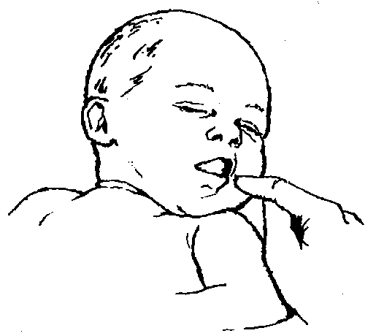
Rooting
Notes:
Stroke cheek near corner of mouth or object brushes the area.
Infant responds by turning head toward stimulation.
Disappears at 3 weeks when child begins to be able to voluntarily turn head.
Helps infant find nipple.

Slide 48
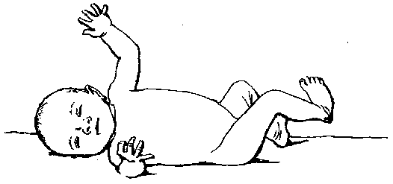
Moro Reflex
Notes:
Moro reflex
Hold infant horizontally on back and let head drop slightly or produce sudden loud sound against the surface supporting the infant.
Infant response is to make an embracing motion by arching back, extending legs, throwing arms outward and then bringing them in toward the body.
Disappears at 6 months.
Probably in human evolution helped baby cling to mother.

Slide 49
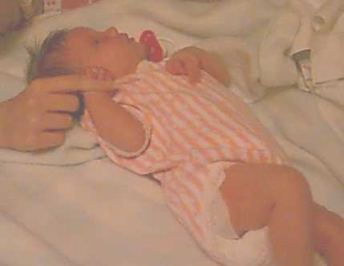
Grasp Reflex
Spontaneous grasp of adult’s finger
Notes:
Spontaeous grasp of adult’s finger.
Neuromuscular/neurologic signs (1) Posture – Increased scores are assigned when greater flexion of the newborn is observed without touching.
(2) Square window – Scores are assessed by applying enough pressure to the hand to flex it to the forearm. Scores increase as the angle between the hypothenar eminence and forearm decreases from 90 to 0 degrees.
(3) Ankle dorsiflexion – The newborn's foot is flexed against the anterior aspect of the leg. Scores increase as this angle decreases from 90 to 0 degrees.
Arm recoil – The newborn's arms are flexed for a few seconds and then extended fully. Recoil is then observed by releasing the hands. Scores increase as the angle of the antecubital space reduces from 180 degrees to <90 degrees.
Leg recoil – This assessment is done the same way as the arm recoil. The score increases as the angle between the knees and the hips decreases from 180 degrees to <90 degrees.
Popliteal angle – The thigh is held in the high chest position. The leg is extended with the other hand. The score increases as the angle behind the knee decreases from 180 to <90 degrees.
Heel to ear – The newborn's feet are drawn as close to the ears as possible. After releasing the feet, the score is then determined by assessing the popliteal angle and whether the feet can touch the ears.
Scarf sign – The newborn's hand is extended to the opposite shoulder. Scores increase if the elbow of the extended hand does not go past the middle of the chest.
Head lag – The newborn is pulled upward by both arms from a supine position. Scores increase if the newborn is able to hold the head forward. The newborn's head should be supported during this assessment.
Ventral suspension – The newborn, in a prone position, is suspended over one hand. The back, legs, arms, and neck are observed for extension. Scores increase as a curved back and neck with extended limp legs progress into a hyperextended back with good flexion of the arms and legs.
Scores indicate weeks of gestation.
Disappears at 3 - 4 months to allow reaching and grasping.
Prepares infant for voluntary grasping.

Slide 50
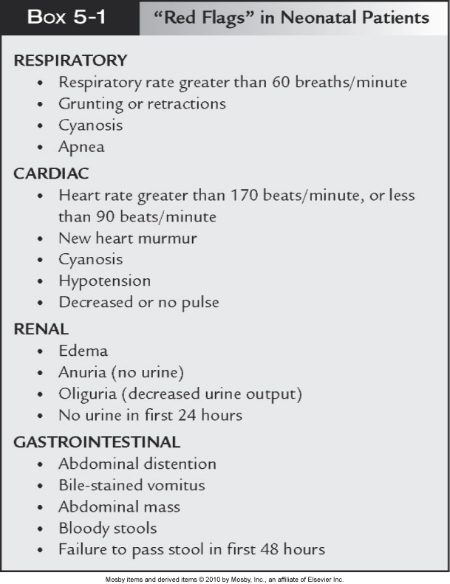

Slide 51
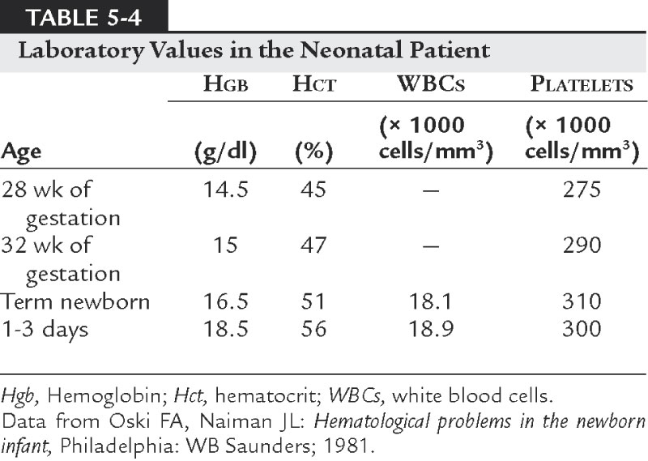
Laboratory Assessment

Slide 52
Laboratory Examination cont.
Electrolytes
Renal function
Calcium
Glucose
Bilirubin
Screening

