Slide 1
RET 203 LOG 1
Lung Development and Fetal Circulation
Notes:
Determining the due date
It's not always possible to determine the exact date of conception. Most due-date calculators are based on a gestational period of 40 weeks from the first day of a woman's Last Menstrual Period (LMP). This assumes a woman ovulates and conceives exactly two weeks after the first day of her LMP and carries the baby for 38 weeks. The problem is, of course, that this is an estimate, and 40 weeks is only an average term of pregnancy.
A normal pregnancy can last anywhere between 38 and 42 weeks. Many obstetricians will use what is called "Naegle's Rule" to determine the approximate due date.
Take the first day of your last period, count back three months, then add seven days. For example, a LMP of January 1, 2001 would give you an approximate due date of October 8, 2001 (an even 40 weeks ahead).

Slide 2
Does lung development end at birth?
What does an infant need to be able to do at birth?
What does lung development include?
50 - 250 million
3 m² - 70 m²

Slide 3
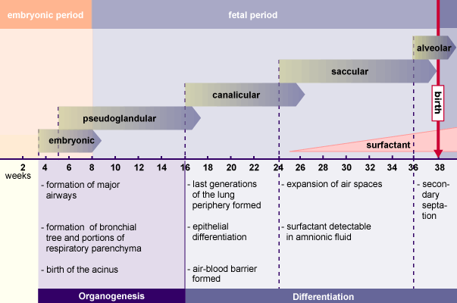

Slide 4
Embryonic Period
Generally regarded as the first 2 months of gestation
26 days – Lung bud emerges from the primordial pharyngeal tissue
Mainstem bronchi formed and the trachealbronchial tree emerges
Tracheoesophageal septum is formed
Lobar bronchi formed (Airway divides)
Segmental bronchi formed (Lung tissue develops)

Slide 5
Embryonic Period
Mesenchyme – (Embryonic connective tissue in the mesoderm) will develop into the pulmonary intersitium, smooth muscle, blood vessels, and cartilage
Week 7 – Complete development of the diaphragm
Pulmonary arteries form plexuses
Left and right pulmonary veins emerge

Slide 6
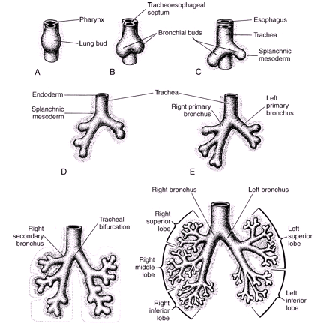
Embryonic Period

Slide 7
Pseudoglandular Period
Week 7 - 16
Type II Pneumocytes
Cilia – Epithelium of the trachea and mainstem bronchi
Goblet cells appear
Submucosal glands develop
Smooth muscle present in large bronchii
Conducting airways completed – Determines the airway pattern in the adult lung

Slide 8
Pseudoglandular Period
Respiratory bronchioles near completion with 16 generations developed
Pulmonary Acinii – Terminal respiratory units begin to develop
Immature cartilage development
Lymphatics rise from the hilum to the lung
Airways, arteries, and veins developed
Immune system – T lymphocytes by week 14

Slide 9
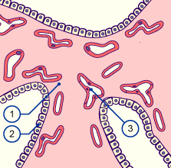
Pseudoglandular Period
1 – Type I pneumocytes
2 – Type II pneumocytes
3 – Capillaries
Notes:
1 – Pulmonary mesenchyme
2 – Type II pneumocytes
3 – Capillaries

Slide 10
Canalicular Period
Weeks 17 - 26
Formation of terminal bronchiole, alveolar ducts
Pulmonary capillary development begins
Type I and type II cells and immature surfactant present
Fetus potentially capable of gas exchange after 24 weeks’ gestation
Airways increase in length/diameter and end in blind pouches
Appearance of type I and II pneumocytes – Immature surfactant
Notes:
What are the minimal developmental features required for an immature human fetus to survive outside the uterus?
- Sufficient alveolar and vascular surface area for gas exchange.
- 22 to 24 weeks of gestation.
- Completion of the canalicular stage.

Slide 11
Canalicular Period
Pulmonary Acinar Units – Respiratory bronchiole, alveolar ducts, and alveolar sacs
Conducting airways now have smooth muscle
Air-blood barrier can support gas exchange
Epithelial cells – Produce fetal lung fluid
Notes:
What are the minimal developmental features required for an immature human fetus to survive outside the uterus?
- Sufficient alveolar and vascular surface area for gas exchange.
- 22 to 24 weeks of gestation.
- Completion of the canalicular stage.

Slide 12
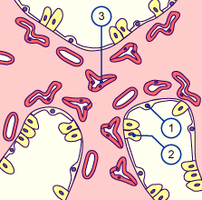
Canalicular Period
1 – Type I pneumocytes
2 – Type II pneumocytes
3 – Capillaries
Notes:
1 – Type I pneumocytes
2 – Type II pneumocytes
3 – Capillaries

Slide 13
Saccular Period
Weeks 27 - 36
Development of saccules (Primitive alveoli)
Mature surfactant present
Early alveoli development
Alveoli increase in size and number

Slide 14
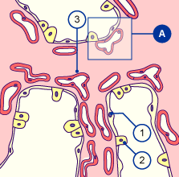
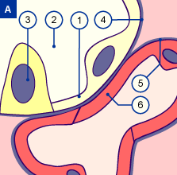
Saccular Period
1 – Type I pneumocytes
2 – Saccular space
3 – Type II pneumocytes
4 – Basal membrane air spaces
5 – Basal membrane capillaries
6 – Endothelium of the capillaries

Slide 15
Alveolar Period
Weeks 36 - 40
Rapid alveolar development
Efficient alveolar capillary membrane present
Pulmonary surfactant is produced in increasing amounts by type II alveolar cells
Notes:
Fetal lung fluid
The fetal lung has no respiratory function before birth; it is a secretory organ that produces approximately 250 to 350 mL of fluid per day. Throughout the gestation period, fluid is produced in the alveoli and continuously flows to the oropharynx, where it is swallowed or expelled into the amniotic fluid. The presence of this liquid maintains lung expansion and facilitates pulmonary growth. The stretch of alveoli by fetal lung fluid and the periodic distension provided by the action of fetal breathing movements appear to be necessary. The absence of lung fluid and breathing movements during fetal development results in an underdeveloped lung.

Slide 16
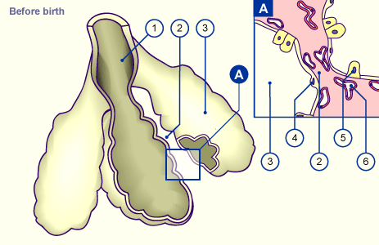
Alveolar Period
1 – Alveolar duct
2 – Primary septum
3 – Alveolar sac
4 – Type I pneumocytes
5 – Type II pneumocytes
6 – Capillaries

Slide 17
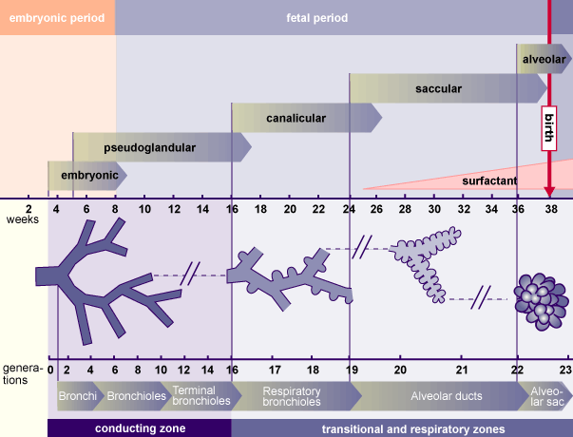
Fetal Lung Development

Slide 18
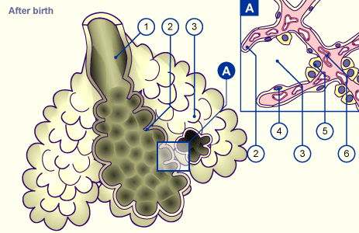
Postnatal Lung Growth
Birth - 8 years
Alveoli continue to increase in number and size, paralleled by arterial development
1 – Alveolar duct
2 – Primary septum
3 – Alveoli
4 – Type I pneumocytes
5 – Type II pneumocytes
6 – Capillaries

Slide 19
Postnatal Lung Growth
Air-blood interface and body surface area directly related
Alveolar volume and alveolar surface area directly related
Lung growth is in proportion to physical growth

Slide 20
The Placenta
The connection between the placenta and the uterus involves chorionic villi
  Villi are structures that increase surface area
  Abruptio placenta
    If the placenta separates from the uterine wall prior to delivery, then there is a great risk of hemorrhage to the fetus and mother
  Placenta previa
    The fertilized egg implants low in the uterus (near the uterine opening) – There will be no path of escape for the infant and a cesarean section is mandatory

Slide 21
Placenta
Umbilical cord
  The lifeline between mother and fetus
  Includes the umbilical vein and 2 arteries
  Vessels are surrounded by a thick gelatinous substance “Wharton’s jelly”
  The jelly prevents kinking and pinching off of the cord
Notes:
A tough gelatinous material called Wharton's jelly surrounds the umbilical vessels, preventing the cord from kinking and occluding blood flow to the fetus. After birth, the umbilical vessels remain open for a short time, allowing vascular access for fluid infusion and blood sampling.
Normal blood-gas values in a term fetus
Umbilical artery
PO₂ 19 mmHg
PCO₂ 47 mmHg
Ph 7.36
Umbilical vein
30
43
7.39

Slide 22
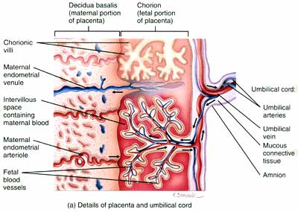

Slide 23
Placenta
Passive transfer of maternal/fetal
  Gas exchange
  Nutrients
  Waste
  Hormones
Notes:
The placenta is a highly vascular gas-exchange organ that provides a circulatory link between mother and embryo. The placenta is required for survival of the fetus. The fetus relies on maternal blood flow through the placenta for the exchange of nutrients and wastes, including oxygen delivery and carbon dioxide removal. The placenta separates the fetus from the endometrium (mucous membrane lining) of the uterus and consists of two compartments: (1) the fetal compartment, arising from the embryonic sac, and (2) the maternal compartment, derived from the endometrium.
The placenta transports nutrients and wastes between mother and fetus through the umbilical cord. Abruptio placentae, or premature detachment of the placenta from the uterine wall, is a medical emergency and may result in life-threatening maternal haemorrhage and fetal asphyxia.

Slide 24
Placenta – Blood Supply
  Maternal
      Uterine arteries
  Fetal vessels
      ONE umbilical vein (Oxygenated blood)
      UV PO ₂ = ~30 mmHg and PCO ₂ =~ 40 mmHg
      TWO umbilical arteries (De-oxygenated blood)
      UA PO ₂ = ~20 mmHg and PCO ₂ = ~55 mmHg
Notes:
The placenta is not a very efficient gas-exchange organ. The PO₂ of maternal blood in the intervillous spaces is about 50 mm Hg, but blood leaving the placenta through the umbilical vein to oxygenate the fetus has a PO₂ of only about 30 mm Hg. Fetal blood returning through the umbilical arteries to the placenta for reoxygenation has a PaO₂ of only about 19 mm Hg. Thus, the maximum PO₂ experienced by the fetus is about 30 mm Hg. The primary factor limiting oxygen transport to the fetus is blood flow. Any factor diminishing uterine or fetal blood flow results in fetal hypoxia and intrauterine growth retardation (IUGR). Severe reduction in fetal blood flow may result in fetal asphyxia and death.

Slide 25
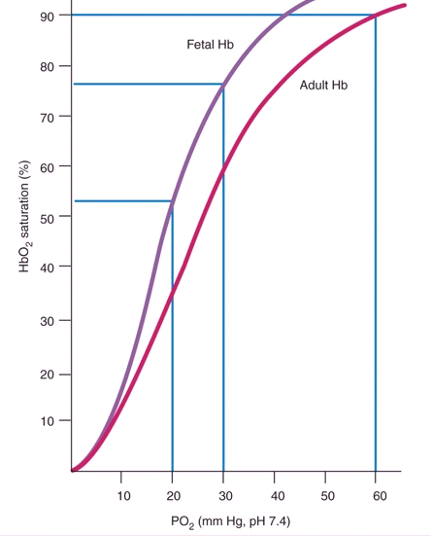
Left shift of the fetal oxyhemoglobin dissociation curve illustrating fetal hemoglobin's greater affinity for oxygen. Note that the fetus’ normal PO₂ of 30 mm Hg produces a saturation of about 78% (From Wilkins RL)
Notes:
Fetal haemoglobin (HbF) has a greater affinity for oxygen than adult haemoglobin. This increase in oxygen affinity is associated with a left shift of the fetal oxyhemoglobin dissociation curve, which means that oxygen binds more readily to HbF (but releases it less readily). Normal fetal Hgb is 16-19 g/100 mL
This facilitates the placental transfer of oxygen to fetal blood, allowing the fetus to survive in a relatively hypoxic environment. The maximum PO₂ of the fetus is only about 30 mm Hg, but this corresponds to a fetal saturation of 75% to 80% This relatively high saturation is possible because HbF has a strong affinity for oxygen, shifting the oxyhemoglobin dissociation curve to the left. Most HbF is replaced by adult Hb by 6 months of age.

Slide 26
Amniotic Fluid
Protects the fetus from trauma by cushioning any blows or impacts to the maternal abdomen and also allows the fetus to move freely, permitting fetal growth and development
Helps control the temperature of the fetus by maintaining a relatively constant thermal environment
Fluid is replenished by fetal urination and lung fluid
Notes:
During development, the fetus periodically exhibits shallow respiratory chest movements, or “fetal breathing.” This normal occurrence moves amniotic and fetal lung fluid into and out of the oropharynx. Vagal stimulation and hypoxic stress caused by cord compression may cause rectal sphincter muscles to relax, resulting in the release of meconium (fetal bowel contents) into the amniotic fluid. Deep gasping movements of the distressed fetus may cause amniotic fluid and meconium to be aspirated into the infant's lung. Meconium aspiration usually leads to respiratory distress after birth because of airway obstruction or chemical irritation. This is known as meconium aspiration syndrome.

Slide 27
Amniotic Fluid
Clear liquid produced by the fetal membranes inside the amnion (Sac that surround the fetus as it develops)
The fluid is continuously secreted and reabsorbed with a volume reaching approximately 1000 mL at full term
The fetus swallows this fluid (~500 ml/day), which is then absorbed by the respiratory and digestive tracts and excreted as urine (~ 500 ml/day)
Notes:
During development, the fetus periodically exhibits shallow respiratory chest movements or “fetal breathing.” This normal occurrence moves amniotic and fetal lung fluid into and out of the oropharynx. Vagal stimulation and hypoxic stress caused by cord compression may cause rectal sphincter muscles to relax, resulting in the release of meconium (fetal bowel contents) into the amniotic fluid. Deep gasping movements of the distressed fetus may cause amniotic fluid and meconium to be aspirated into the infant's lung. Meconium aspiration usually leads to respiratory distress after birth because of airway obstruction or chemical irritation. This is known as meconium aspiration syndrome.

Slide 28
Polyhydramnios
An excessive amount of amniotic fluid occurs when the fetus does not swallow and absorb the usual amount of amniotic fluid
The most common cause of polyhydramnios is a birth defect of the central nervous system or gastrointestinal tract resulting in a fetal swallowing dysfunction
A complication associated with polyhydramnios is premature rupture of amniotic membranes, which may lead to premature delivery

Slide 29
Oligohydramnios
Oligohydramnios, or too little amniotic fluid, results from prematurely ruptured membranes, placental dysfunction, or fetal abnormalities such as renal agenesis (failure of the kidneys to form)
The absence of fetal urine as a component of amniotic fluid is the most common cause of oligohydramnios
Complications for the fetus with oligohydramnios include asphyxia, secondary to umbilical cord compression, and skeletal deformities caused by uterine wall compression of the fetus

Slide 30
Key Pulmonary Requirements for Extra-Uterine Life
Pulmonary vasculature must be sufficient enough to permit transport of O₂ and CO₂ to and from the lung
Gas exchange surface must be structurally stable, functional, and elastic to require minimal effort for ventilation and response to metabolic needs
Structural maturation of the airways, chest wall, respiratory muscles, and neural control is fundamentally required

Slide 31
Key Pulmonary Requirements for Extra-Uterine Life
Pulmonary vasculature must be sufficient to permit transport of gas exchange of O₂ and CO₂
Exchange surface must be structurally stable, functional, and elastic to require minimal effort for ventilation and response to metabolic needs
Structural maturation of the airways, chest wall, respiratory muscles, and neural control is fundamentally required

Slide 32
Fetal Lung Fluid
Fetal breathing
  Results in egress of fluid from lung at a predictable rate
  Ensures that lung volumes stay about 30 mls/kg (Equivalent to FRC)
  Excessive egress results in pulmonary hypoplasia
  Inadequate egress results in pulmonary hyperplasia

Slide 33
Fetal Lung Fluid
Surfactant
  Assessment of fetal surfactant is possible; however, use of a standard test (L/S ratio) is in decline
  First, the standard!
    L = Lecithin, which is a phospholid, (phosphitadyl choline)
    S = Sphyngomyelin, a long-chain lipid that is a non-pulmonary lipid but exists in a relatively stable concentration

Slide 34
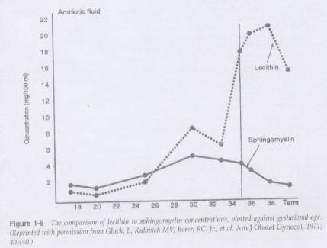
L/S Ratio
Notes:
We see the relatively static value of the sphingomyelin, and more importantly we see the elevation in lecithin that occurs around 33 - 35 weeks as the type II pneomocytes really start doing their job.
If we calculated this ratio on the dotted line, we would get:
Lecithin = 18 = 4.5
Sphingo= 4
Dr. Gluck et al. first published this method to become routine practice in 1971 (work done in the Am J Ob/Gyn).

Slide 35
L/S Ratio
Clinical significance
  >2.0 indicates lung maturity and no RDS in 98% of patients
  1.5 - 1.9 indicates increased risk of RDS in 50% of population
  <1.5 = 73% risk of RDS
  IDM (Infant of a Diabetic Mother) can develop RDS with an L/S ratio >2.0
Indication for test includes
  Prem labour, prom, etc. where early delivery is possible
Notes:
There is also a risk of false positive in the case of meconium in the amniotic fluid.
The information is used to decide whether to tocolyze or deliver or give dexamethosone if delivery is imminent.
Prophylactic surfactant is administered after a period of stabilization in the first 15 minutes of life, compared with 1.5 to 7.4 hours in the rescue group. The use of prophylactic surfactant compared with rescue treatment has been shown to decrease the risk for mortality, pneumothorax, and pulmonary interstitial emphysema. Studies also demonstrated decreased neonatal mortality as well as a trend toward decreased IVH. Although evidence is strong for the use of prophylactic surfactant, the majority of studies enrolled infants with less than 30 weeks of gestation. Therefore, there is some debate as to whether a lower threshold for prophylaxis (e.g. <750 g, <1000 g, or <28 to 29 weeks’ gestation) would define a higher-risk group and avoid unnecessary prophylaxis of more mature infants. In addition, in these studies, lower rates of antenatal steroid use were reported and this may have affected the rates of RDS, air leak, IVH, and mortality.

Slide 36
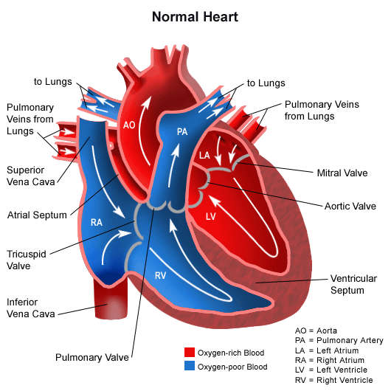
Fetal Circulation

Slide 37
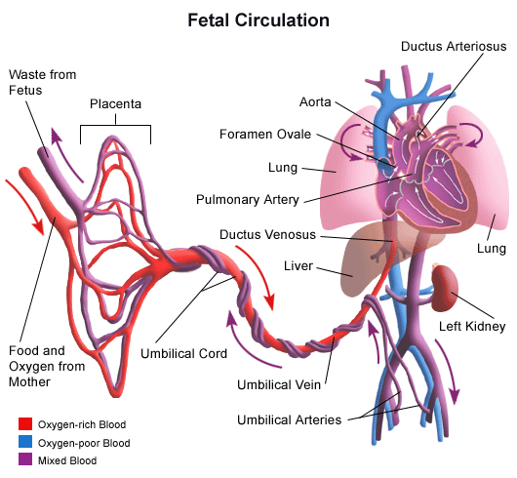
Fetal Circulation

Slide 38
Fetal Circulation
  Blood travels from the placenta through the umbilical cord via the Umbilical Vein (UV) to the fetus
    This blood is effectively the baby’s arterial blood in that it is oxygen- and nutrient-rich and scrubbed of waste metabolites and carbon dioxide
    This vessel is used after delivery as a site for venous access and delivery of medications and volume expanders
  The UV enters the liver, where about ½ of the flow supplies the organ and the other ½ flows through the ductus venosus to the inferior vena cava

Slide 39
Fetal Circulation
After entering the inferior vena cava, blood mixes in the right atrium with blood from the superior vena cava (Deoxygenated blood)
Most of the blood then flows through the Foramen Ovale into the left atrium
A small amount (~10-15%) of additional deoxygenated blood from the pulmonary veins enters the left atrium, further decreasing the overall saturation before being pumped out of the left ventricle to provide systemic perfusion

Slide 40
Fetal Circulation
The blood that is not involved in this normally occurring shunt enters the right ventricle, where it is pumped into the pulmonary artery. Of this, only about 10 - 15% actually passes through the lung, and the rest is shunted through the ductus arteriosis into the aorta.

Slide 41
Transition from Fetal Circulation
At birth, several changes are required to support extra-uterine life
  Fluid-filled lungs air-aerated by the removal of fetal lung fluid by the pulmonary circulation and lymphatics, and squeezing during delivery
  With the aid of surfactant to maintain some FRC, pulmonary gas exchange results in elevated PO₂’s (must be at least 45-50 mmHg). This causes vasodilation of the pulmonary circulation and constriction of the ductus arteriosis.
    Blood from the right heart now follows the normal adult course through the lungs

Slide 42
Transition from Fetal Circulation
The consequent fall in right atrial pressures causes the pressure gradient across the foramen ovale to reverse
  Functional closure within hours
  ~20% of adults have some degree of patent foramen ovale that is generally of no consequence
Removal of blood flow through the ductus venosus as the placenta is removed from the equation results in rapid closure of this vessel
The closure of the ductus venosus and loss of the placenta results in an increase in SVR

Slide 43
Fetal Circulation

Slide 44
Transition from Fetal Circulation
As the placenta dramatically ceases to function, pH and PO₂ fall and PCO₂ rises. The exact mechanism is unknown, however the central and peripheral chemoreceptors acutely increase in sensitivity, and a stimulus to take the first breath is triggered
The increase in PO₂ causes dilation of the pulmonary vascular bed, resulting in a reduction in PVR
SVR is now greater than PVR, and right to left shunting is decreased

Slide 45
Fetal Circulation – Shunts
Ductus Venosus
  Becomes the Ligamentum Venosum – A fibrous cord in the liver
Foramen Ovale
  Becomes a depression in the atrial septum called the Fossa Ovalis
Ductus Arteriosis
  Atrophies into the Ligamentum Arteriosum, a fibrous cord between the PA and aorta
  Occurs between 24 hrs - 2 weeks’ postpartum

Slide 46
Postpartum Circulation
Blood flow through the foramen ovale and the ductus arteriosus is dependent on the balance between PVR and SVR
This balance can be greatly affected by the presence of congenital heart defects
These CHDs can be classified as either
  Cyanotic – Right to left shunting
  Acyanotic – Left to right shunting

Slide 47
Fetal Blood Gases
Umbilical vein PO₂ = 29 mm Hg , saturation=80%
Umbilical arteries PO₂ = 17 mm Hg
* Maternal PO₂ = 80 - 100
* Sufficient oxygenation occurs in the fetus
* A decrease in PO₂ between mother and fetus is due to
Varying thickness of the placental (Diffusion is limited)
Uneven distribution of maternal blood flow
(Spurting of maternal blood)
  Oxygen consumption of the placenta

