Slide 1
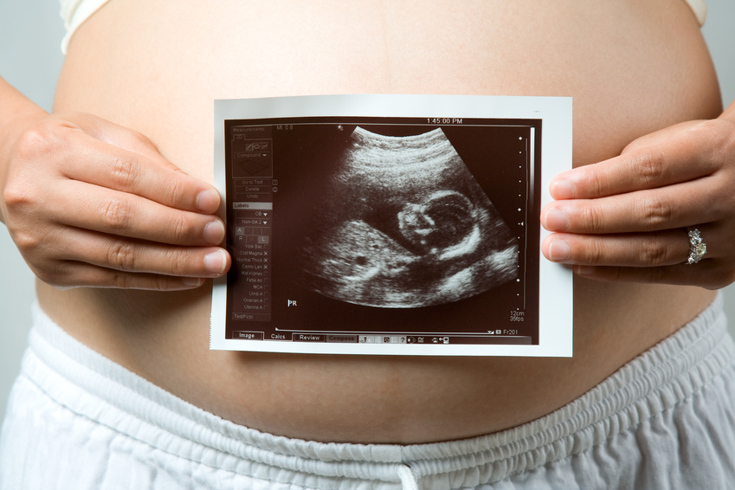
Prenatal and Perinatal History
LOG #2
Notes:
The newborn's history begins with the mother's history. Was the mother healthy before she was pregnant? Does she have chronic diseases? Is she taking medications or illicit drugs? For example, infants born to mothers with diabetes mellitus often are maturationally delayed and may be susceptible to diseases of prematurity such as Respiratory Distress Syndrome (RDS). Conversely, infants born to mothers who have chronic hypertension may be maturationally advanced for their gestational age.
The mother's previous pregnancy history can give the historian valuable information. Obstetricians note this information in the mother's medical record using the terms gravida, para, and abortion. Gravida is a pregnant woman, para is a woman who delivers a live infant, and abortion is the delivering of a dead infant. These terms will most likely be abbreviated and followed by numbers (e.g. G2, P1, Ab0, which means this woman is in her second pregnancy, has delivered a living infant, and has not had any abortions). Abortions can be further subdivided into therapeutic and spontaneous; these are frequently abbreviated as TAb and SAb, respectively. If the mother has had multiple pregnancies that have ended with spontaneous abortions rather than living infants, there is the possibility of chromosomal or metabolic disease that can have serious consequences for the current pregnancy or the mother may have an incompetent cervix that is associated with chronic preterm deliveries. If the mother has had multiple pregnancies that have ended with therapeutic abortions, the historian should think about the possibility of maternal drug abuse. Finally, for a mother who has had multiple pregnancies that have ended with the delivery of living children, the historian should inquire about the perinatal health of those children because severity of diseases tends to be similar in families.

Slide 2
Learning objectives for LOG 2
After completing this LOG, you should be able to
Describe the factors that lead to classification of a high-risk mother/delivery
Describe various methods of fetal assessment and monitoring
Describe the process of labour and delivery
Prior to any delivery, it is imperative to identify those mothers and fetuses which are at a higher risk. By doing this, you can then be prepared for any treatment modality required. This module will guide students to explore the delivery process, methods of assessing the mother and fetus, as well as the potential complications of being ‘high-risk’.

Slide 3

High-Risk Pregnancy
Notes:
Pages 31-71 from Whitaker
Maternal mortality is 6 in 100,000 births
Most perinatal deaths:
-Congenital anomalies
-Prematurity
-Multiple births
-Pre-eclampsia, eclampsia

Slide 4
High-Risk Pregnancy
Prenatal history
    1. Socioeconomic and demographic factors
      Mother’s age
      Income
      Nutritional status
Notes:
Mom’s age less than 15 or over 40 (Depends on current health) – Age can affect risk of pre-eclampsia and SGA.
Income may result in lack of prenatal care and monitoring.
Nutrition – low Ca, folic acid.
Weight below 100 lb or less than 5 feet tall.
Maternal obesity has an increase risk of diabetes and hypertension.

Slide 5
2. Obstetrical History
Previous pregnancies – Anything pertinent to previous pregnancies
  Miscarriages
  Multiple births
  Fetal/neonatal mortality
  Dystocia
Notes:
Gravida/Para/Abortus (GPA), or sometimes just Gravida/Para (GP), is a shorthand notation for a woman's obstetric history.
Gravida indicates the total number of times a woman has been pregnant, regardless of whether these pregnancies were carried to term. A current pregnancy, if any, is included in this count. Para indicates the number of viable (>20 wks) births. Pregnancies consisting of multiples, such as twins or triplets, count as ONE birth for the purpose of this notation. Abortus is the number of pregnancies that were lost for any reason, including induced abortions or miscarriages. The abortus term is sometimes dropped when no pregnancies have been lost.
Therefore, the history of a woman who has had two pregnancies (both of which resulted in live births) would be noted as G₂P₂. A woman who had 4 pregnancies, one of which was miscarried, is noted as G₄P₃A₁.
Ectopic (Fertilized egg implanted outside of uterine wall): 1 in 60 reoccur or end in spont. abortion.
Multiple (5 or more) – Postpartum hemorrhage and decreased uterine tone.
Cervix (Narrow canal at bottom) of uterus opening into birth canal – Incompetent cervix can cause painful dilation and in 2 - 3rd trimester, may result in prolapse of membranes into vagina. Premature delivery. Will then need a cervical suture to hold canal together.
Dystocia means a difficult birth – May then need C-section.

Slide 6
3. Maternal Medical History
Cardiac/pulmonary disease
Diabetes (Pregestational)
    Normal endogenous production of insulin increases by 30%
    Associated with
      Prematurity
      Congenital anomalies
      Stillbirth
      Mild diabetes
        Macrosomic (large) infants and delayed lung maturation
Notes:
Increase insulin in fetus due to hyperglycemia causes a decreased surfactant production.
Diabetic moms need close monitoring of glycemic levels.
Also need lots of counselling/monitoring on diet etc. and increase u/s for fetal monitoring.

Slide 7
Maternal Medical History
Hypertension
Infection (E.g. Rubella, ‘German Measles’)
Increase risks of
  Miscarriage
  Congenital heart defects
  Stillbirth
  Cataracts
  Prematurity
  Mental retardation
  IUGR
  Deafness
Notes:
Group B streptococcus (10 - 40%) are colonized – Vaginal swab done at 35-37 wks – If +ve, then Tx with antibiotics.
Hepatitis B – If tx with immunoglobulin and immunized – 95% are not infected.
HIV – C-section and no breastfeeding.
Mental retardation and deafness can happen with rubella.
Rubella, if present for mom ~5 months gestation, means there can be increased congenital abnormalities.

Slide 8
Infection
T – Toxoplasmosis
O – Other
R – Rubella
C – Cytomegalovirus
H – Herpes virus
Notes:
T – Contracted by mother via cat feces or from raw meat. Infects fetus via placenta.
C – (CMV) – Member of the herpes family. Transferred via placenta. Devastating to fetal development early on but has no effects on neonate (++issues and hearing loss).
H – Usually type II. Can infect baby so usually a C-section is scheduled because contact with infected maternal tissues during vaginal delivery
has very serious complications and a high mortality rate.
O – Syphilis, HIV, Hep B.
Rubella (German measles).

Slide 9
4. Current Obstetric Status
Absence of prenatal care
Anomalies of the reproductive tract
Notes:
Cervical insufficiency – May need cervical sutures to hold canal together.

Slide 10
5. Placental Problems
Increases incidence of premature labour and early separation from the placenta
Early separation reduces fetal/maternal gas exchange and may result in fetal asphyxia
Notes:
Placenta should implant in upper ½ of uterine wall.

Slide 11
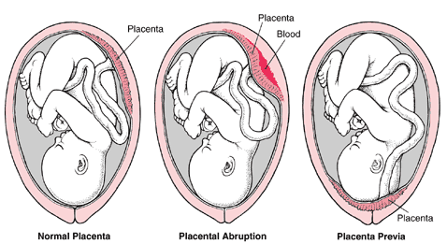

Slide 12
Placenta Previa
Abnormal implantation of the placenta in the lower wall of the uterus
Can be diagnosed by ultrasound
Obstruction to fetal passage
Notes:
Three types
Low implantation
Partial previa
Total previa
Increase risk for this with increased maternal age, muliparity, multi gest. or prior C-sec.

Slide 13
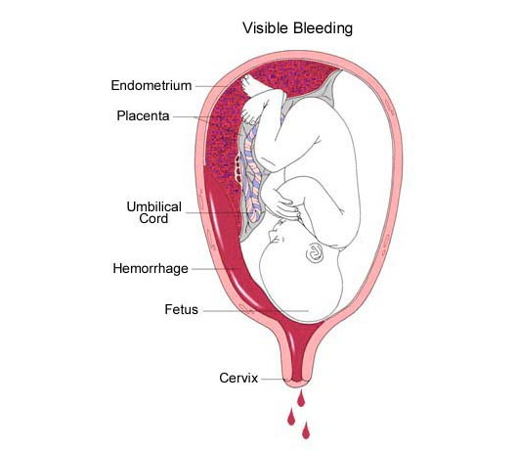
Abruptio Placenta
Premature detachment of the placenta
Notes:
Most common cause is hypertension, which includes pre-eclampsia.
Grade 0 - 3 – Hemorrage, anemia, shock
Monitor fluid and blood vol.
Frequently causes prem labour to begin.
50% fetal mortality due to acute blood loss.
3 types
Partial separation (Concealed hem.)
Partial separation (External hem.)
Complete sep.
Increased risk with maternal hypertension, mulitparity, PROM, trauma, substance abuse, uterine tumour.

Slide 14
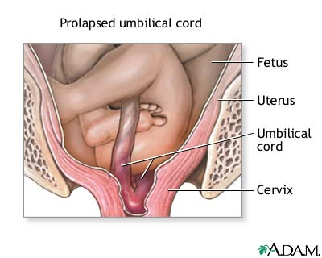
Prolapse of the Umbilical cord
Premature expulsion of the cord before the infant is delivered
Notes:
Common in breech.
Problem occurs as fetus passes through birth canal and compresses the cord – This leads to hypoxia and eventual asphyxia and requires immediate intervention.
Tx – Amnioinfusion, so there is incr. room for fetus and therefore decr. chances of compression.

Slide 15
6. Amniotic Fluid Imbalance
Polyhydramnious
  > 2 litres of amniotic fluid, associated with impaired fetal swallowing (Caused by fetal malformations)
  Associated with
      Premature labour
      Placental abruptio
      Perinatal mortality
      PROM – Overdistends uterus and increases chance of cord prolapse
Notes:
Amniotic fluid is derived from fetal membranes that compose the amniotic sac. Later, the majority of product is fetal urination.
Fetal lungs help circulate fluid and fetal swallowing is an important mechanism of amniotic fluid absorption.
Polyhydramnios: Common cause is orogastric malformations and CNS malformations.
Also higher risk of happening with maternal diabetes.

Slide 16
      Treatment
      Multiple amniocentesis
      Prostaglandin synthesis inhibitors (Decrease amniotic fluid and act as a diuretic)

Slide 17
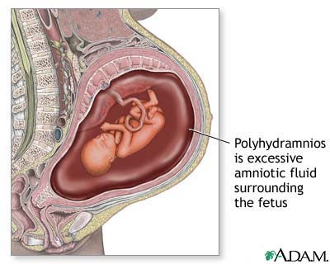

Slide 18
Amniotic Fluid Balance
Oligohydramnious
  Deficiency in the amount of AF <300mls
  Associated with
  -PROM
  -Post-term
  -Uteroplacental insufficiency
  -Use of prostoglandin inhibitors
  Potential consequences
  -Fetal deformities
  -Umbilical cord compression
  -Meconium passage
  -Fetal demise
  -Early in pregnancy, can cause underdeveloped lungs and limb
  deformities
  Treatment – Amnioinfusion
Notes:
Fetal mortality – renal agenisis – potters syndrome – urinary tract obstruction.

Slide 19
7. Pregnancy Induced Hypertension (PIH)
BP ≥ 140mmHg or ≥ 90 mmHg after 20 wks’ gestation
OR
Rise of 30 mmHg systolic or 15 diastolic from prepregnant or 2nd trimester measurements of BP

Slide 20
Pregnancy Induced Hypertension
Pre-Eclampsia – Hypertension plus proteinuria, edema, or both
Severe Pre-Eclampsia – BP ≥160/110 plus proteinuria and edema
Eclampsia – Hypertension plus seizures or coma related to underlying neurologic conditions
Notes:
Pre eclampsia – 5 - 8% of preg.
Re occurance ~ 25 %
Predisposing factors: First preg (nulliparity), older mom, chronic hypertension, renal disease, diabetes mellitus, and more factors.
Severe pre:
-IUGR ; oliguria (decr. urine output); headache; abd. Pain; liver dysfunction.
Eclampsia – Can lead to grand mal seizures.
Magnesium sulfate given to prevent seizures.
Antihypertensive meds given.

Slide 21
8. Premature Rupture of Membranes (PROM)
If rupture occurs more than 24 hours prior to delivery
More common with prematurity
↑ risk of fetal infection
Decreases amniotic fluid and increases compression on cord
Notes:
When ‘water’ breaks, delivery should occur within 24 hours.

Slide 22
9. RH Isoimmunization or Erythroblastosis Fetalis
A type of hemolytic anemia; results form fetal-maternal blood group incompatibility
Rh factor when mother’s Rh is negative and infant is Rh positive
Isoimmunization occurs after the first pregnancy
May result in jaundice and severe anemia

Slide 23
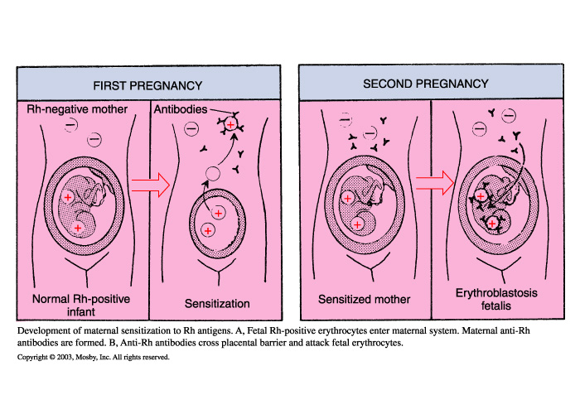

Slide 24
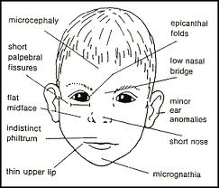
10. Habits
Smoking
Alcohol intake
Drug use and abuse
Notes:
Smoking: CO and nicotine – Decrease availability of O₂ to fetus/placenta.
Associated with lower birth weight babies.
Increase risk of PROM/placental abruption/ previa and SIDS.
Alcohol: Teratogen – Fetal alcohol syndrome (Mental retardation, growth restrictions, brain/cardiac/spinal and craniofacial anomalies) ~4-6 drinks/day for this to occur.
- ~10% of preg. mothers have substance abuse.
Cocaine – Many problems.

Slide 25
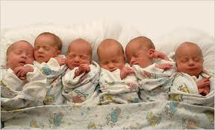
11. Multiple Gestation
Twins/triplets
IUGR
Congenital anomalies
Notes:
Prematurity and IUGR twice as common than singlets.
Increased incidence of problems with placenta and decreased room in uterus.

Slide 26
12. Postmaturity
Placental function declines
Greater than 42 weeks’ gestation
Can cause maternal and fetal issues
SGA, signs of wasting (placenta not able to supply nutrients, fetus can lose weight)
Intra-uterine asphyxia, ?death
Presentation
  Dry, cracked skin; long nails; excessive hair
  Meconium staining
May require induction or caesarean section
Notes:
Unknown cause, but perhaps decreased prostoglandin production or problems with cervix.
Maternal issues: Increased size of baby, trauma to mom during delivery.
Asphyxia from cord compression (decrease fluid) and placental fx.

Slide 27
13. Uteroplacental Insufficiency
May result from PIH
May occur with post maturity
Inadequate blood flow to the placenta
Should be suspected with the 3rd trimester – bleeding or oligohydromnios
May cause IUGR, chronic intrauterine asphyxia, meconium aspiration
Assessment of placental function
Fetal Heart Rate (FHR) monitoring
L/S ratio (Sample by amniocentesis)
*Urinary estriol level are not done anymore

Slide 28
14. Gestational Diabetes Mellitus (GDM)
Screened for at 24 - 28 weeks’ gestation with glucose challenge test
Abnormal glucose tolerance that is first recognized during pregnancy (3%)
Poor blood sugar control will lead to macrosomia
(Birth weight > 4000g)
With proper maternal glycemic control, pregnancies can proceed to full term and have normal deliveries
Notes:
1st test 1hour post-100 g oral glucose drink being ingested (glucose challenge test). If mother fails this, then she needs a 3-hour glucose tolerance test.
Macrosomnia can lead to a traumatic vaginal delivery due to size of baby. Another term is LGA (Large for Gestational Age).
After birth, infants born to moms with poorly controlled diabetes have increased risk of metabolic problems like hypoglycemiz and idiopathic respiratory distress syndrome.
Long-term, ~50% of moms with GDM will be Dx with type II diabetes within 10 years.

Slide 30
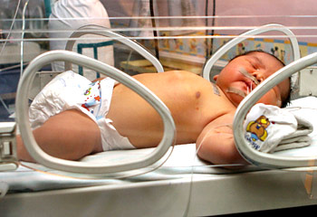
Macrosomic infant. Excess of fat and organomegaly (liver and heart).

Slide 31
Consequences of Increased Fetal Risk
Prematurity (<37 weeks’ gestation)
Highest infant mortality rate
Premature respiratory and digestive systems
Problems with thermoregulation and defense system
Poor tissue perfusion, ↑ incidence of intraventricular hemorrhage (brain)
Most common disorders
  a. HMD (Hyaline Membrane Disease)
  b. Asphyxia
  c. Infection
Notes:
Some of the tocolytics used are as follows.
Most commonly used
•Magnesium sulfate
•β-Mimetic agents
•Indomethacin (a prostaglandin inhibitor)
Less commonly used
•Nifedipine (calcium channel blocker)
•Nitroglycerin (nitric oxide donor drug)
•Atosiban (oxytocin antagonist)
•Combination therapy
All women between 24 and 34 weeks of gestation with preterm labour and intact membranes are candidates for antenatal corticosteroid therapy. Patients with preterm labour and ruptured membranes benefit from corticosteroid therapy between 24 and 32 weeks of gestation. Betamethasone and dexamethasone are most commonly used for antenatal corticosteroid therapy. Maximal benefit occurs 48 hours after initiation of therapy and lasts for 7 days. Corticosteroids reduce respiratory distress syndrome and neonatal morbidity by 50%. This effect is due to induction of proteins that regulate the production of surfactant by type II cells in the fetal lungs. Corticosteroids also decrease the incidence of intracranial hemorrhage, probably by promoting maturation of the germinal matrix in the fetal brain. Repeat corticosteroid courses should not be used routinely because of the possible risk of adverse neurodevelopmental outcome.

Slide 32
Asphyxia
Impaired maternal blood flow to the placenta
Hypoxia, hypercarbia, and both resp. and met. acidosis
IUGR
Diminished blood flow
Chronically hypoxic in-utero
Mec aspiration
Asphyxia
Mortality is higher in low birth wt vs. IUGR

Slide 33
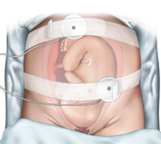
Fetal Assessment

Slide 34
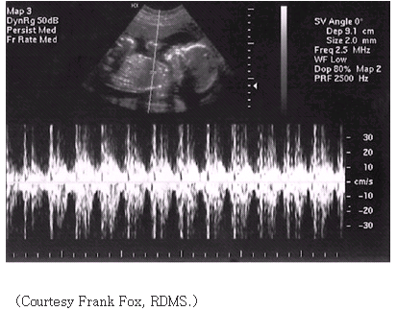
Ultrasound
Uses sound wave to produce still or moving images (real-time)
Rapid sequence of images, impression of movement
Over abdomen or transvaginally with a transducer
Can be used early on in pregnancy
Notes:
Pages 31 - 46 in Whitaker.
Pages 12-14 in LOG 2
u/s – As sound waves come in contact with different density tissues, some are absorbed and others are reflected to a transducer. The reflected waves are converted to a screen image.
Hltrahigh-frequency sound waves to obtain real-time images, and with transabdominal or transvaginal transducers the clinician can diagnose multifetal pregnancy and evaluate fetal anatomy, growth, and position. One can also localize the placenta within the uterus, measure amniotic fluid volume, estimate fetal growth over time, and assess fetal biophysical status. In addition, Doppler flow studies measure blood flow to fetal organs. This measurement permits early identification of fetuses at risk, enabling opportune delivery or transport to sophisticated perinatal centres. Ultrasonography is also invaluable for guiding the physician while performing amniocentesis, umbilical blood sampling, and other invasive procedures.
Three-dimensional ultrasound imaging has been introduced to the obstetrics field. It offers better visualization of fetal organs (especially the face, heart, and spine) than the conventional two-dimensional ultrasound imaging. Outcome studies are underway, accompanied by an increase in the use of three-dimensional ultrasound imaging among obstetricians and maternal fetal specialists.

Slide 35
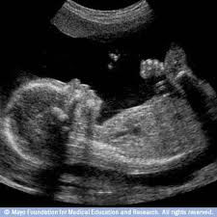
Ultrasound Uses
Validates pregnancy (in the 1st trimester) if used very early on
Assesses fetal growth (in the 3rd trimester) by the measurement of organs (Week 12 crown rump) – Gold standard to assess fetal age/growth
Assess multiple gestation
Assess fetal position
Localize the placenta
Assess congenital anomalies
Amniotic fluid levels
Fetal death
Check for heart rate and respiratory effort
Also to detect for incomplete miscarriage or ectopic pregnancy

Slide 36
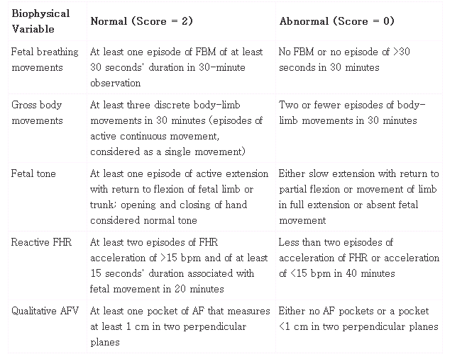
Notes:
Biophysical profile scoring system.
More recently, the so-called fetal Biophysical Profile (BPP) has gained popularity as a tool to assess placental function and fetal well-being.
The BPP has been likened to the Apgar score. Five determinants of fetal status are assessed and given a score of 0 to 2. The four assessed by ultrasonography are fetal breathing, fetal tone, fetal gross body movement, and amniotic fluid volume. The fifth determinant is the NST. A BPP score of 8 to 10 is considered normal and reassuring; a score of 6 is equivocal and is generally repeated within 24 hours; BPP scores of 0 to 4 are clearly abnormal and are associated with poor perinatal outcomes.

Slide 37
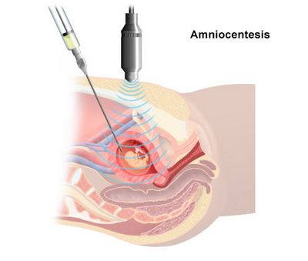
3. Amniocentesis
Done in conjunction with ultrasound
Performed ~18 weeks gestation
Uses
  Lung maturity L/S ratio
  Genetic disorders alphafetoprotein
  Rh – Incompatibility bilirubin
  Renal maturity creatinine

Slide 38
4. Chorionic Villus Sampling
Performed at ~ 12 weeks’ gestation
Alternative to amnio
Obtain placental tissue for prenatal assessment (Sample of chorionic villus)
With ultrasound, a catheter is inserted through the cervix and directed to the placenta
Tissue aspirated
Uses
Chromasomal defects (More accurate than amnio)
Risky – So early in gestation, can affect placental function
Cannot detect neural tube defects

Slide 39
Fetal monitoring
During labour and delivery or intrapartum
Fetal Heart Monitoring (FHR)
Before the rupture of membranes
External monitor is used
After the rupture of membranes
Direct (usually the scalp) monitoring
Heart rate and uterine contractions’ intensity, timing, and duration
Notes:
Fetal well-being is highly dependent on placental function. Assessment of placental function is commonly done by monitoring the Fetal Heart Rate (FHR) response when the fetus moves spontaneously (Nonstress Test [NST]) or in reaction to induced uterine contractions (Contraction Stress Test [CST]). For both tests, the FHR is monitored continuously. In the normally oxygenated fetus (as with a child or adult), cardiac output rises to support physical activity. This rise in cardiac output can be mediated by an increase in either heart rate or stroke volume. In the fetus, cardiac output rises by increasing the heart rate.
A reactive NST requires at least two accelerations in fetal heart rate, each of at least 15 beats per minute and lasting at least 15 seconds, associated with maternal perception of fetal movement over a period of 20 minutes. A reactive NST is highly correlated with normal uteroplacental function. If no change in maternal clinical status transpires, this result predicts normal fetal survival when this test is performed within 1 week of delivery.

Slide 40
Establish a baseline
Normal is 120 - 160 bpm early in gestation 140 bpm
↓ or ↑ 20 - 30 bpm
Bradycardia < 100 bpm most dangerous, cause asphyxia check scalp PH
Tachycardia > 180 bpm
Accelerations >160 bpm meds (sympathomemetics) and decelerations <120 bpm are measured
Three significant decelerations are
  Early Type I
  Late Type II
  Variable Type III
Notes:
Fetal Biophysical Profile
The so-called fetal Biophysical Profile (BPP) assesses placental function and fetal well-being. The BPP has been likened to the Apgar score (a quick method to assess the health of a newborn baby, based on the scoring of five factors.) In producing a BPP, five determinants of fetal status are assessed and given a score of 0 to 2. Four are assessed by ultrasonography; they include fetal breathing, fetal tone, fetal gross body movement, and amniotic fluid volume. The fifth determinant is the NST (Non-Stress-Test). A BPP score of 8 to 10 is considered normal and reassuring; a score of 6 is equivocal and is generally repeated within 24 hours; BPP scores of 0 to 4 are clearly abnormal and are associated with poor perinatal outcomes and require careful evaluation and usually immediate delivery.

Slide 41
Early decelerations (type I)
FHR ↓’s (60 - 80) At the same time, uterine contractions occur and return to normal (120 - 160 beats/minute) caused by the compression of the fetal head against the cervix
Normal

Slide 42
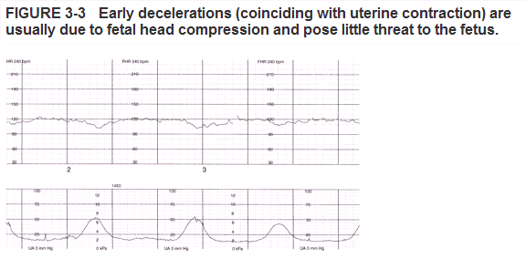

Slide 43
Late deceleration (type II)
FHR ↓’s after the onset of a contraction and returns to normal after the contraction has ended
Impaired maternal blood flow to the placenta
↓
UPI associated with fetal asphyxia and low Apgar scores
O₂ may help; attention to maternal hemodynamic status

Slide 44
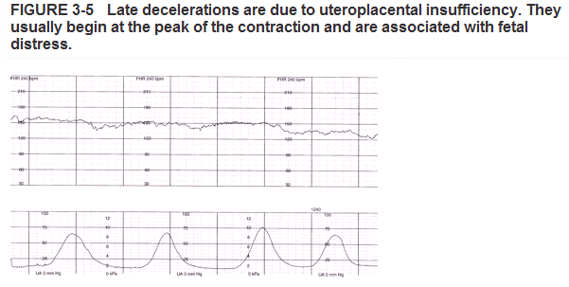

Slide 45
Variable decelerations (type III)
No relationship between FHR and contractions
Most common deceleration pattern caused by compression of the cord by fetal parts
Most fetuses can tolerate short periods of cord compression, longer = asphyxia

Slide 46
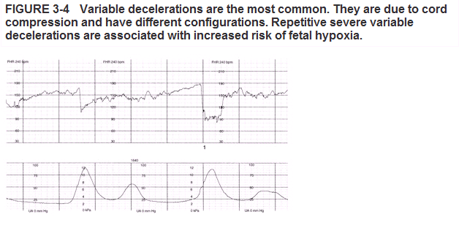

Slide 47
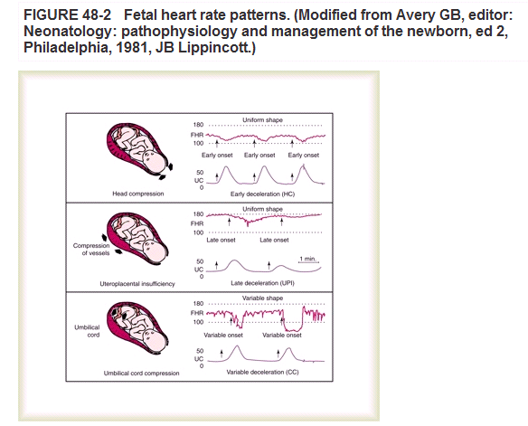

Slide 48
Fetal scalp monitoring
Analysis of fetal capillary blood (Usually the scalp)
Used to determine fetal well-being
pH=7.35 beginning of labour
pH=7.25 second stage of labour normal
pH= 7.2-7.24 slight asphyxia
pH<7.20= fetal distress ++ severe asphyxia
Notes:
TABLE 3-2 Normal Values for Fetal Scalp Blood and Umbilical Cord Blood Gases
Fetal scalp during labour.
Umbilical cord at birth.
Arterial sample after birth.
First-stage labour.
Second-stage labour.
Umbilical artery.
Umbilical vein.

Slide 49
Two types of situations
Interference of placental blood flow (respiratory acidosis)
If interference is prolonged (lactic acidosis)
*Fetal scalp blood sampling reserved for cases when the fetus has demonstrated distress, late decelerations, or is known to be at high risk for asphyxia

Slide 50
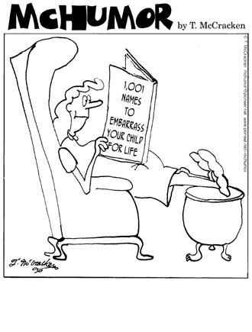
Labour and Delivery
Notes:
Pages 54-71
Another term is parturition

Slide 51
Five Events
Membranes rupture
Dilatation of the cervix
Contraction of the uterus
Placental separation
Shrinking of the uterus
Notes:
That encompass the birthing process.
Water breaks – Uterine contractions start shortly.
Dilation (2 until 10 cm).
Regular contractions 5 - 10 minutes apart.

Slide 52
L&D Introduction
Labour occurs as a result of placental and fetal hormones
  Progesterone decreases
  Estrogen increases
  Oxytocin stimulates uterine contractions
  Relaxin ↑’s the flexibility of the pubic symphysis

Slide 53
True Labour
Regular intervals, produces pain
Localized back pain that intensifies with walking
Reliable indicator is dilatation of the cervix and the “show” (blood containing mucous)

Slide 54
False Labour or Braxton Hicks
Pain is felt in abdomen and is irregular
Does not intensify with walking; no show and no dilatation

Slide 55
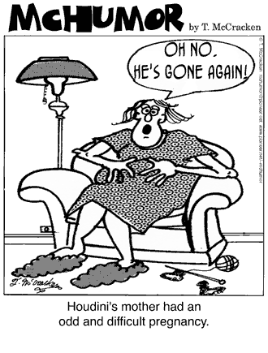
The Three Stages of Labour

Slide 56
Stage One – Dilatation
Onset of labour to complete dilation of the cervix
Thinning of cervix (effacement) %
Contractions 10 - 15 mins. apart, lasting 30 - 90 secs.
Amniotic sac ruptures
Regular contractions
16 - 18 hrs. (primagravida) 7 - 12(multi)

Slide 57
Stage Two – Expulsion
95% of all births are vertex
Aided by contraction of abdominal wall and diaphragm
Complete dilatation to delivery
Location of the head=stations or engagement
20 minutes to 2 hours

Slide 58
Stage Three – Placental Delivery
Delivery of the placenta, expelled by uterine contractions
These contractions also constrict blood vessels, decreasing risk of hemorrhage
5 to 45 minutes

Slide 59
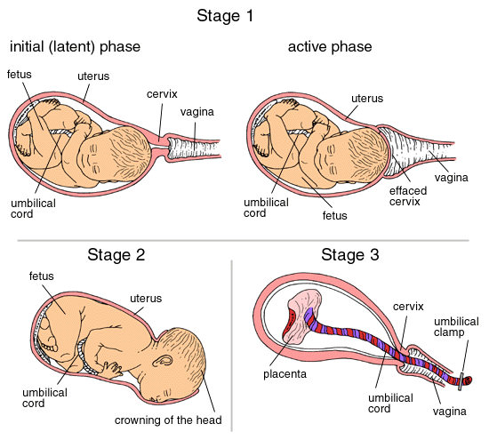
Notes:
Stage 1 Dilation and effacement of the cervix is the longest stage of labour, lasting on average 12 to 14 hours with a first baby and 4 to 6 hours with later births.
Dilation and effacement of the cervix involves the widening and thinning of the cervix, resulting in a clear pathway from the uterus into the birth canal.
Uterine contractions are forceful and regular. Gradually, they get closer together, occurring every 2 to 3 minutes, and become more powerful, continuing for as long as 60 seconds.
Transition is reached when the frequency and strength of contractions are at their peak and the cervix opens completely.
In stage 2 the infant is born. Delivery of the baby lasts approximately 50 minutes for a first baby and 20 minutes in subsequent births.
Strong contractions continue, and the mother feels a natural urge to squeeze and push with her abdominal muscles, forcing the baby down and out.
An episiotomy is a small incision that increases the size of the vaginal opening and permits the baby to pass without damaging the mother’s tissues.
The baby’s head crowns when the vaginal opening stretches around the entire head.
Stage 3 delivery of the placenta.
The final stage lasts about 5 to 10 minutes.
The final contractions and pushes cause the placenta to separate from the uterine wall and be delivered.

Slide 60
Dystocia
Painful or difficult birth or difficult labour
Present when 1st and 2nd stages exceed 20 hrs
Causes
1. Uterine dysfunction (abnormal contractions)
2. Excessive fetal size (hydrocephalus, macrosomia)
3. Any abnormality in shape or size of the birth canal
4. Abnormal fetal presentation (breech)

Slide 61
Abnormal Fetal Presentations
Breech delivery
Frank breech (Buttocks first)
Complete breech (Both buttocks and lower extremities)
Footling breech (Lower extremities first)
Breech deliveries = ↑ risk of trauma and asphyxia

Slide 62
Labour and Delivery Medication
80 to 95% of births in the United States
Analgesics are pain-relieving drugs that help the mother relax
Anaesthetics are stronger painkillers that block sensation
Notes:
Anesthetics weaken uterine contractions during the first stage of labour and interfere with the mother’s ability to feel contractions and push during the second stage, prolonging labour.
Since medications rapidly cross the placenta, the newborn may be sleepy and withdrawn, suck poorly during feedings, and be irritable when awake.
Some experts claim the use of medications during childbirth has a lasting impact on physical and mental development, but their findings have been challenged.

Slide 63
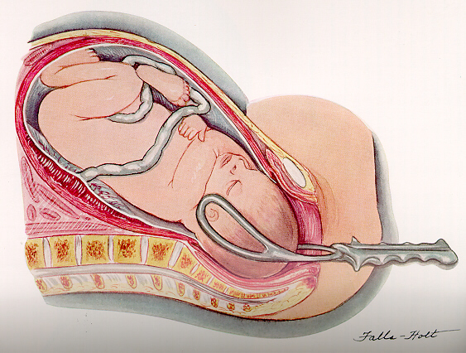
Instrument Delivery
Forceps
Notes:
Instrument delivery is used when the mother’s pushing during the second stage of labour does not cause the baby to move through the birth canal in a reasonable amount of time.
In the United States, forceps or vacuum extractors are used in about 12 percent of births. They are used less than 5 percent of the time in Europe. Their use can result in head injury or brain damage.
Neither methods should be used when the mother can be encouraged to deliver normally and there is no special reason to hurry.
Forceps are metal clamps placed around the baby’s head to pull the infant from the birth canal.

Slide 64
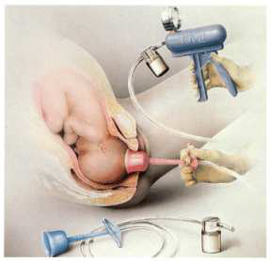
Vacuum Extraction
Notes:
A vacuum extractor is a suction tube that is attached to a plastic cup placed on the baby’s head.

Slide 65
Induced Labour
Labour is started artificially by breaking the amnion and giving the mother a hormone that stimulates contractions
Used when continuing the pregnancy threatens the well-being of mother or baby
Contractions often longer, harder, and closer together

Slide 66
Tocolysis (Tocolytic therapy)
Pharmacological prolongation of pregnancy
Likelihood of neonatal survival/morbidity needs to be assessed before aggressive attempts to prolong pregnancy are initiated
Indicated
Labour begins before 37 weeks, but it is generally difficult to justify risks to mom/fetus greater than 34 weeks
Placenta previa
Preterm birth is leading cause of perinatal mortality

Slide 67
Factors that should be present before starting therapy
True labour
< 4 cm cervical dilation and < 50% effacement
Fetus 20 - 36 week gestation
No signs of fetal distress
No medical/obstetrical disorders that would contraindicate prolongation of pregnancy
Informed consent

Slide 68
Agents used
Beta sympathomimetic (adrenergic) drugs used to relax smooth muscle contractions
Anticonvulsant that stop uterine contractions (magnesium sulfate)
Prostoglandin synthesase (indomethacin) – Used to stop prostoglandin-induced labour
Calcium channel blockers
These agents all have potential side effects that
could be harmful to both mother and fetus

Slide 69
