Slide 1
RET 203
Special Problems in the Newborn
‘Thermoregulation’

Slide 2
Thermoregulation
Defined as the maintenance of equality between heat dissipation and heat production
Neonates are very vulnerable
Ideal is core of 37 degrees
Must be closely monitored
Must be placed in a proper thermal environment
Keep metabolic rate and oxygen consumption at a minimum

Slide 3
Thermoneutrality depends on
Metabolic rate
Gestational age
Weight
Adults shiver
Newborns do not shiver; they metabolize brown fat

Slide 4
Regulatory Mechanisms
Three components
Sensory system for monitoring temperature
Central system to keep core temp. constant (hypothalamus)
Some method of regulating heat production and heat loss (brown fat and vasodilation)

Slide 5
Neutral Thermal Environment (NTE)
Maintain a normal internal temperature without increasing oxygen consumption
Temperature assessment
Rectal – The best indicator for core temperature, but poor indicator of thermal balance in a cold environment
Axillary – Not as accurate because of brown fat deposition, still the site of choice for quick temperature checks
Skin – Since the skin has the sensors to mediate a response, it is the best site (36-36.5)

Slide 6
Thermogenesis (Heat Production)
Heat is produced by the metabolism of brown fat stores and is referred to as non-shivering thermogenesis
This mechanism is impaired by hypoxemia
Brown fat appears at 26 - 30 weeks’ gestation and disappears during the first few weeks following birth
Exposure to low temperatures depletes stores rapidly
Shivering only occurs at very low temperatures
(15 degrees Celsius)

Slide 7
Brown fat is stored
Around the heart
Nape of the neck
Between the scapulas
Around the kidneys
Surrounding the spinal cord

Slide 8
Cold Stress
(Non-Shivering Thermogenesis)
Stimulation of sympathetic nervous system
Increased levels of norepinephrine are released
This activates lipase
Breaks fat down into fatty acids
Acids are hydrolyzed into glycerol and nonstratified fatty acids
The oxidation of these fatty acids produces heat

Slide 9
Physiology of Heat Loss
Internal Thermal Gradient ( ITG )
The difference between the warm body core and the cooler skin
Unable to take in enough calories
Frequent handling a problem
External Thermal Gradient (ETG)
The temperature difference between the skin and the environment

Slide 10
Methods and Prevention of Heat Loss
Radiant – The dissipation of heat from the neonate to cooler objects surrounding but not touching the neonate
  Wrapped in a warm blanket and immediately placed under radiant heater; use a cap
Conductive – The transfer of heat from the neonate to a cooler surface in contact with the infant
  Warmed mattress
Convective – Air current passing over the infant
  Place in an incubator
Evaporative – Loss of heat that accompanies the evaporation of water from the surface of the infant’s skin
  Dry the infant after delivery

Slide 11
Newborns who cannot compensate for cold stress and who become hypothermic may develop severe apnea
Response to heat
Hyperthermia = peripheral vasodilation
Heat-dissipating activities may cause increased oxygen consumption, resulting in hypoxemia
May increase incidence of apnea
May result from
  Infection
  Dehydration
  Poorly functioning isolettes
  Radiant warmers

Slide 12
Incubator
Maintain constant temperature (Skin temperature if servo-controlled heater 36.5) vs. heater
Skin probe must be secured (usually abdomen) if it comes off = hyperthermia
Aluminum foil over skin probe to reflect radiant heat
Can have O₂ controlled inside isolette, but O₂ layers so put the O₂ analyzer by the infant’s face. Also, every time the isolette is opened O₂ mixes with room air
Controlled environment
Quieter
Difficult to access patient

Slide 13
Overhead Warmer
Difficult to manage radiant heat loss / convective heat loss, inability to control the environment
Easy access to patient

Slide 14
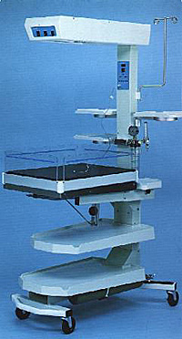
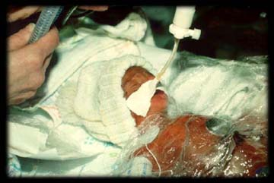

Slide 15
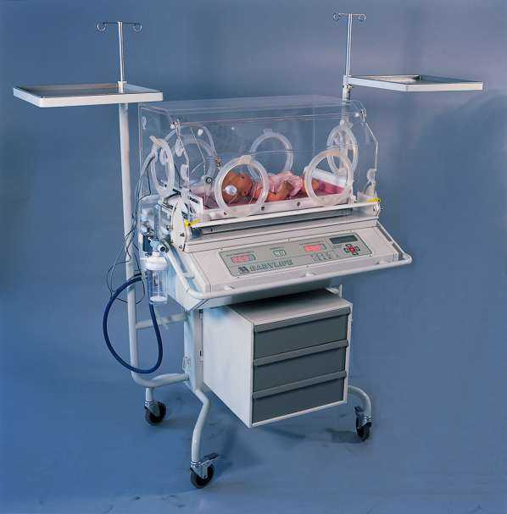

Slide 16
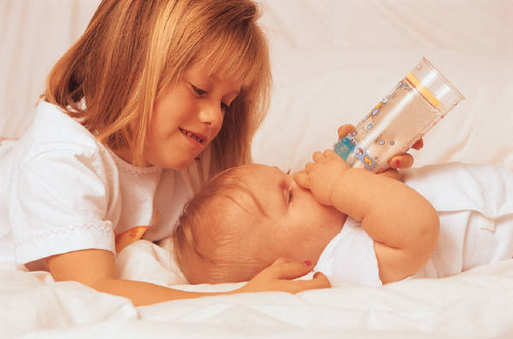
Nutrition & Metabolism

Slide 17
Nutrition
Definition – Ingestion of the materials needed for the body’s metabolic requirements (Including growth, replacement, and energy production)
Good nutrition is essential for normal growth and development

Slide 18
Nutritional requirements are in 3 categories
Energy/Calorie
Energy expenditures
    Basal metabolic rate
    Activity
    Requirements for thermoregulation
    Energy costs for digestion and metabolism

Slide 19
Energy sources
    Fat
    Protein
    Carbohydrates
Newborn excretion – Fecal and urinary loses, heat lost by radiation and/or evaporation

Slide 20
Newborn requirements
Water 140-150 mL/Kg/day
Calories 100-120 kcal/Kg/day
Protein 7-16% of calories
Fat 35-55% of calories
Carbohydrates 35-65% of calories

Slide 21
2. Minerals and solutes
Sodium, potassium, chloride, calcium, phosphorus, etc.
3. Vitamins
Essential for normal metabolism
Vitamins C, K, A, E, and D
Water is also a consideration

Slide 22
Monitoring
Measurements of body weight, length, and head circumference (plotted on growth charts)
Serum electrolytes, calcium, phosphorus, albumin, and hemoglobin monitored for dietary deficiencies

Slide 23
Premature GI tract = Problems with carbohydrate absorption because of lactase deficiency and fat malabsorption (Due to small size of the bile acid pool and the lack of pancreatic lipase)
Suck and swallow reflexes develop at 34 weeks

Slide 24
Feeding via NG, OG, and gastrostomy tubes (Vagal stimulation may cause apnea or bradycardia)
Enteral vs. parenteral TPN (Total Parenteral Nutrition) – All calories and nutrients provided via IV
Close attention needs to be paid to adequate nutrition in the critically ill neonate

Slide 25
Metabolism
Metabolic rate is high in newborns
Infants have greater O₂ requirements proportional to body size – 100cal/kg, then this decreases to 40 to 50cal/kg in adults
Metabolism affects the neonate’s response to pharmacologic agents, resulting in each patient having dramatically different reactions to medications
There are no definitive dosages or frequencies of administration. Each time a drug is given, the dosage must be adjusted for the individual patient requirements

Slide 26
Other factors
Neonates have a large amount of skin surface area for their body weight
Term – 0.07m /kg
28 week – 0.15m /kg
Adult male – 0.02m /kg
Infants are very prone to heat loss and resultant cold stress because 80% of body weight is water. The water is mainly found in extracellular spaces, and fluid balance is precarious.
Overhydration and dehydration can be difficult to avoid.

Slide 27
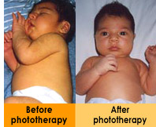
Jaundice
NAIT – RET 203
Angie Depner RRT

Slide 28
Jaundice (Severe = Kernicterus)
Yellowish-orange skin colour that accompanies ↑ levels of bilirubin (hyperbilirubinemia)
Normal levels of total bilirubin are 0.1mg/dl to 1mg/dl
Most bilirubin comes from the breakdown of old red blood cells (rbc)
Levels peak 3 - 4 days (term) 5 - 7 days (prem)
Globin portion → Reused as a protein elsewhere in the body
Heme portion → Source of bilirubin
Bilirubin is a waste product and is usually eliminated via the intestinal tract or the kidneys

Slide 29
If bilirubin deposits in the brain tissue, there is a danger of kernicterus (Bilirubin encephalopathy)
Jaundice occurs in 25 - 50% of all term newborns (higher in preemies), and appears when bilirubin levels exceed 4 to 6 mg/dl
Two types
Physiologic (normal)
Pathologic

Slide 30
Physiology
Destruction of RBC
↓
Enzymes reduce the HGB and produce
Carbon monoxide
Bilirubin (unconjugated) released in plasma and binds protein albumin; it is carried in blood to the liver
    In this form it is not water-soluble but soluble in fatty tissue, especially brain tissue
    In the liver it is released from the albumin, where it becomes conjugated and is now water-soluble
    Conjugated bilirubin is passed into the intestine through the biliary tree and kidneys
    The process of conjugating the bilirubin requires oxygen and glucose, therefore an ↑ incidence of hyperbilirubinemia occurs with a disturbance in either one

Slide 31
Physiologic Jaundice
Very common due to
RBCs
  Increased #
  Shorter life span (70 - 90 days)
  Increased fragility
Immature liver enzyme system
  This results in there being large amounts in the body and significant amounts to be reabsorbed in the intestine
  The neonatal liver is unable to conjugate all of the excess bilirubin
  50% in term newborns
  80% in preterm newborns

Slide 32
Physiologic Jaundice
Causes
Materno-fetal blood incompatibilities
  Rh or ABO
Fetal hemorrhages
Bacterial and viral infections

Slide 33
Pathologic Jaundice
Common cause is Rh/ABO isoimmunization
3% in term newborns
16% in preterm newborns
Criteria
Jaundice appears within the first 24 hours following birth
Serum unconjugated (indirect) bilirubin >13mg/dl (term)
15mg/dl (prems)
3. Indirect levels rise more than 5mg/dl in a 24-hr period
4. Direct levels exceed 1.5mg/dl
The jaundice persists beyond 7 days (term), and 14 in the preemie

Slide 34
Complications
Kernicterus
Because of the high affinity for fat that unconjugated bilirubin possesses, in high levels it crosses the blood-brain barrier.
This leads to
  Neurologic deficits
  Locomotor dysfunction
  Cerebral palsy
  Hearing impairments

Slide 35
Complications
The exact level of bilirubin that will produce kernicterus is unknown
For this reason it is imperative that treatment start quickly and efficiently to prevent kernicterus
First question
Is the jaundice physiologic or pathologic?

Slide 36
Treatment
Phototherapy (Blue fluorescent lights)
Breaks down bilirubin into water-soluble products that are easily excreted
Exchange transfusion
Two major indications
Hyperbilirubinemia
Anemia due to erythroblastosis fetalis
Pharmaceuticals
Phenobarbitol – Increases bilirubin conjugation and excretion
Albumin – Increases capacity of the blood to transport unconjugated bilirubin to the liver

Slide 37
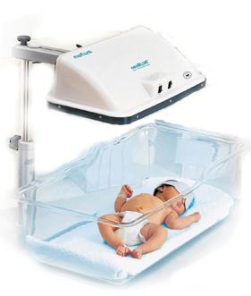
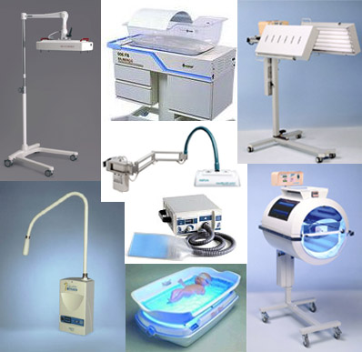


Slide 38

Fluid and Electrolyte Balance

Slide 39
Fluid Balance
Most fetuses are born in reasonable fluid balance for their gestation
Neonatal regulatory mechanism, combined with medical interventions, to achieve balance
Definition of an electrolyte
Compounds that dissolve in water and separate into charged particles (ions) that are capable of conducting an electric current

Slide 40
Disorders that cause imbalances in the fluid and electrolytes
Asphyxia, CHD, sepsis, renal disorders, urinary tract anomalies, endocrine, decreased skin integrity, hydrops fetalis (gross edema with anemia), respiratory disorders

Slide 41
Fluid balance
Goal is to have input = output
(Not a positive or negative balance)
TBW (Total Body Water) = ECF (Extracellular Fluid) + ICF (Intracellular Fluid)
ECF = ISF (Interstitial Fluid) + PV (Plasma Volume)

Slide 42
Components of Intake & Output
Output
IWL (Insensible Water Loss) – Water lost by evaporation from skin (70%) and respiratory tract (30%)
Greater in low birth weights
  Increased skin permeability
  Larger body surface area per unit of body weight
  High skin blood flow in relation to weight

Slide 43
Factors that ↑ IWL
Early gestational age
Respiratory distress (⬆ RR)
Environmental temps
Elevated body temps
Skin breakdowns
Radiant warmers
Phototherapy
⬆ motor activity and crying

Slide 44
Assessing Fluid Deficit
History – Urine output, weights
Physical – Skin (turgor) and head (sutures and fontanelles)
Laboratory values – (⬆Na = seizures)
Vitals, low or ⬇ BP, tachycardia, ⬆ baseline HR
Compromise in vascular volume (When 10% of volume has been withdrawn)

Slide 45
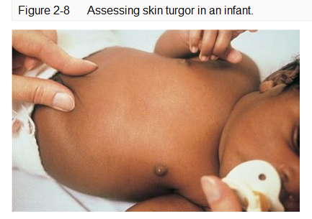

Slide 46
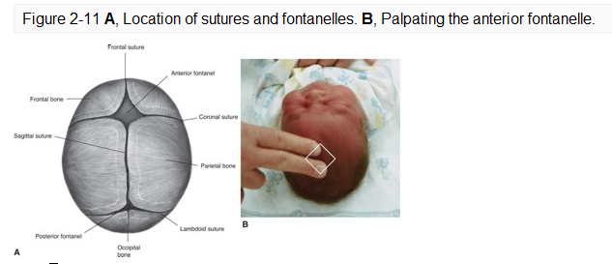

Slide 47
Input
Water and electrolyte intake
Enteral (oral) feedings
IV fluids (Parenteral feedings)
Meds
Transfusions
Patients may even absorb water when on ventilator via humidified gases

Slide 48
Maintenance and Monitoring of Electrolytes/Fluid Status
Need to closely monitor electrolytes because imbalances can lead to serious medical issues
Does a presence of edema mean an adequate level of TBW?

Slide 49
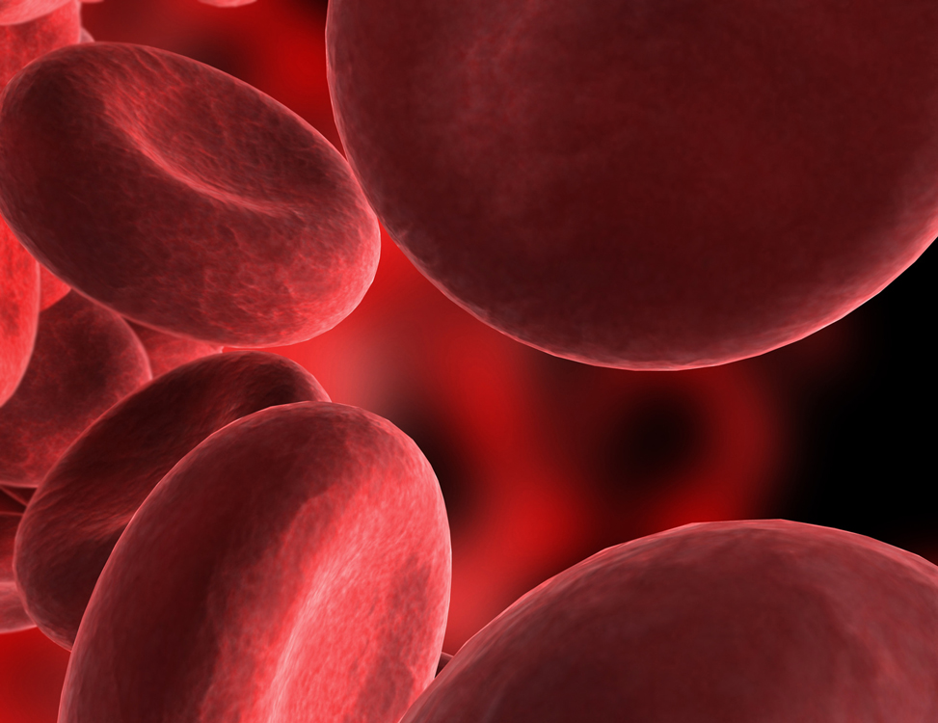
Anemia

Slide 50
A deficiency in the concentration of Red Blood Cells (RBC) and hemoglobin
Some background – Starts with physiologic anemia of infancy
PaO₂ is considerably higher after birth
Erythropoietin production is blunted
Therefore, red blood cell production ceases
For 2 - 3 months, Hb concentration gradually falls and is exaggerated by shortened RBC lifespan (90 days)

Slide 51
Anemia of prematurity
caused by
The rapid growth rate of the preterm infant. Their expanding blood volume quickly outgrows their shrinking erythrocyte mass
Frequent blood collections

Slide 52
Causes of anemia
1. Blood loss (Chronic or acute)
50% of all pregnancies; intrauterine, perinatally, postnatally
2. Decreased red blood cell production
Iron defiecincy
3. Hemolytic anemias (Shortened red blood cell survival)
  Hyperbilirubinemia
  Rhesus incompatibility
  Infection

Slide 53
Acute
Symptoms
Pale
Shallow respirations
Increased heart rate
Poor peripheral perfusion
Decreased venous pressure

Slide 54
Acute
Treatment
Prompt intervention
IV – Shock
Transfusion
Volume expanders

Slide 55
Chronic
Milder symptoms
Treat with
Iron therapy
Packed RBC

Slide 56
Hypoglycemia

Slide 57
Hypoglycemia
Abnormally low blood sugar

Slide 58
Risks
  SGA and prems
    Small livers and minimal carbohydrate stores
  IDM
    High insulin levels in the infant’s blood in response to the mom’s high blood sugar in-utero
    The infant’s blood sugar is used up quickly

Slide 59
Risks
  3) Stressed infants
    Birth asphyxia, cold stress, shock, cardiac or respiratory distress, sepsis, increased energy needs
  4) LGA, Rh isoimmunization
    High insulin levels like IDMs
    Rh incompatibility may have hyperinsulinism because of pancreatic islet cell hyperplasia

Slide 60
Signs
    Possibly asymptomatic
    Tremors, convulsions, jittery
    Cyanosis, pallor
    Apnea
    Tachypnea

Slide 61
Diagnosis
    Glucose levels in blood
Treatment
    Start feeds if respiratory status is stable
    If unable to feed, start IV D10W

Slide 62
Polycythemia/Hyperviscosity

Slide 63
Definition – Increased blood volume and increased hematocrit (venous Hct.65%)
May be caused by chronic hypoxia due to impaired uteroplacental function

Slide 64
Other causes
Twin-to-twin transfusion
Maternal fetal transfusion
Delayed cord clamping
a. Intentional
b. Unassisted home delivery
c. May increase blood volume 55%

Slide 65
Other causes
Maternal diabetes
Maternal smoking
Maternal cyanotic heart disease
Trisomy 13, 18, 21 or congenital adrenal hyperplasia
Idiopathic

Slide 66
In approx. 5% of all infants affected, Hx should reflect above.
Increased viscosity causes sludging in microvasculature which leads to neonatal tissue ischemia, hypoxia, and hypoglycemia. An increased risk for NEC in preterm infants is also apparent due to decreased mesenteric blood flow.
Polycythemia may provide for low saturations, yet adequate O₂ content as carrying capacity is increased. The infant may appear cyanotic as only 5% of deoxygenated hemoglobin can present in this fashion.

Slide 67
Signs and symptoms
Plethoric appearance – Ruddy red
Cyanosis – Acrocyanosis not resolved with warmth
If severe, may be difficult to distinguish from cyanotic CHD
Respiratory – Tachypnea, dyspnea (decreased pulmonary perfusion)
CNS – Jitteriness, lethargy, hypotonia, apnea, seizures, cerebral infarcts, cerebral palsy, thromboemboli

Slide 68
Signs and symptoms
Jaundice – With increased red blood cells there is increased RBC destruction which equals increased bilirubin (overwhelms the liver)
NEC
CHF – Increased heart size with pulmonary back pressure due to viscosity
Renal – Renal tubular necrosis

Slide 69
Management
Treated with partial plasma exchange transfusion
Treatment is given to all symptomatic infants with a hematocrit > 60%
Transfuse with FFP or 5% albumin to drop Hct to normal range
Which infants need treatment
Asymptomatic – Monitor Hct; may require no intervention
Symptomatic – Treat

Slide 70
Management
Treated with partial plasma exchange transfusion
Treatment is given to all symptomatic infants with a hematocrit > 60%
Transfuse with FFP or 5% albumin to drop Hct to normal range
Which infants need treatment
Asymptomatic – Monitor Hct; may require no intervention
Symptomatic – Treat

